Slide 1
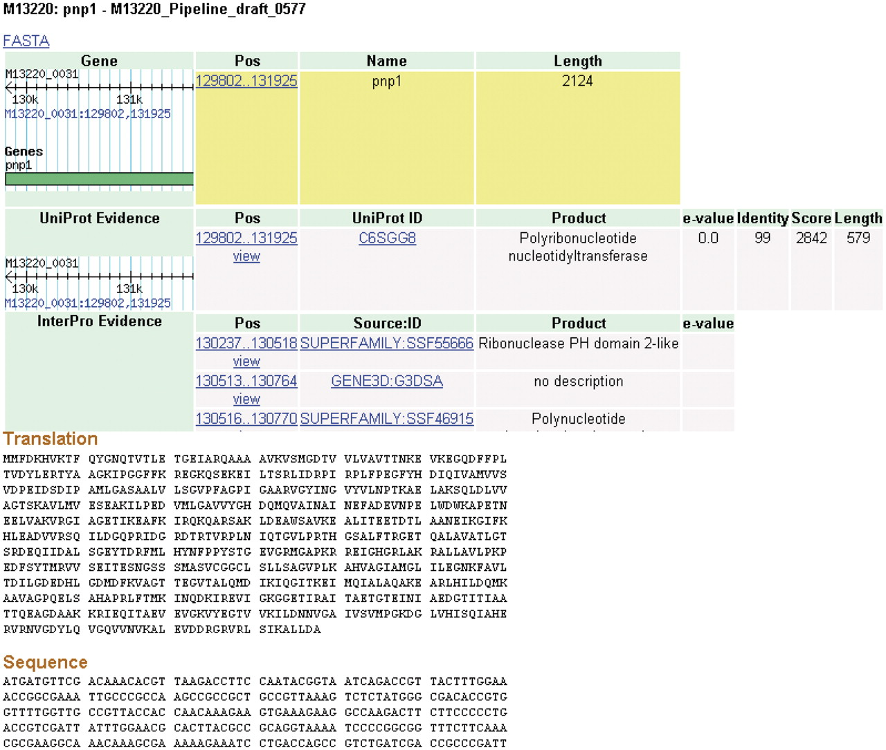
Figure 4. Details page. The details for some features of a coding sequence are shown. Up to five overlapping feature ...
Notes:
Figure 4. Details page. The details for some features of a coding sequence are shown. Up to five overlapping feature types may appear: gene, protein, protein domain, signal peptide and transmembrane structure. The target feature is highlighted in yellow. The nucleotide and amino acid sequences for this feature appear at the bottom of the page. All features on the page include links to their coordinates in GBrowse genome viewer.
Unless provided in the caption above, the following copyright applies to the content of this slide: © The Author(s) 2011. Published by Oxford University Press.This is Open Access article distributed under the terms of the Creative Commons Attribution Non-Commercial License (http://creativecommons.org/licenses/by-nc/2.5), which permits unrestricted non-commercial use, distribution, and reproduction in any medium, provided the original work is properly cited.

Slide 2
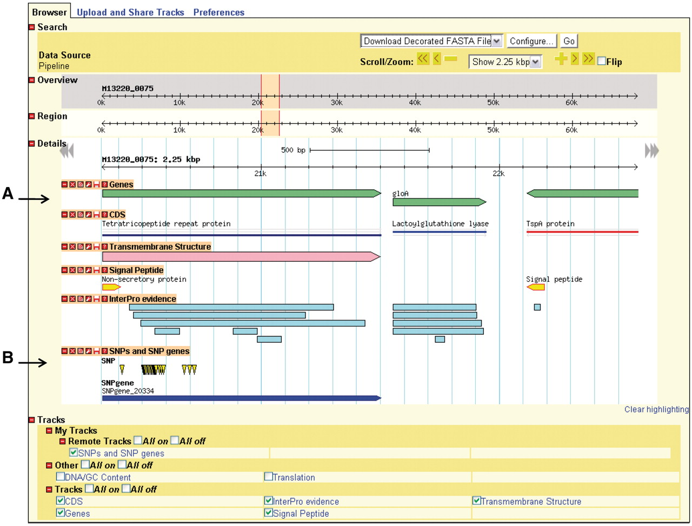
Figure 3. Genome depiction. The genome is represented linearly, with features on their respective coordinates. (A) ...
Notes:
Figure 3. Genome depiction. The genome is represented linearly, with features on their respective coordinates. (A) Genes and their coding sequences (CDS) each have their own track and are links to their own details page. (B) Uploaded tracks.
Unless provided in the caption above, the following copyright applies to the content of this slide: © The Author(s) 2011. Published by Oxford University Press.This is Open Access article distributed under the terms of the Creative Commons Attribution Non-Commercial License (http://creativecommons.org/licenses/by-nc/2.5), which permits unrestricted non-commercial use, distribution, and reproduction in any medium, provided the original work is properly cited.

Slide 3
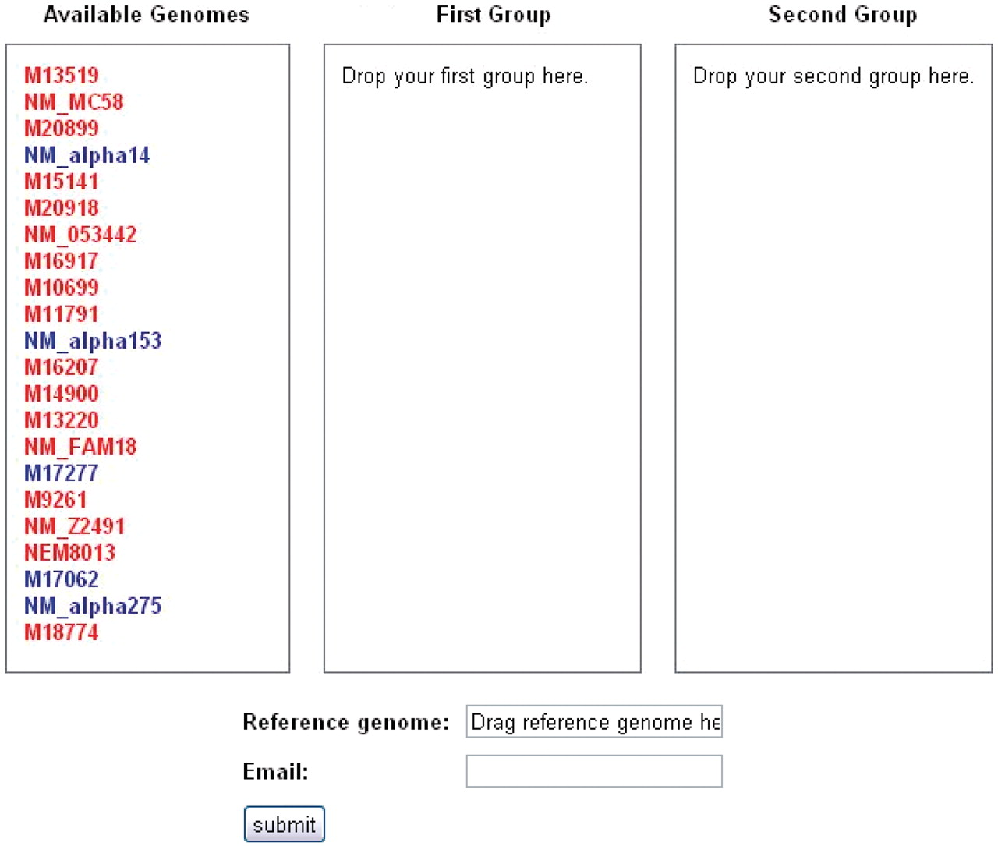
Figure 2. SNPtool. The SNPtool finds discriminating SNPs between two groups of genomes. Each group is defined by the ...
Notes:
Figure 2. SNPtool. The SNPtool finds discriminating SNPs between two groups of genomes. Each group is defined by the user, by dragging each genome to a designated group. Not all genomes must be used. A reference genome must be designated, as the results can be viewed on the graphical genome browser from the vantage point of the chosen reference genome. Invasive isolates are designated by red, carriage by blue.
Unless provided in the caption above, the following copyright applies to the content of this slide: © The Author(s) 2011. Published by Oxford University Press.This is Open Access article distributed under the terms of the Creative Commons Attribution Non-Commercial License (http://creativecommons.org/licenses/by-nc/2.5), which permits unrestricted non-commercial use, distribution, and reproduction in any medium, provided the original work is properly cited.

Slide 4
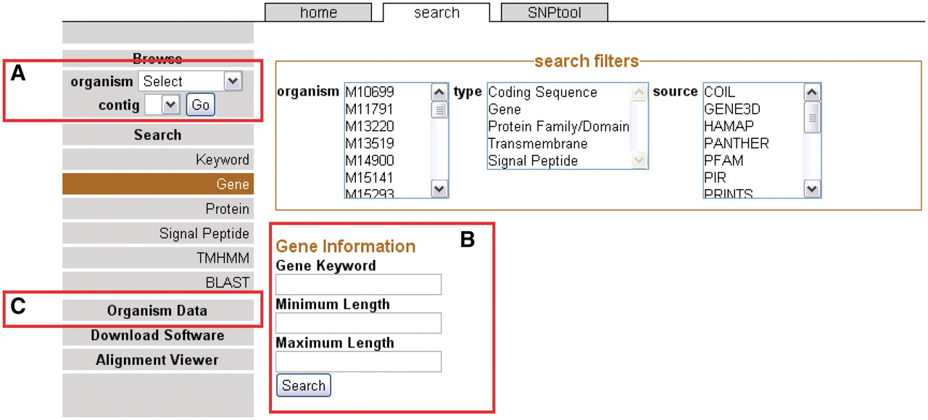
Figure 1. The front page sidebar. The sidebar provides access to the genome browser, search functions and metadata. (A) ...
Notes:
Figure 1. The front page sidebar. The sidebar provides access to the genome browser, search functions and metadata. (A) To browse, users can select a genome and a contig to proceed to the GBrowse interface. (B) To search, a user can supply a keyword or can choose to search via one of several search items. (C) Genomic metadata is available via the Organism Data link (Supplementary Table S1). A link is provided to the alignment data page.
Unless provided in the caption above, the following copyright applies to the content of this slide: © The Author(s) 2011. Published by Oxford University Press.This is Open Access article distributed under the terms of the Creative Commons Attribution Non-Commercial License (http://creativecommons.org/licenses/by-nc/2.5), which permits unrestricted non-commercial use, distribution, and reproduction in any medium, provided the original work is properly cited.

