Slide 1
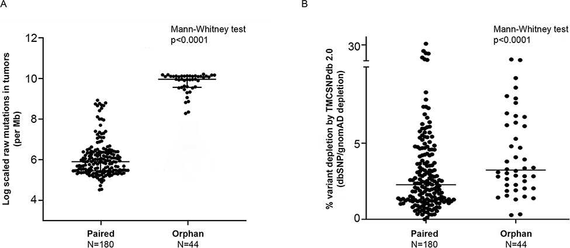
Figure 2. Somatic variant comparison across paired and orphan tumors; A) log-scaled raw mutation count across the ...
Notes:
Figure 2. Somatic variant comparison across paired and orphan tumors; A) log-scaled raw mutation count across the paired and orphan exome sequence samples used in the study, B) percent variant depletion by the ethnic-specific germline variant set (GenomeAsia, IndiGenomes, TMC-SNPdb 2.0 and in-house PON created using 173 normal exome samples), over and above gnomAD/dbSNP depletion. Comparison between two groups performed using the Mann–Whitney test.
Unless provided in the caption above, the following copyright applies to the content of this slide: © The Author(s) 2022. Published by Oxford University Press.This is an Open Access article distributed under the terms of the Creative Commons Attribution-NonCommercial License (https://creativecommons.org/licenses/by-nc/4.0/), which permits non-commercial re-use, distribution, and reproduction in any medium, provided the original work is properly cited. For commercial re-use, please contact journals.permissions@oup.com

