Slide 1
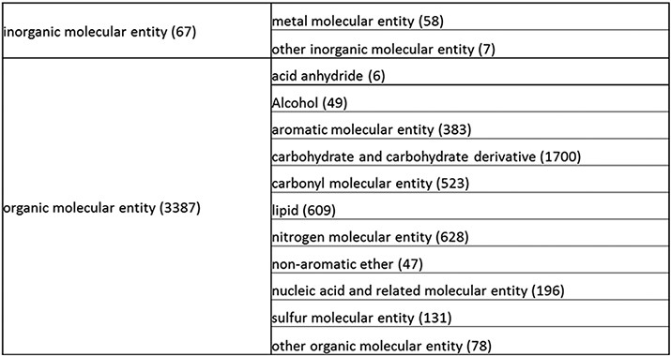
Figure 1. Overall structure of the revised chemical tree whereby the highest level is subdivided into organic and ...
Notes:
Figure 1. Overall structure of the revised chemical tree whereby the highest level is subdivided into organic and inorganic chemicals. The inorganic and organic branches are further subdivided into the most prominent and intuitive categories. The number of entries per level is indicated at the end of each branch’s label.
Unless provided in the caption above, the following copyright applies to the content of this slide: © The Author(s) 2021. Published by Oxford University Press.This is an Open Access article distributed under the terms of the Creative Commons Attribution License (http://creativecommons.org/licenses/by/4.0/), which permits unrestricted reuse, distribution, and reproduction in any medium, provided the original work is properly cited.

