Slide 1
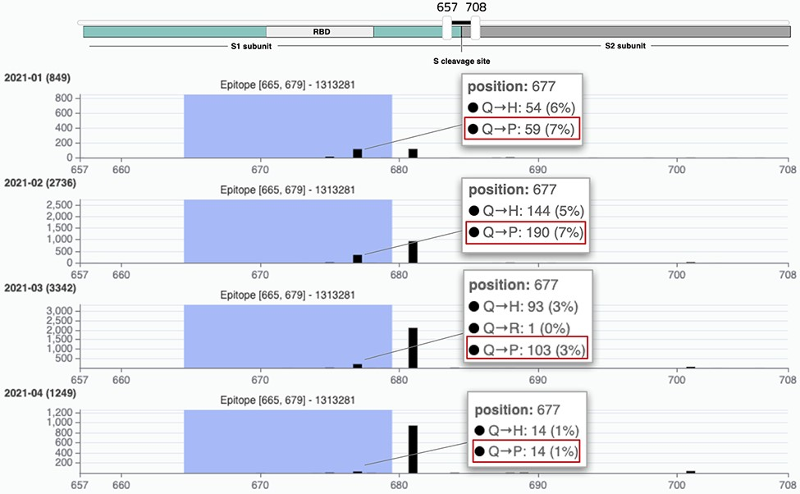
Figure 6. VirusViz compare functionality was applied to four groups of sequences collected in Texas in the first months ...
Notes:
Figure 6. VirusViz compare functionality was applied to four groups of sequences collected in Texas in the first months of 2021 (see Example 3). We highlight a particular epitope that does not include the highly mutated 681 position (belonging to B.1.1.7 lineage, known as the UK variant of concern) but does include the position 677 and thus the Q766P mutation.
Unless provided in the caption above, the following copyright applies to the content of this slide: © The Author(s) 2021. Published by Oxford University Press.This is an Open Access article distributed under the terms of the Creative Commons Attribution License (https://creativecommons.org/licenses/by/4.0/), which permits unrestricted reuse, distribution, and reproduction in any medium, provided the original work is properly cited.

