Slide 1
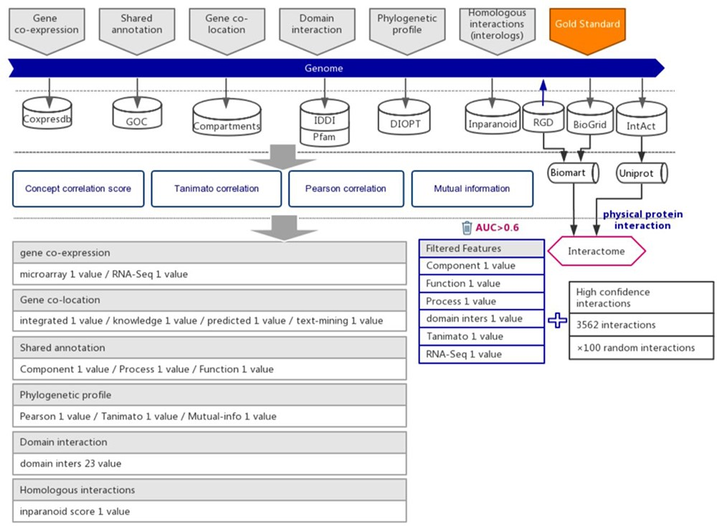
Figure 1. The workflow diagram for the influence of functional interactions between rat genes. The training dataset ...
Notes:
Figure 1. The workflow diagram for the influence of functional interactions between rat genes. The training dataset consisted of high-quality experimental confirmed protein interactions from three databases that were used as positive examples. Random gene pairs that did not overlap with positive examples were used as negative examples. The positive to negative ratio was 1:100. Six types of functional association evidence were collected from 10 databases. Six high-quality feature values were selected from 36 feature values that characterize the functional association evidence with different mathematical representations.
Unless provided in the caption above, the following copyright applies to the content of this slide: © The Author(s) 2020. Published by Oxford University Press.This is an Open Access article distributed under the terms of the Creative Commons Attribution License (http://creativecommons.org/licenses/by/4.0/), which permits unrestricted reuse, distribution, and reproduction in any medium, provided the original work is properly cited.

