Slide 1
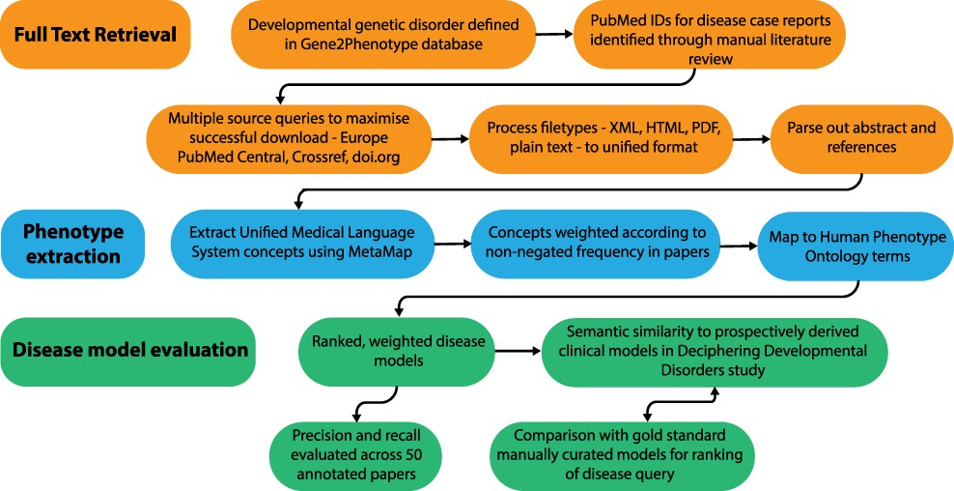
Figure 1. Overview of the disease model pipeline. Input was PMIDs for case reports describing developmental genetic ...
Notes:
Figure 1. Overview of the disease model pipeline. Input was PMIDs for case reports describing developmental genetic disorders. Full-text downloads were performed using the Cadmus package. Output was disease models consisting of HPO terms weighted according to their frequency in full text. These were evaluated against ‘real life’ models from the Deciphering Developmental Disorders study and against gold standard manually curated models.
Unless provided in the caption above, the following copyright applies to the content of this slide: © The Author(s) 2022. Published by Oxford University Press.This is an Open Access article distributed under the terms of the Creative Commons Attribution-NonCommercial License (https://creativecommons.org/licenses/by-nc/4.0/), which permits non-commercial re-use, distribution, and reproduction in any medium, provided the original work is properly cited. For commercial re-use, please contact journals.permissions@oup.com

Slide 2
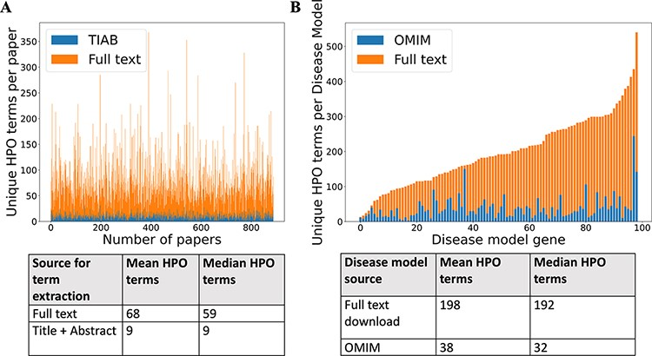
Figure 2. (A) Comparison of number of unique HPO terms extracted from full text vs title + abstract for sample of 962 ...
Notes:
Figure 2. (A) Comparison of number of unique HPO terms extracted from full text vs title + abstract for sample of 962 papers, using full-text download pipeline. (B) Comparison of number of unique HPO terms in disease models generated by full-text download pipeline vs manually curated models in OMIM, for a sample of 99 diseases.
Unless provided in the caption above, the following copyright applies to the content of this slide: © The Author(s) 2022. Published by Oxford University Press.This is an Open Access article distributed under the terms of the Creative Commons Attribution-NonCommercial License (https://creativecommons.org/licenses/by-nc/4.0/), which permits non-commercial re-use, distribution, and reproduction in any medium, provided the original work is properly cited. For commercial re-use, please contact journals.permissions@oup.com

Slide 3
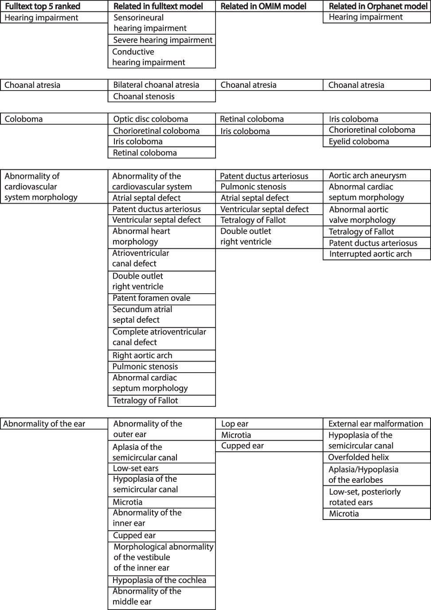
Figure 3. Example of top-five ranked terms in the disease model for CHD7/CHARGE syndrome (left column). Clinically ...
Notes:
Figure 3. Example of top-five ranked terms in the disease model for CHD7/CHARGE syndrome (left column). Clinically related terms in the remainder of the disease model (n = 540), OMIM model (n = 71) and Orphanet model (n = 82) shown.
Unless provided in the caption above, the following copyright applies to the content of this slide: © The Author(s) 2022. Published by Oxford University Press.This is an Open Access article distributed under the terms of the Creative Commons Attribution-NonCommercial License (https://creativecommons.org/licenses/by-nc/4.0/), which permits non-commercial re-use, distribution, and reproduction in any medium, provided the original work is properly cited. For commercial re-use, please contact journals.permissions@oup.com

Slide 4
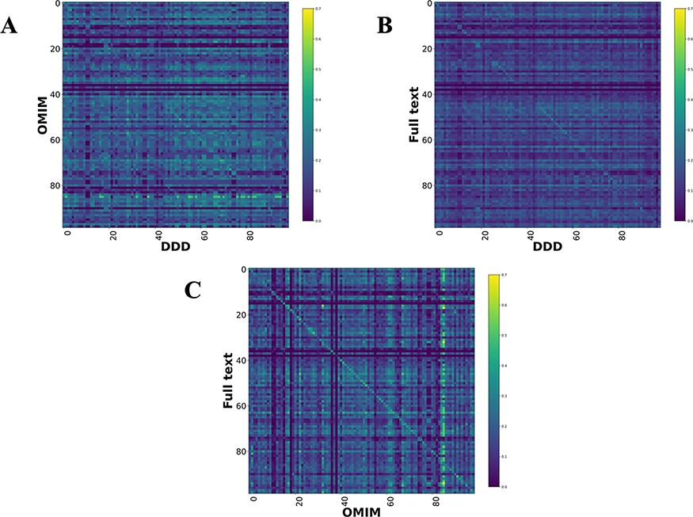
Figure 4. Disease model comparison heatmaps using RBO for literature-, OMIM- and DDD-derived models. Each model on the ...
Notes:
Figure 4. Disease model comparison heatmaps using RBO for literature-, OMIM- and DDD-derived models. Each model on the y-axis is compared with every model in the DDD set. Disease/DDD models describing the same disorder are on the rightward slanting diagonal. (A) compares OMIM and DDD models. (B) compares literature-derived and DDD models. (C) compares literature-derived and OMIM models. 99 diseases in comparison set.
Unless provided in the caption above, the following copyright applies to the content of this slide: © The Author(s) 2022. Published by Oxford University Press.This is an Open Access article distributed under the terms of the Creative Commons Attribution-NonCommercial License (https://creativecommons.org/licenses/by-nc/4.0/), which permits non-commercial re-use, distribution, and reproduction in any medium, provided the original work is properly cited. For commercial re-use, please contact journals.permissions@oup.com

Slide 5
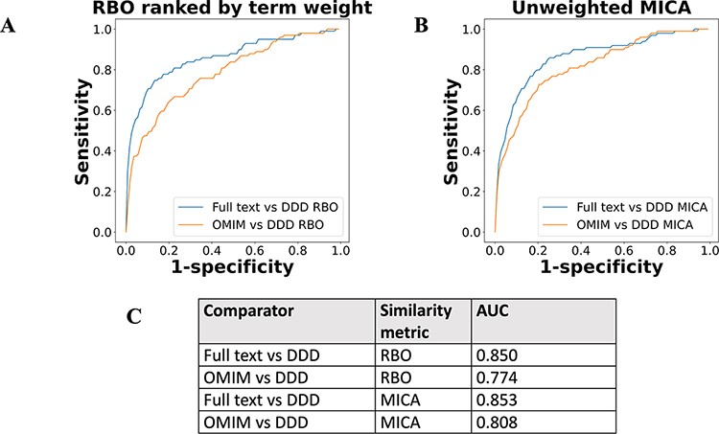
Figure 5. ROC curves using threshold ranking for literature-derived/OMIM disease models compared to real-life terms in ...
Notes:
Figure 5. ROC curves using threshold ranking for literature-derived/OMIM disease models compared to real-life terms in the DDD study, across sample of 99 diseases, with a disease model and DDD model for each. Each disease model is compared to every model in the DDD set. (A) uses RBO to compare ranked lists of terms. Literature-derived and DDD models were ranked according to the model term frequency. OMIM models were ranked according to the frequency of terms across all OMIM models. (B) uses mean MICA to compare models, with IC calculated according to Resnik. Unweighted models were used for comparison, meaning each term in a model appeared only once, and term frequencies were not utilized. (C) shows the AUC for each model comparison.
Unless provided in the caption above, the following copyright applies to the content of this slide: © The Author(s) 2022. Published by Oxford University Press.This is an Open Access article distributed under the terms of the Creative Commons Attribution-NonCommercial License (https://creativecommons.org/licenses/by-nc/4.0/), which permits non-commercial re-use, distribution, and reproduction in any medium, provided the original work is properly cited. For commercial re-use, please contact journals.permissions@oup.com

Slide 6
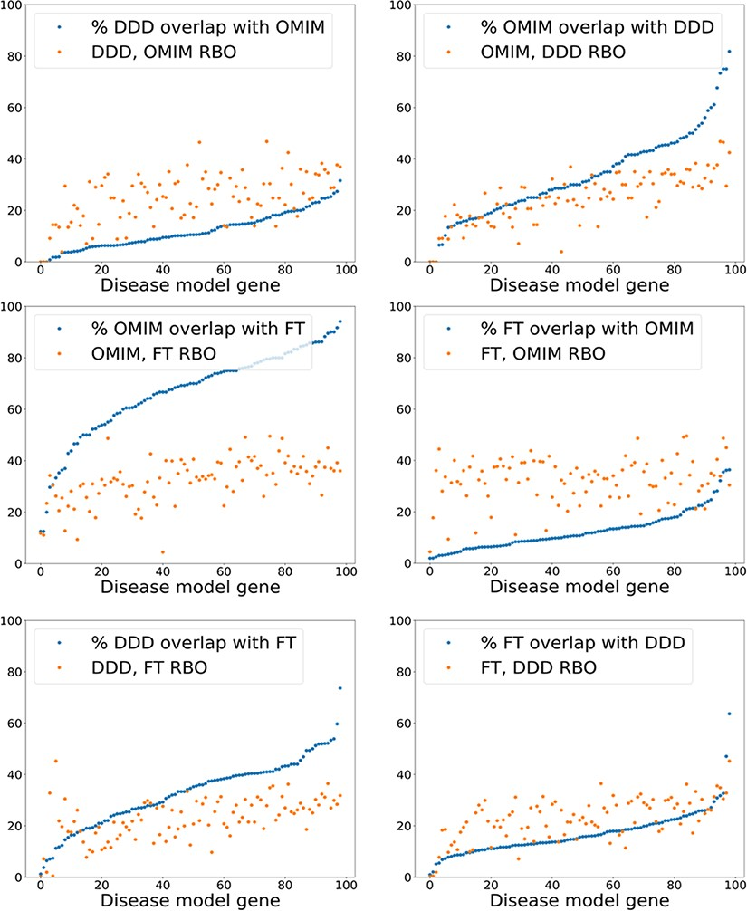
Figure 6. Exact model term overlap against RBO. For each pair of comparison models—A & B—the percentage of exact match ...
Notes:
Figure 6. Exact model term overlap against RBO. For each pair of comparison models—A & B—the percentage of exact match terms (A in B/A) is shown. The corresponding RBO similarity score for A & B is also plotted. RBO scores multiplied by 100 to normalize to percentage range. FT—full-text-derived.
Unless provided in the caption above, the following copyright applies to the content of this slide: © The Author(s) 2022. Published by Oxford University Press.This is an Open Access article distributed under the terms of the Creative Commons Attribution-NonCommercial License (https://creativecommons.org/licenses/by-nc/4.0/), which permits non-commercial re-use, distribution, and reproduction in any medium, provided the original work is properly cited. For commercial re-use, please contact journals.permissions@oup.com

