Slide 1
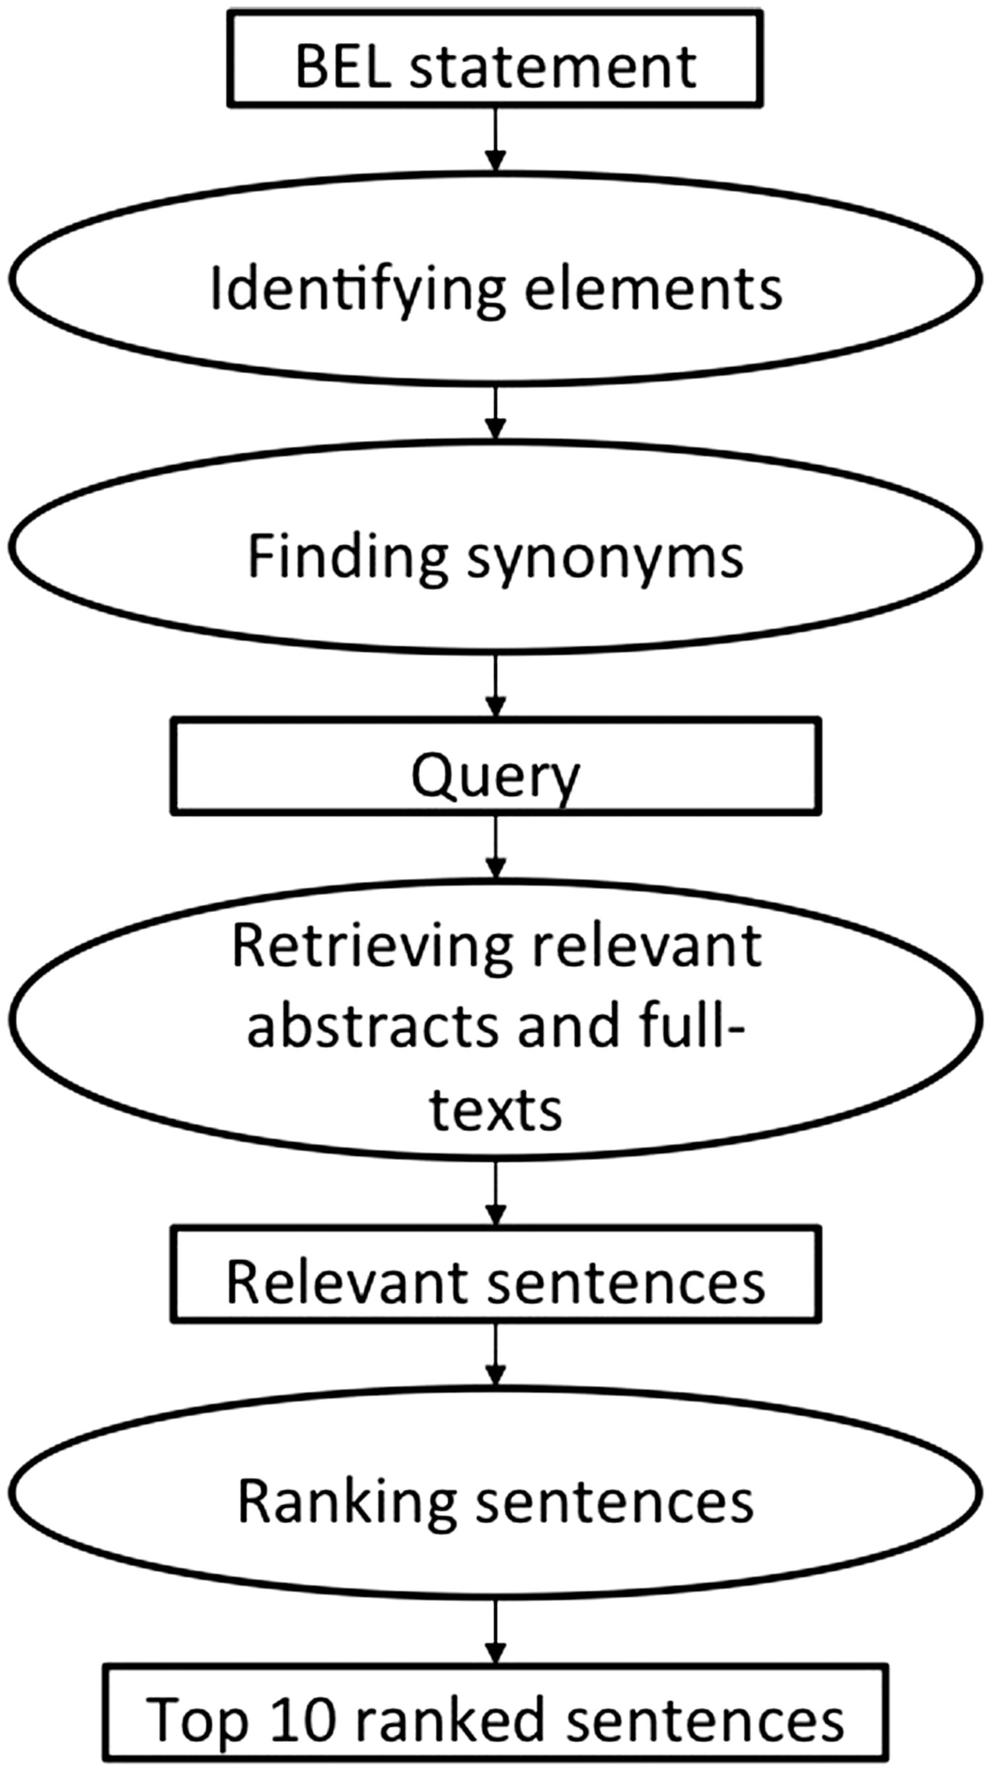
Figure 2. The workflow of the first method employing the semantic search engine SCAIView. The second method consists ...
Notes:
Figure 2. The workflow of the first method employing the semantic search engine SCAIView. The second method consists of two main components: a retrieval and a ranking component (see Figure 3 ). For an underlying BEL statement, the retrieval component identifies the sub parts of the BEL statement, adds the corresponding synonyms from dictionaries and translates everything into a search engine query. In the next step, it gathers the relevant documents from PubMed and PubMed Central from the search index. The ranking component identifies the significant supporting text excerpts and ranks them according their relevance. Similarly to the first method, up to 10 different text excerpts were evaluated as part of the BEL_Sentence_Classification corpus . This system was the only system participating in the BioCreative V BEL track task 2. Further details and evaluation results have been published by Rastegar-Mojarad et al. ( 44 ). Figure 3. The workflow of the second method implemented by Rastegar-Mojarad et al. ( 44 ).
Unless provided in the caption above, the following copyright applies to the content of this slide: © The Author(s) 2016. Published by Oxford University Press. This is an Open Access article distributed under the terms of the Creative Commons Attribution License ( http://creativecommons.org/licenses/by/4.0/ ), which permits unrestricted reuse, distribution, and reproduction in any medium, provided the original work is properly cited.

