Slide 1
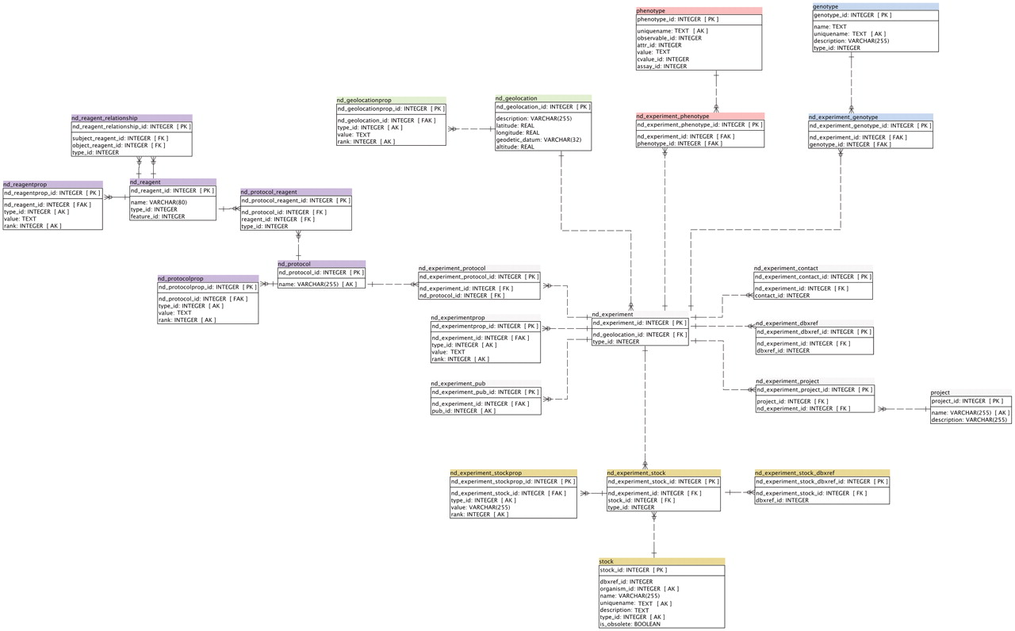
Figure 2. Detailed Schema diagram of the Natural Diversity Module, and interactions with other major Chado modules. All ...
Notes:
Figure 2. Detailed Schema diagram of the Natural Diversity Module, and interactions with other major Chado modules. All Natural Diversity tables are denoted with ‘nd_’ prefix.
Unless provided in the caption above, the following copyright applies to the content of this slide: © The Author(s) 2011. Published by Oxford University Press.This is an Open Access article distributed under the terms of the Creative Commons Attribution Non-Commercial License (http://creativecommons.org/licenses/by-nc/3.0), which permits unrestricted non-commercial use, distribution, and reproduction in any medium, provided the original work is properly cited.

