Slide 1
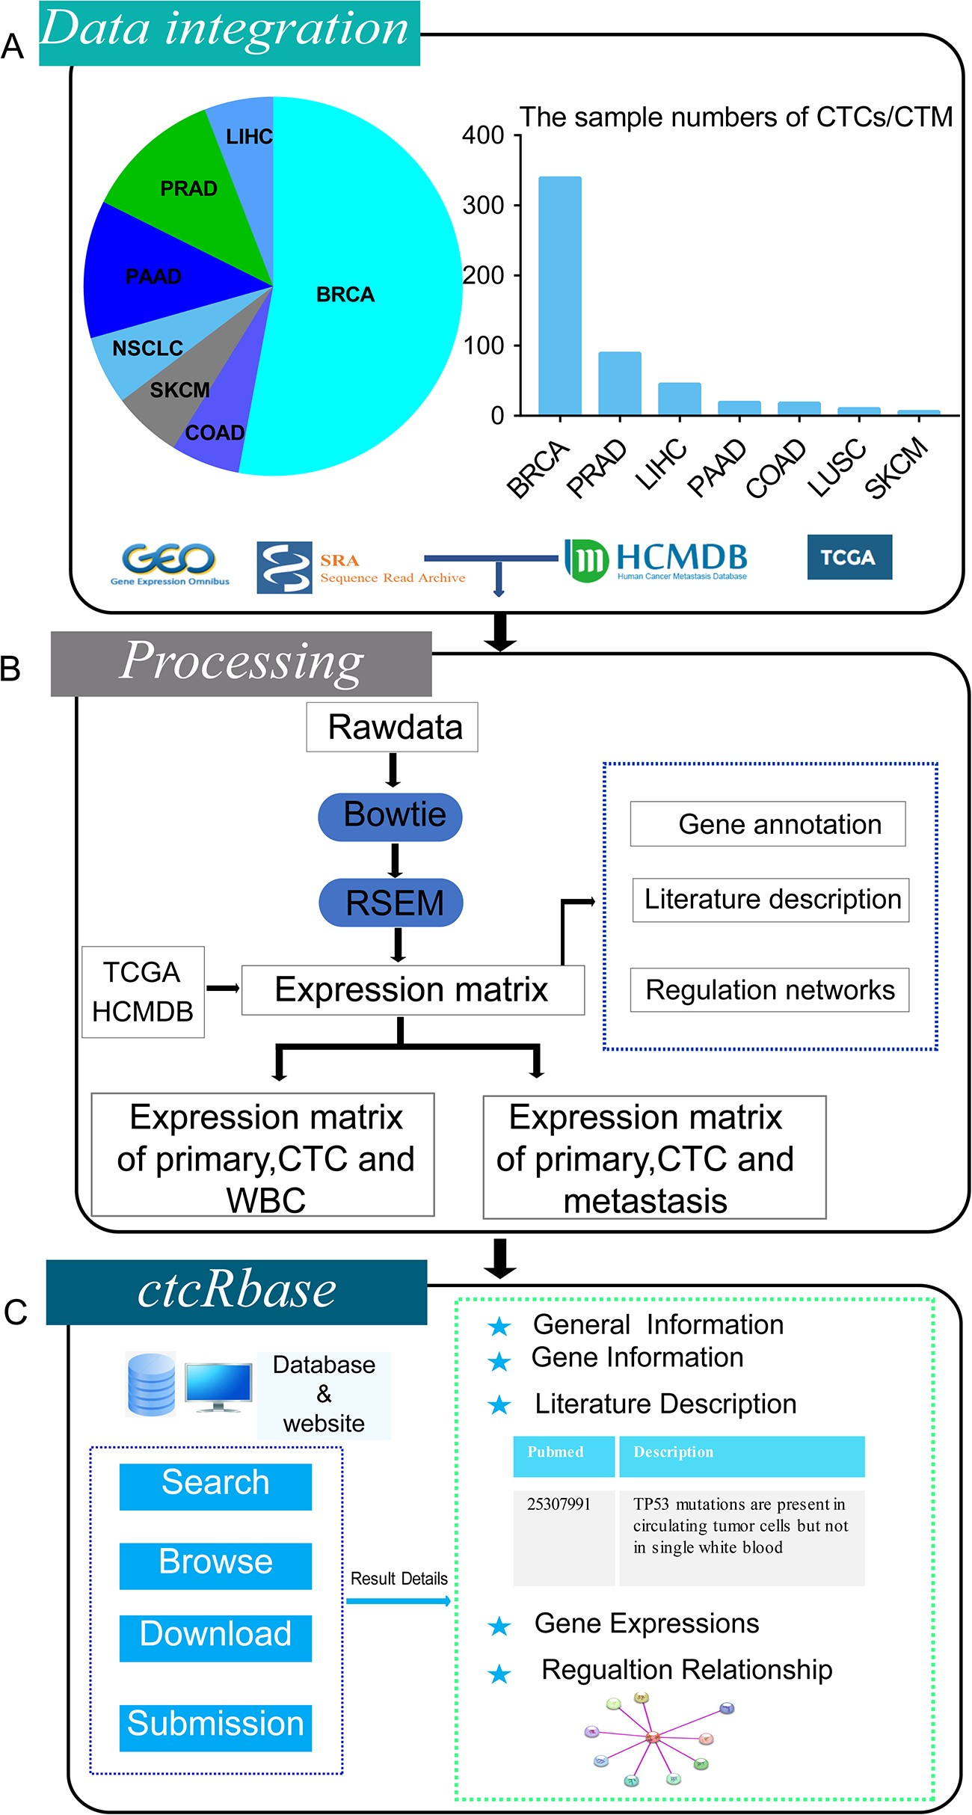
Figure 1 Overall design of ctcRbase. (A) Data distribution of CTCs/CTMs in ctcRbase. ctcRbase contains CTC/CTM data ...
Notes:
Figure 1 Overall design of ctcRbase. (A) Data distribution of CTCs/CTMs in ctcRbase. ctcRbase contains CTC/CTM data across seven cancer types, including breast cancer (BRCA), colorectal cancer (COAD), melanoma (SKCM), non-small cell lung cancer (LUSC), pancreatic cancer (PANC), prostate cancer (PRAD) and liver cancer (LIHC). The data from TCGA and HCMDB was used to compare the expression of WBC, primary tumor, CTCs/CTM and metastasis sites. (B) Data processing of ctcRbase. Bowtie and RSEM was used to get expression matrix. (C) The main functions of ctcRbase include ‘Search’, ‘Browse’, ‘Download’ and ‘Submission’. Result page contains five parts: (i) general information; (ii) gene information; (iii) literature description; (iv) gene expressions; and (v) competing endogenous RNA network.
Unless provided in the caption above, the following copyright applies to the content of this slide: © Crown copyright 2020.This Open Access article contains public sector information licensed under the Open Government Licence v3.0 (http://www.nationalarchives.gov.uk/doc/open-government-licence/version/3/).

