Slide 1
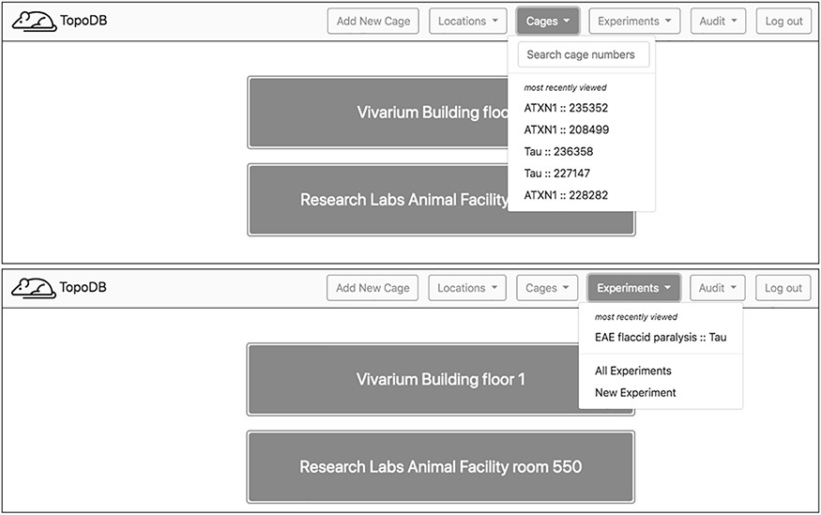
Figure 2. Upon login, a home page showing the top level of cage organization—Locations—is shown. A navigation bar at ...
Notes:
Figure 2. Upon login, a home page showing the top level of cage organization—Locations—is shown. A navigation bar at the top of each page enables users to quickly access recently visited cages and experiments. A search box also assists in finding specific cages.
Unless provided in the caption above, the following copyright applies to the content of this slide: © The Author(s) 2020. Published by Oxford University Press.This is an Open Access article distributed under the terms of the Creative Commons Attribution License (http://creativecommons.org/licenses/by/4.0/), which permits unrestricted reuse, distribution, and reproduction in any medium, provided the original work is properly cited.

