Slide 1
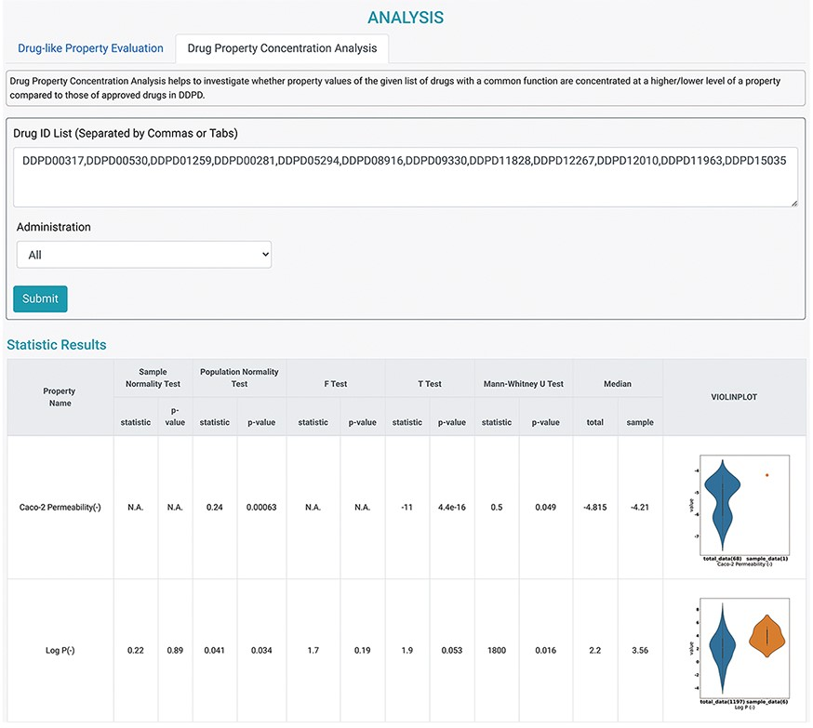
Figure 4. Analysis tools of DDPD. Using the Drug Property Concentration Analysis tab of the Analysis page, users can ...
Notes:
Figure 4. Analysis tools of DDPD. Using the Drug Property Concentration Analysis tab of the Analysis page, users can query a list of drugs via DDPD ID and visualize the property value distribution of the query list via violin plots. The blue violin plots represent the property value distribution of all the approved drugs in our database. The orange plots represent the distribution of the queried compounds. For the queried drugs for caco-2 permeability, only one data entry is found, therefore, one orange dot is shown. Additionally, the pvalues of the selected statistical tests are calculated and listed in the respective columns.
Unless provided in the caption above, the following copyright applies to the content of this slide: © The Author(s) 2022. Published by Oxford University Press.This is an Open Access article distributed under the terms of the Creative Commons Attribution License (https://creativecommons.org/licenses/by/4.0/), which permits unrestricted reuse, distribution, and reproduction in any medium, provided the original work is properly cited.

