Slide 1
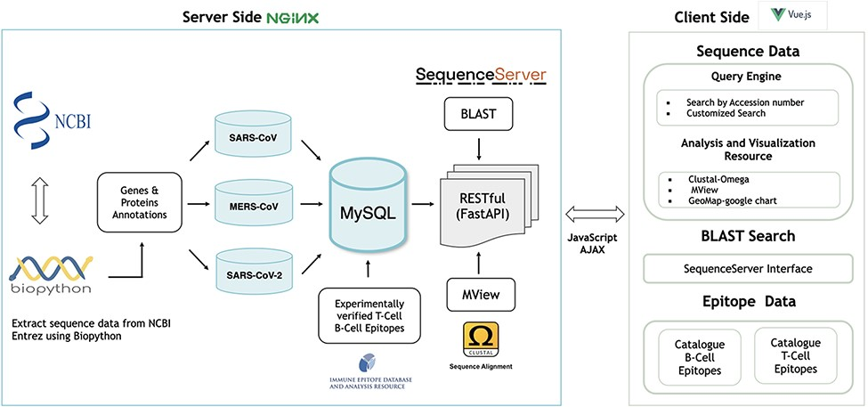
Figure 1. Architecture of the hCoronavirsesDB bioinformatics resource.
Notes:
Figure 1. Architecture of the hCoronavirsesDB bioinformatics resource.
Unless provided in the caption above, the following copyright applies to the content of this slide: © The Author(s) 2022. Published by Oxford University Press.This is an Open Access article distributed under the terms of the Creative Commons Attribution License (https://creativecommons.org/licenses/by/4.0/), which permits unrestricted reuse, distribution, and reproduction in any medium, provided the original work is properly cited.

Slide 2
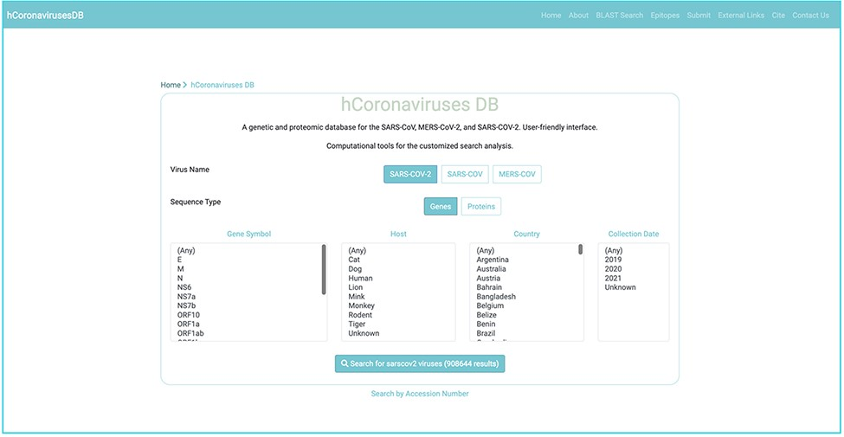
Figure 2. Nucleotide and protein sequences search interface for the SARS-CoV, SARs-CoV-2, and MERS-CoV.
Notes:
Figure 2. Nucleotide and protein sequences search interface for the SARS-CoV, SARs-CoV-2, and MERS-CoV.
Unless provided in the caption above, the following copyright applies to the content of this slide: © The Author(s) 2022. Published by Oxford University Press.This is an Open Access article distributed under the terms of the Creative Commons Attribution License (https://creativecommons.org/licenses/by/4.0/), which permits unrestricted reuse, distribution, and reproduction in any medium, provided the original work is properly cited.

Slide 3
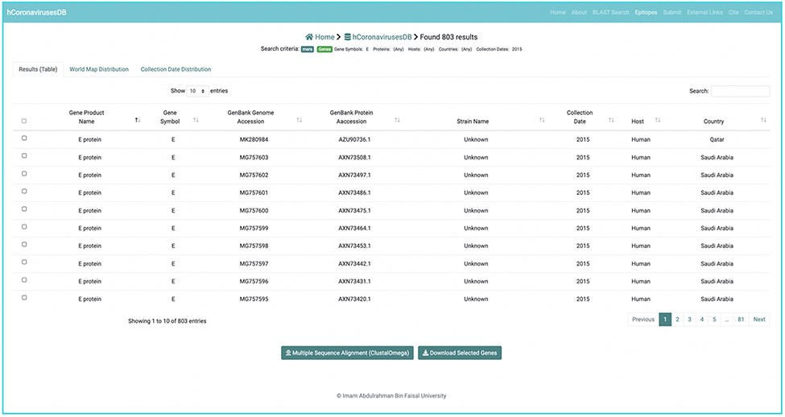
Figure 3. Sequence data search output.
Notes:
Figure 3. Sequence data search output.
Unless provided in the caption above, the following copyright applies to the content of this slide: © The Author(s) 2022. Published by Oxford University Press.This is an Open Access article distributed under the terms of the Creative Commons Attribution License (https://creativecommons.org/licenses/by/4.0/), which permits unrestricted reuse, distribution, and reproduction in any medium, provided the original work is properly cited.

Slide 4
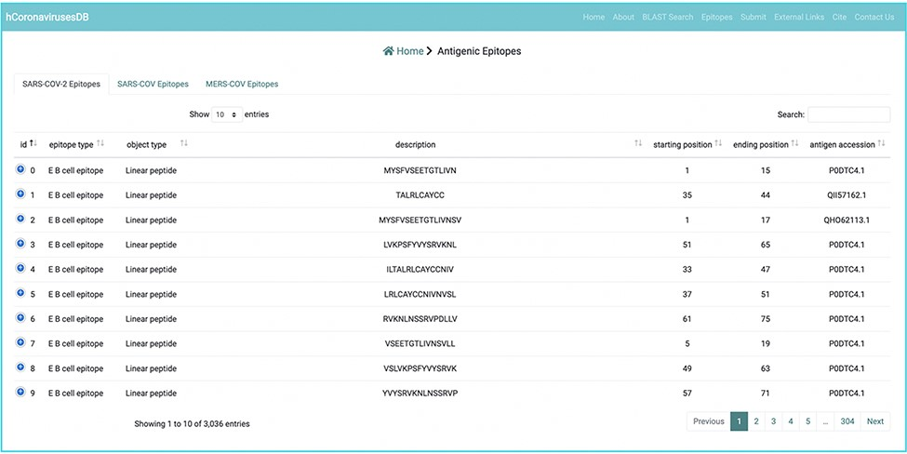
Figure 4. Example of an experimentally verified B cell and T cell epitope data in the hCoronavirusesDB.
Notes:
Figure 4. Example of an experimentally verified B cell and T cell epitope data in the hCoronavirusesDB.
Unless provided in the caption above, the following copyright applies to the content of this slide: © The Author(s) 2022. Published by Oxford University Press.This is an Open Access article distributed under the terms of the Creative Commons Attribution License (https://creativecommons.org/licenses/by/4.0/), which permits unrestricted reuse, distribution, and reproduction in any medium, provided the original work is properly cited.

Slide 5
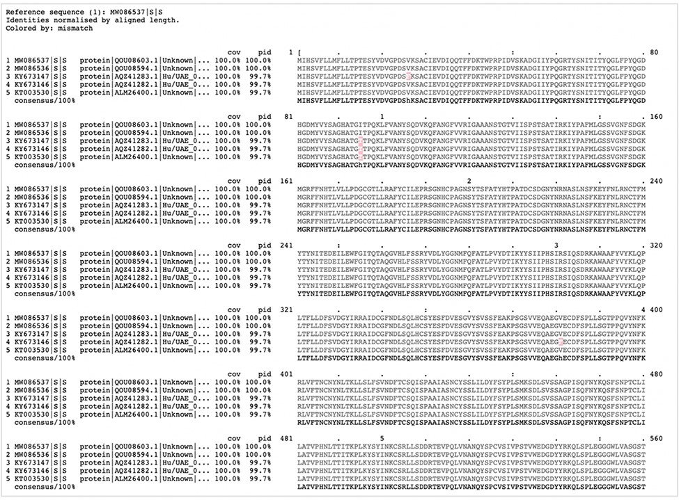
Figure 5. Clustal-Omega alignment of a customized search and visualized by MView.
Notes:
Figure 5. Clustal-Omega alignment of a customized search and visualized by MView.
Unless provided in the caption above, the following copyright applies to the content of this slide: © The Author(s) 2022. Published by Oxford University Press.This is an Open Access article distributed under the terms of the Creative Commons Attribution License (https://creativecommons.org/licenses/by/4.0/), which permits unrestricted reuse, distribution, and reproduction in any medium, provided the original work is properly cited.

Slide 6
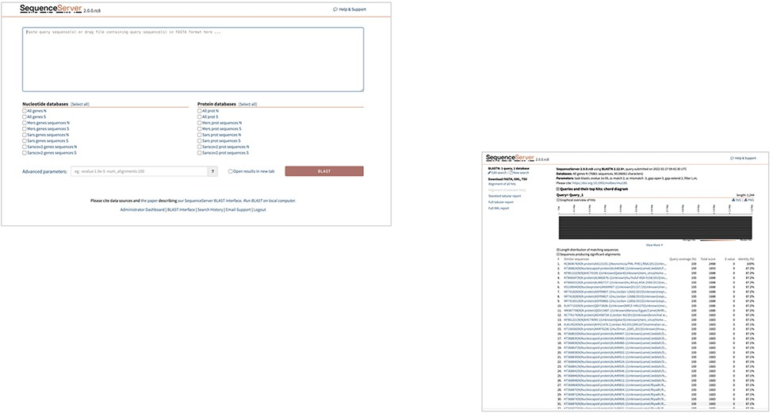
Figure 6. Illustration of Geo-Map of customized sequence search.
Notes:
Figure 6. Illustration of Geo-Map of customized sequence search.
Unless provided in the caption above, the following copyright applies to the content of this slide: © The Author(s) 2022. Published by Oxford University Press.This is an Open Access article distributed under the terms of the Creative Commons Attribution License (https://creativecommons.org/licenses/by/4.0/), which permits unrestricted reuse, distribution, and reproduction in any medium, provided the original work is properly cited.

Slide 7
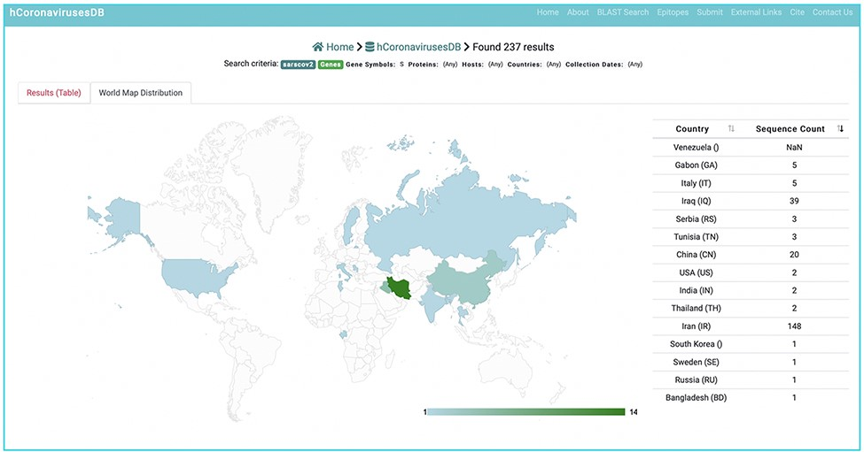
Figure 7. Customized BLST search of the hCoronavirusesDB. BLAST search query interface and BLAST.
Notes:
Figure 7. Customized BLST search of the hCoronavirusesDB. BLAST search query interface and BLAST.
Unless provided in the caption above, the following copyright applies to the content of this slide: © The Author(s) 2022. Published by Oxford University Press.This is an Open Access article distributed under the terms of the Creative Commons Attribution License (https://creativecommons.org/licenses/by/4.0/), which permits unrestricted reuse, distribution, and reproduction in any medium, provided the original work is properly cited.

