Slide 1
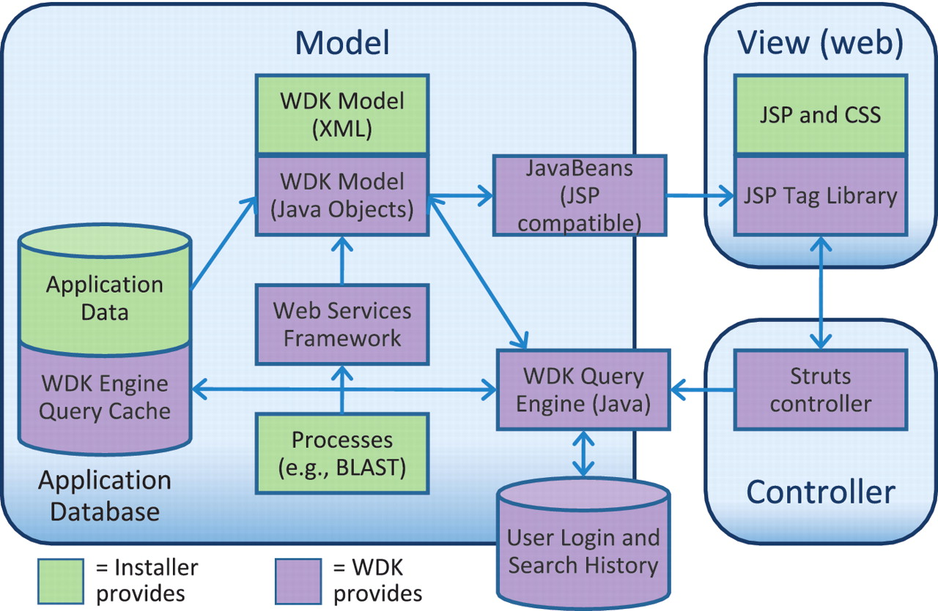
Figure 5. The Strategies WDK MVC design. Scientific data is stored in an application database of any design (supported ...
Notes:
Figure 5. The Strategies WDK MVC design. Scientific data is stored in an application database of any design (supported vendors are Oracle and PostgreSQL). The WDK’s query cache can reside in that database or a separate one. The WDK Model is specified in XML and instantiated into Java objects that represent records and searches. The WDK query engine uses the Java model to perform searches against the application database or using a web services framework. The Java model is made available to the front-end through a JSP-compatible JavaBeans API. The View is primarily comprised of JSP, JSP tags and CSS, and also uses JavaScript, JQuery and AJAX.
Unless provided in the caption above, the following copyright applies to the content of this slide: © The Author(s) 2011. Published by Oxford University Press.This is Open Access article distributed under the terms of the Creative Commons Attribution Non-Commercial License (http://creativecommons.org/licenses/by-nc/2.5), which permits unrestricted non-commercial use, distribution, and reproduction in any medium, provided the original work is properly cited.

