Slide 1
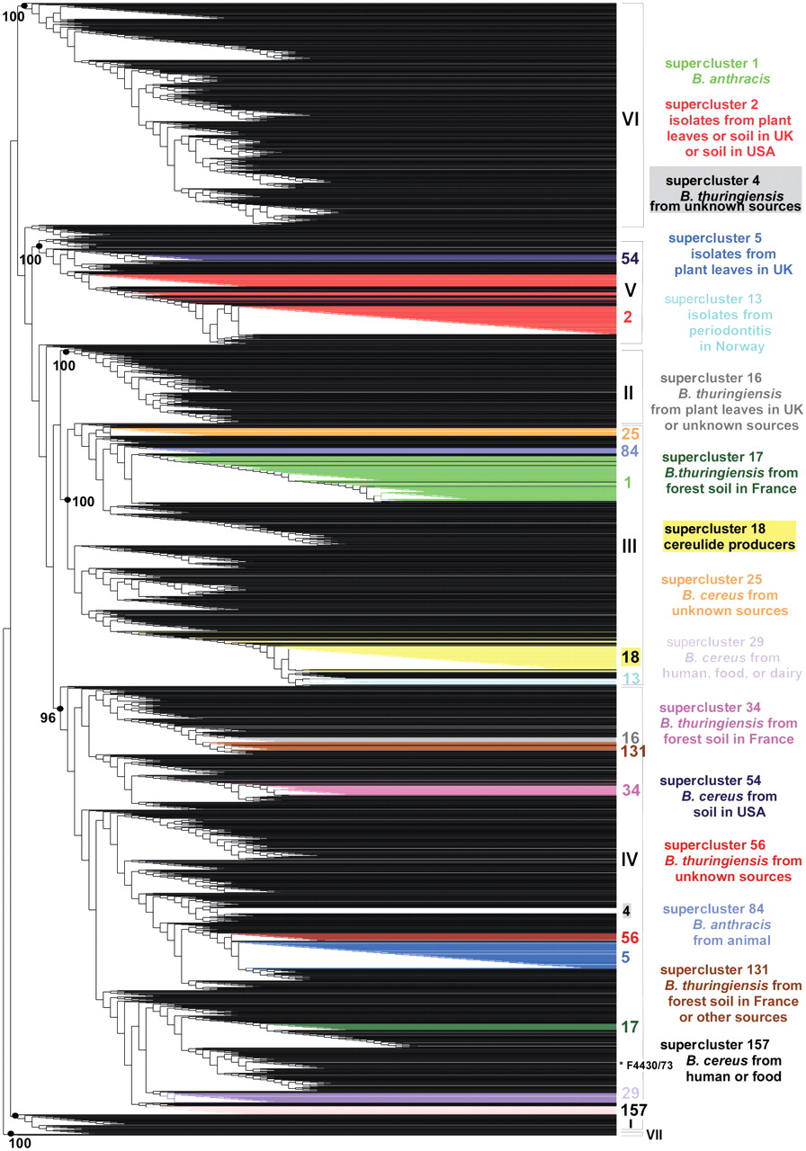
Figure 1. Weighted supertree of 2143 B. cereus group isolates based on phylogenetic information from five MLST schemes ...
Notes:
Figure 1. Weighted supertree of 2143 B. cereus group isolates based on phylogenetic information from five MLST schemes and three AFLP studies available in HyperCAT. The supertree was inferred following the MRP strategy, with a weight of 40 or 68 given to the AFLP studies and a weight of 1 given to each of 26 MLST genes. For the sake of legibility, isolate names are not shown. The seven major phylogenetic subdivisions of the B. cereus group defined by ref. (10) are designated by roman numerals (I–VII) and their branch support values (based on aLRT probabilities) are indicated when >95%. Superclusters of genetically closely related isolates (sharing identical MLST or AFLP profiles) that have been computed independently using a recursive approach and that contain 10 or more isolates have been mapped onto the supertree and are listed on the right (the supercluster descriptions apply to most isolates of the superclusters, not necessarily all). Isolates belonging to a given supercluster are drawn in the same color. As can be seen, isolates from the same supercluster are closely related in the tree. One exception is indicated by an asterisk and corresponds to strain B. cereus F4430/73 of supercluster 157. The image was generated using TreeDyn (44).
Unless provided in the caption above, the following copyright applies to the content of this slide: © The Author(s) 2010. Published by Oxford University Press.This is Open Access article distributed under the terms of the Creative Commons Attribution Non-Commercial License (http://creativecommons.org/licenses/by-nc/2.5), which permits unrestricted non-commercial use, distribution, and reproduction in any medium, provided the original work is properly cited.

Slide 2
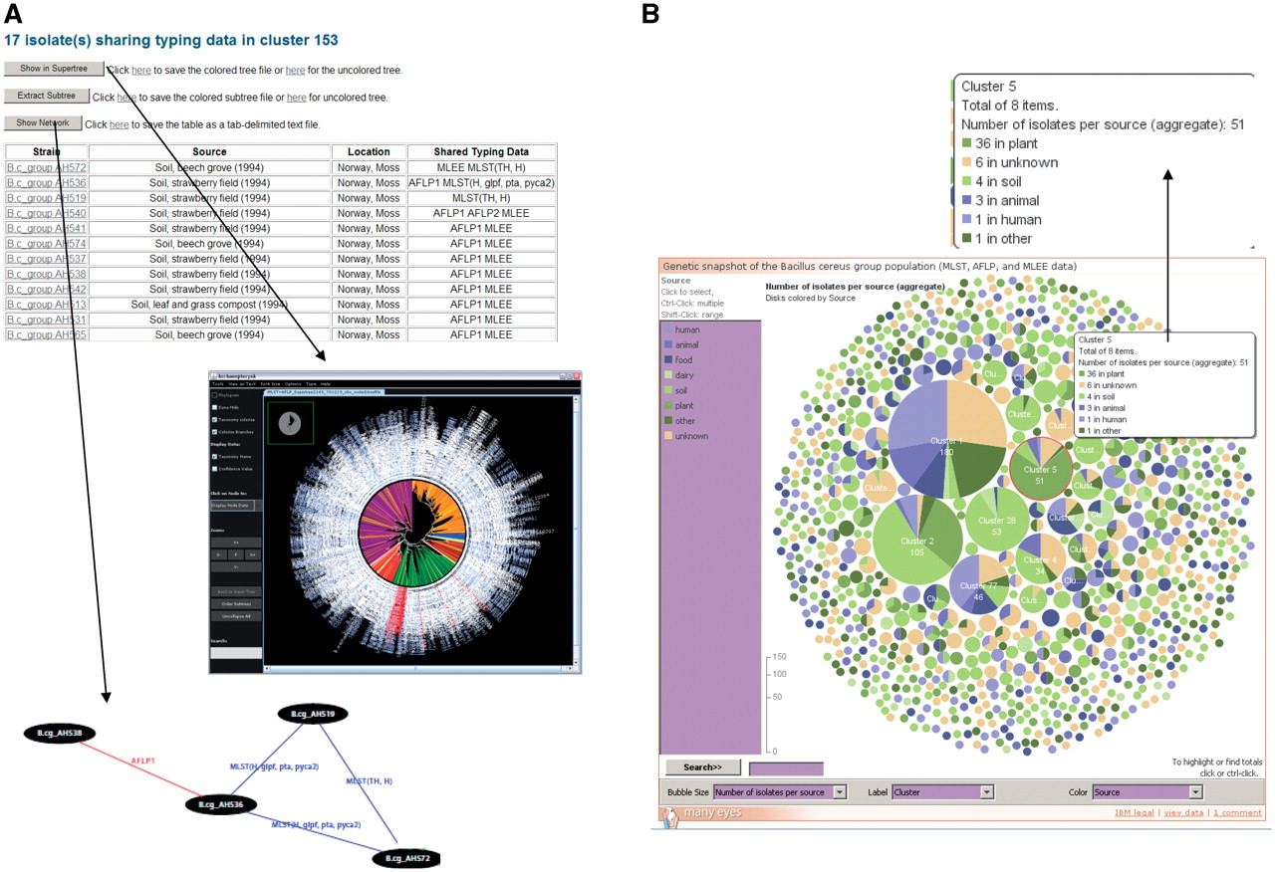
Figure 2. Exploration of superclusters of genetically closely related B. cereus group isolates in HyperCAT. (A) Tabular ...
Notes:
Figure 2. Exploration of superclusters of genetically closely related B. cereus group isolates in HyperCAT. (A) Tabular view of the superclusters. Each cluster is reported in a table, listing detailed information about the isolates and the genotying profiles shared. In addition, pressing one of the three buttons above the table allows to view the phylogenetic positions of the isolates in the multi-datatype supertree using Archaeopteryx, to extract from the supertree the subtree containing only the isolates forming the supercluster, or to display a network graph showing the specific typing data shared between the isolates of the supercluster. In the latter network, isolates having identical MLST and/or AFLP profiles are connected by blue and red lines, respectively. Every isolate in the supercluster shares a profile with at least one other isolate. The network can be browsed interactively using the ZGRViewer. (B) Graphical overview of all the superclusters resulting from typing information from five MLST schemes and three AFLP studies. Superclusters were built using a recursive approach, grouping strains that shared identical sequences at all loci of at least one of the MLST schemes and/or have identical AFLP profiles. The complete distribution consists of 283 groups totaling 1152 isolates, and 991 singletons. The set of superclusters and singletons can be navigated using an interactive bubble chart generated by means of the IBM/alphaWorks ‘many eyes’ system. Each supercluster is represented by a pie proportional to the number of isolates in the supercluster and the pie is divided according to the species or sources of the isolates included in the supercluster. Selecting or mousing over a supercluster brings up a window giving information about its content (shown in the inset indicated by an arrow).
Unless provided in the caption above, the following copyright applies to the content of this slide: © The Author(s) 2010. Published by Oxford University Press.This is Open Access article distributed under the terms of the Creative Commons Attribution Non-Commercial License (http://creativecommons.org/licenses/by-nc/2.5), which permits unrestricted non-commercial use, distribution, and reproduction in any medium, provided the original work is properly cited.

Slide 3
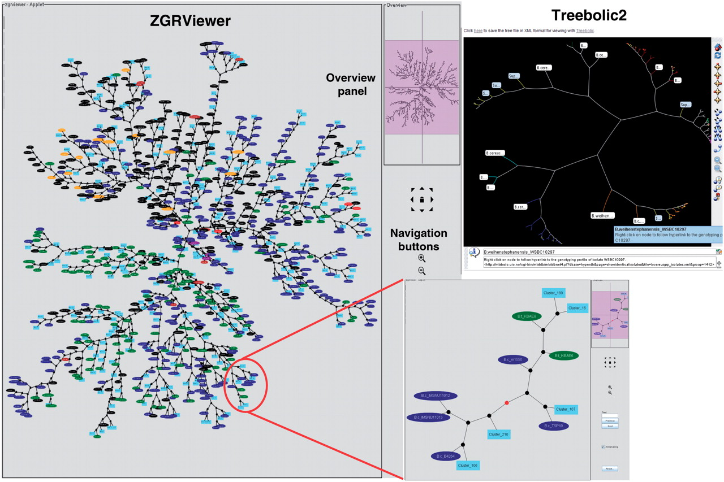
Figure 3. Phylogenetic snapshot of the B. cereus group population based on MLST and AFLP typing data for 2143 isolates. ...
Notes:
Figure 3. Phylogenetic snapshot of the B. cereus group population based on MLST and AFLP typing data for 2143 isolates. The snapshot combines supertree and supercluster information. The supertree is represented as an unrooted network in which the closely related strains belonging to a supercluster have been replaced by a representative isolate. Superclusters are drawn as filled lightblue boxes, while singleton isolates are drawn as ellipses colored by bacterial species (red, B. anthracis; blue, B. cereus; green, B. thuringiensis; brown, B. mycoides; purple, B. pseudomycoides; orange, B. weihenstephanensis; black, uncharacterized B. cereus group isolate). The network can be browsed interactively using the ZGRViewer navigation buttons and mouse functions. Clicking on an internal node loads a new page displaying the subtree including all descendants of that node in the supertree. An example is given in the inset showing the subtree circled in red. The view in the upper right corner shows the display of the supertree in hyperbolic space using Treebolic2.
Unless provided in the caption above, the following copyright applies to the content of this slide: © The Author(s) 2010. Published by Oxford University Press.This is Open Access article distributed under the terms of the Creative Commons Attribution Non-Commercial License (http://creativecommons.org/licenses/by-nc/2.5), which permits unrestricted non-commercial use, distribution, and reproduction in any medium, provided the original work is properly cited.

