Slide 1
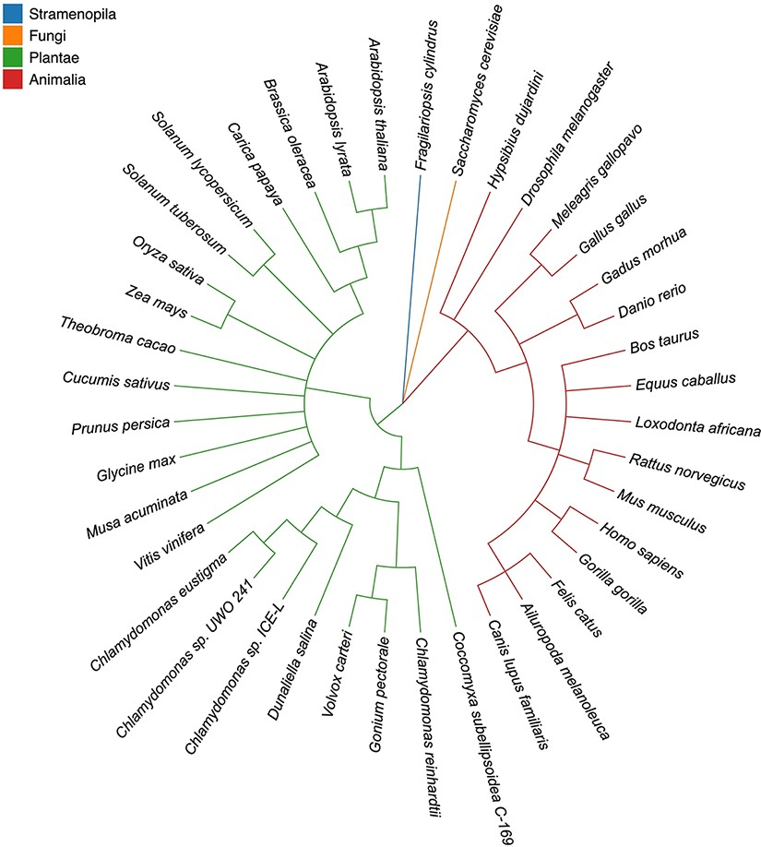
Figure 1. Taxonomic tree of 40 eukaryotic species in four highlighted categories. Stramenopila, Plantae , Fungi and ...
Notes:
Figure 1. Taxonomic tree of 40 eukaryotic species in four highlighted categories. Stramenopila, Plantae , Fungi and Animalia are in blue, orange, green and red, respectively. The tree topologies were inferred by Taxonomy Common Tree from NCBI (https://www.ncbi.nlm.nih.gov/Taxonomy/CommonTree/wwwcmt.cgi).
Unless provided in the caption above, the following copyright applies to the content of this slide: © The Author(s) 2022. Published by Oxford University Press.This is an Open Access article distributed under the terms of the Creative Commons Attribution-NonCommercial License (https://creativecommons.org/licenses/by-nc/4.0/), which permits non-commercial re-use, distribution, and reproduction in any medium, provided the original work is properly cited. For commercial re-use, please contact journals.permissions@oup.com

