Slide 1
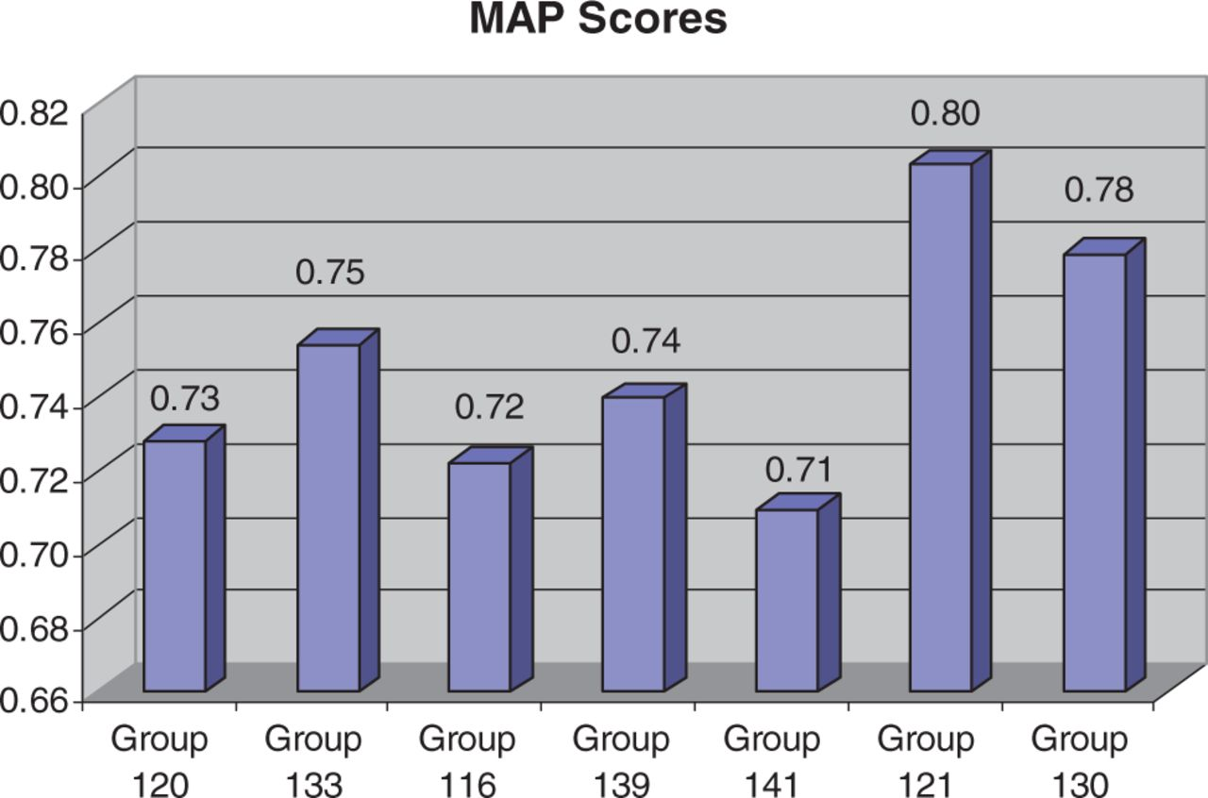
Figure 2 MAP (9) score results for each participating group. For MAP score calculations, an article was counted as ...
Notes:
Figure 2 MAP (9) score results for each participating group. For MAP score calculations, an article was counted as relevant if it had one or more associated curated interactions. Across the groups, MAP scores were fairly high and consistent, ranging from 71% to 80%.
Unless provided in the caption above, the following copyright applies to the content of this slide: © The Author(s) 2012. Published by Oxford University Press.This is an Open Access article distributed under the terms of the Creative Commons Attribution License (http://creativecommons.org/licenses/by-nc/3.0/), which permits non-commercial reuse, distribution, and reproduction in any medium, provided the original work is properly cited. For commercial re-use, please contact journals.permissions@oup.com.

