Slide 1
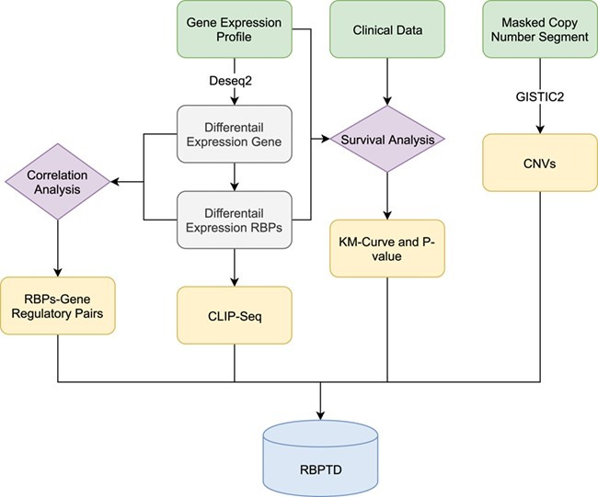
Figure 1 Workflow of RBPTD development. Expression profiles, prognostic information and copy number variation (CNV) ...
Notes:
Figure 1 Workflow of RBPTD development. Expression profiles, prognostic information and copy number variation (CNV) data were downloaded from The Cancer Genome Atlas (TCGA). To find the cancer-related RBPs, we used the DESeq2 package in the R software environment to analyse differentially expressed genes (DEGs), and the survival package of R software was used for survival analysis. To reveal the causes of abnormality of dysregulated RBPs, the genomic identification of significant targets in cancer (GISTIC) was used for CNV analysis. We also predicted the function of RBPs by CLIP-Seq experimental data and co-expression analysis. Finally, we then developed a database using the obtained RNA binding protein (RBP) results.
Unless provided in the caption above, the following copyright applies to the content of this slide: © The Author(s) 2020. Published by Oxford University Press.This is an Open Access article distributed under the terms of the Creative Commons Attribution License (http://creativecommons.org/licenses/by/4.0/), which permits unrestricted reuse, distribution, and reproduction in any medium, provided the original work is properly cited.

Slide 2
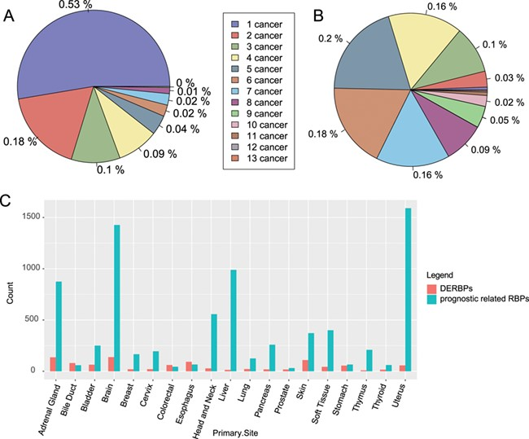
Figure 2 Distribution of RBPs among cancers. (A) Distribution of significantly differentially expressed RBPs among ...
Notes:
Figure 2 Distribution of RBPs among cancers. (A) Distribution of significantly differentially expressed RBPs among cancers. (B) Distribution of RBPs with significant prognostic value among caners. (C) Count of DERBPs and RBPs with prognostic values in cancers. The number ahead of cancer means the number of cancers with the same RBPs. DERBPs = differentially expressed RBPs.
Unless provided in the caption above, the following copyright applies to the content of this slide: © The Author(s) 2020. Published by Oxford University Press.This is an Open Access article distributed under the terms of the Creative Commons Attribution License (http://creativecommons.org/licenses/by/4.0/), which permits unrestricted reuse, distribution, and reproduction in any medium, provided the original work is properly cited.

Slide 3
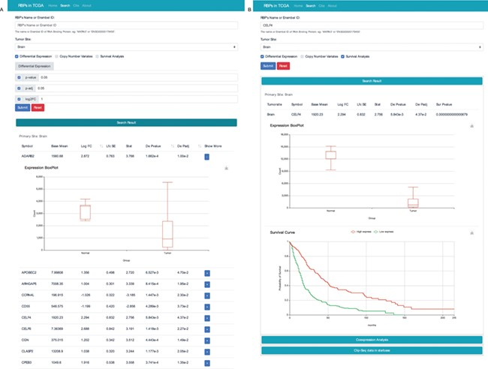
Figure 4 RBP result interface with two search modes. (A) Search the database according to tumour site, P value, p-adj ...
Notes:
Figure 4 RBP result interface with two search modes. (A) Search the database according to tumour site, P value, p-adj and/or log2FC. (B) Search the database according to the name of RBP and cancer type. To get more details, users can click the “+” button.
Unless provided in the caption above, the following copyright applies to the content of this slide: © The Author(s) 2020. Published by Oxford University Press.This is an Open Access article distributed under the terms of the Creative Commons Attribution License (http://creativecommons.org/licenses/by/4.0/), which permits unrestricted reuse, distribution, and reproduction in any medium, provided the original work is properly cited.

Slide 4
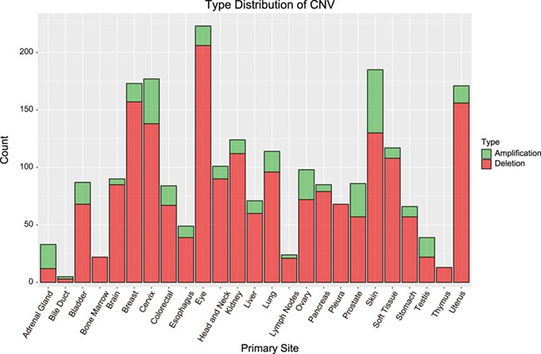
Figure 3 Distribution of CNVs among cancer types. Bar height indicates the number of genes with CNV in the primary ...
Notes:
Figure 3 Distribution of CNVs among cancer types. Bar height indicates the number of genes with CNV in the primary site. Amplification = amplified regions. Deletion = deleted regions.
Unless provided in the caption above, the following copyright applies to the content of this slide: © The Author(s) 2020. Published by Oxford University Press.This is an Open Access article distributed under the terms of the Creative Commons Attribution License (http://creativecommons.org/licenses/by/4.0/), which permits unrestricted reuse, distribution, and reproduction in any medium, provided the original work is properly cited.

