Slide 1
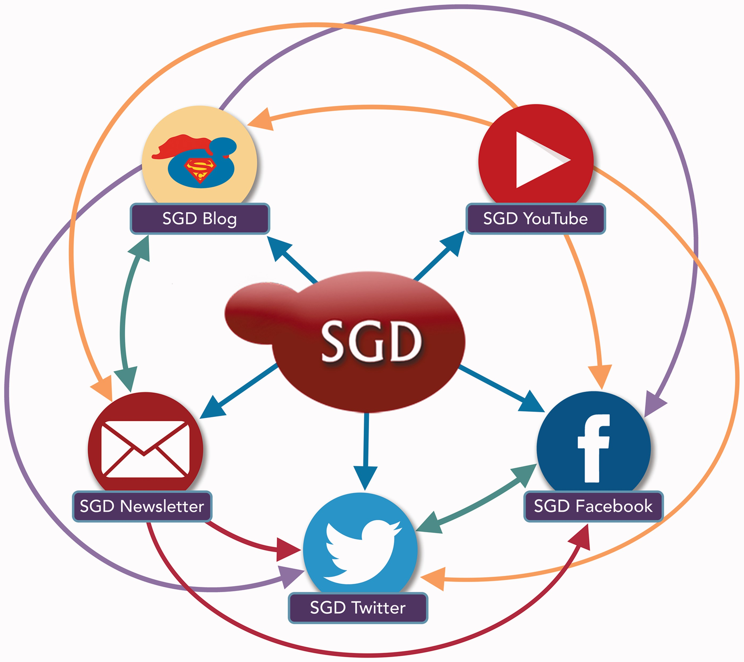
Figure 1 The SGD uses a variety of outreach and social media platforms to disseminate news and information to our user ...
Notes:
Figure 1 The SGD uses a variety of outreach and social media platforms to disseminate news and information to our user community. To increase readership and reach the broadest possible audience, content posted on one outreach platform is often publicized, announced or re-posted on other outreach platforms. Colored arrows indicate the directions in which content is pushed from one platform to another.
Unless provided in the caption above, the following copyright applies to the content of this slide: © The Author(s) 2017. Published by Oxford University Press.This is an Open Access article distributed under the terms of the Creative Commons Attribution License (http://creativecommons.org/licenses/by/4.0/), which permits unrestricted reuse, distribution, and reproduction in any medium, provided the original work is properly cited.

