Slide 1
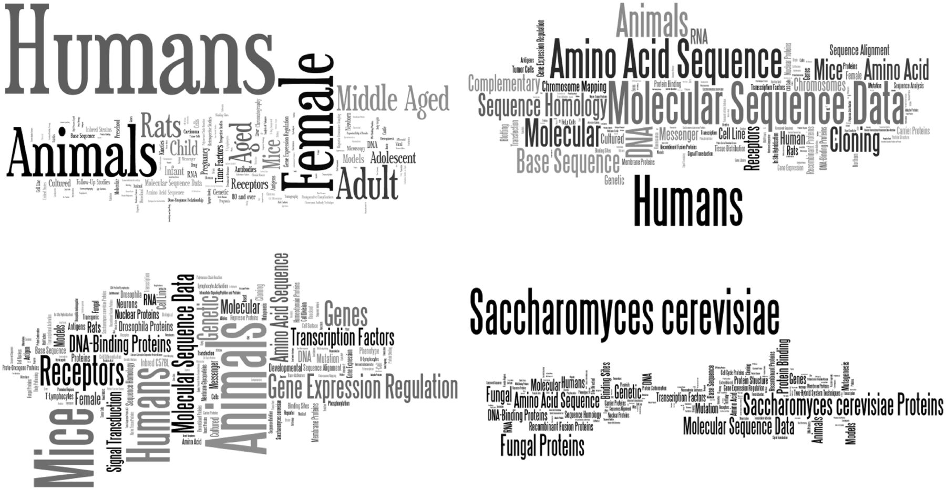
Figure 3 Word cloud ( http://www.wordle.net/create ) representations of MeSH terms found in each corpus: Ab3P (top ...
Notes:
Figure 3 Word cloud ( http://www.wordle.net/create ) representations of MeSH terms found in each corpus: Ab3P (top left), BIOADI (top right), MEDSTRACT (bottom left) and Schwartz and Hearst (bottom right). The MeSH terms confirm each corpus’ original intent: Ab3P was intended as a representation of all biomedical literature in PubMed, BIOADI is the corpus used in the BioCreative II gene normalization challenge, half of MEDSTRACT documents were a result of the search term ‘gene’ on MEDLINE restricted to a small group of biomedical journals and Schwartz and Hearst was a selection of documents returned as a result of the search term ‘yeast’ applied to PubMed.
Unless provided in the caption above, the following copyright applies to the content of this slide: Published by Oxford University Press 2014. This work is written by US Government employees and is in the public domain in the US.

Slide 2
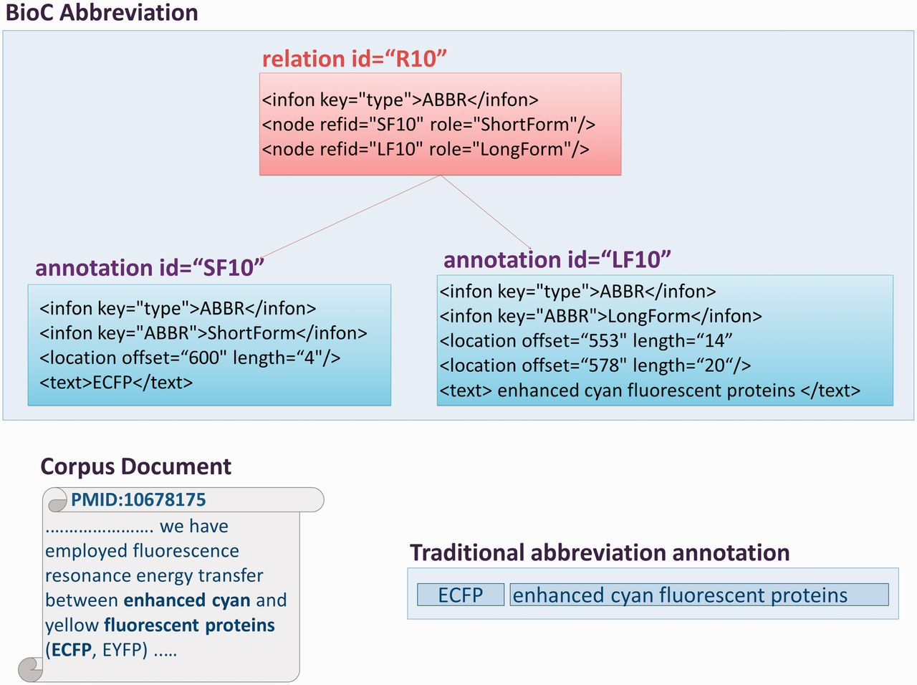
Figure 2 A graphical representation of abbreviation annotations in BioC format. The excerpt from one of the corpus ...
Notes:
Figure 2 A graphical representation of abbreviation annotations in BioC format. The excerpt from one of the corpus documents contains multi-segmented abbreviation long forms. The traditional ShortForm, LongForm pairing is shown in the figure, as well as the infons detailing BioC annotations for an abbreviation, and the relation between them, with the corresponding precise text offsets.
Unless provided in the caption above, the following copyright applies to the content of this slide: Published by Oxford University Press 2014. This work is written by US Government employees and is in the public domain in the US.

Slide 3
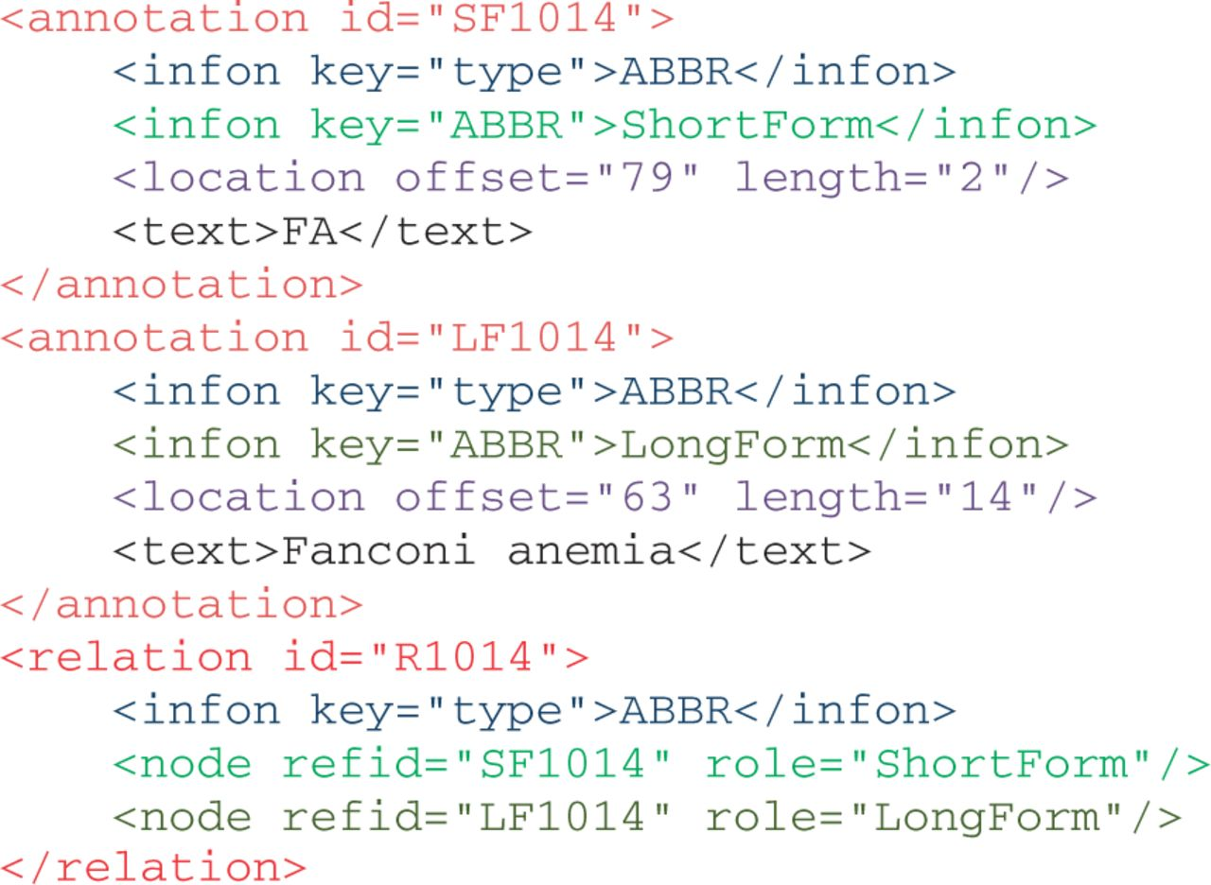
Figure 1 Illustration of abbreviation annotation in BioC format.
Notes:
Figure 1 Illustration of abbreviation annotation in BioC format.
Unless provided in the caption above, the following copyright applies to the content of this slide: Published by Oxford University Press 2014. This work is written by US Government employees and is in the public domain in the US.

