Slide 1
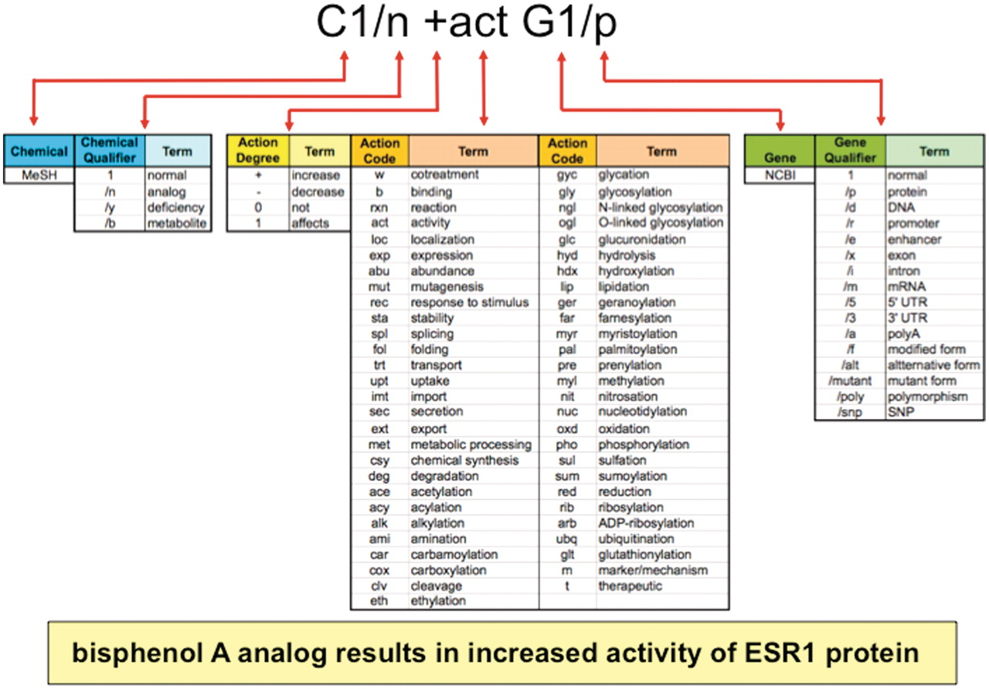
Figure 2. Anatomy of an interaction. Biocurators curate data in structured notation (top) by conjoining terms from ...
Notes:
Figure 2. Anatomy of an interaction. Biocurators curate data in structured notation (top) by conjoining terms from multiple vocabularies (middle), including the chemical branch of MeSH, 4 chemical qualifiers, 4 action term degrees, 55 action terms, NCBI gene symbols and 16 gene qualifiers. Multiplexing these short lists allow exponential combinations. Here, the biocurator additionally chose bisphenol A for C1 and ESR1 for G1 to complete the interaction. The notation is translated and displayed as a sentence on public CTD (yellow box).
Unless provided in the caption above, the following copyright applies to the content of this slide: © The Author(s) 2011. Published by Oxford University Press.This is Open Access article distributed under the terms of the Creative Commons Attribution Non-Commercial License (http://creativecommons.org/licenses/by-nc/2.5), which permits unrestricted non-commercial use, distribution, and reproduction in any medium, provided the original work is properly cited.

