Slide 1
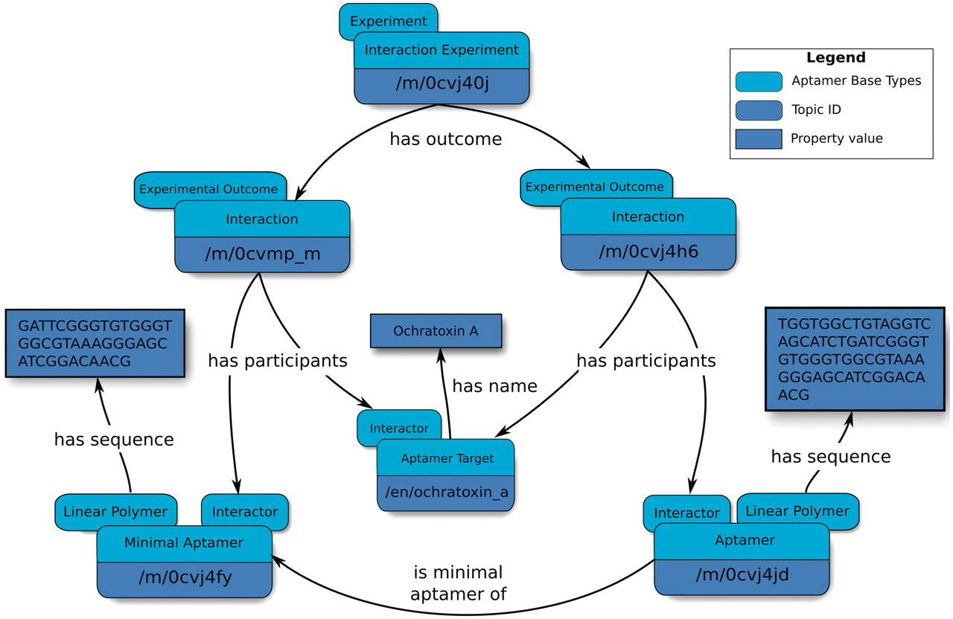
Figure 3. Overview of an abridged relation map describing minimal aptamers. Minimal aptamers are captured in the ...
Notes:
Figure 3. Overview of an abridged relation map describing minimal aptamers. Minimal aptamers are captured in the Aptamer Base by creating a new Interaction for each individual Minimal Aptamer, permitting the description of unique Aptamers can then be associated with the unique Interaction topics.
Unless provided in the caption above, the following copyright applies to the content of this slide: © The Author(s) 2012. Published by Oxford University Press.This is an Open Access article distributed under the terms of the Creative Commons Attribution Non-Commercial License (http://creativecommons.org/licenses/by-nc/3.0), which permits unrestricted non-commercial use, distribution, and reproduction in any medium, provided the original work is properly cited.

