Slide 1
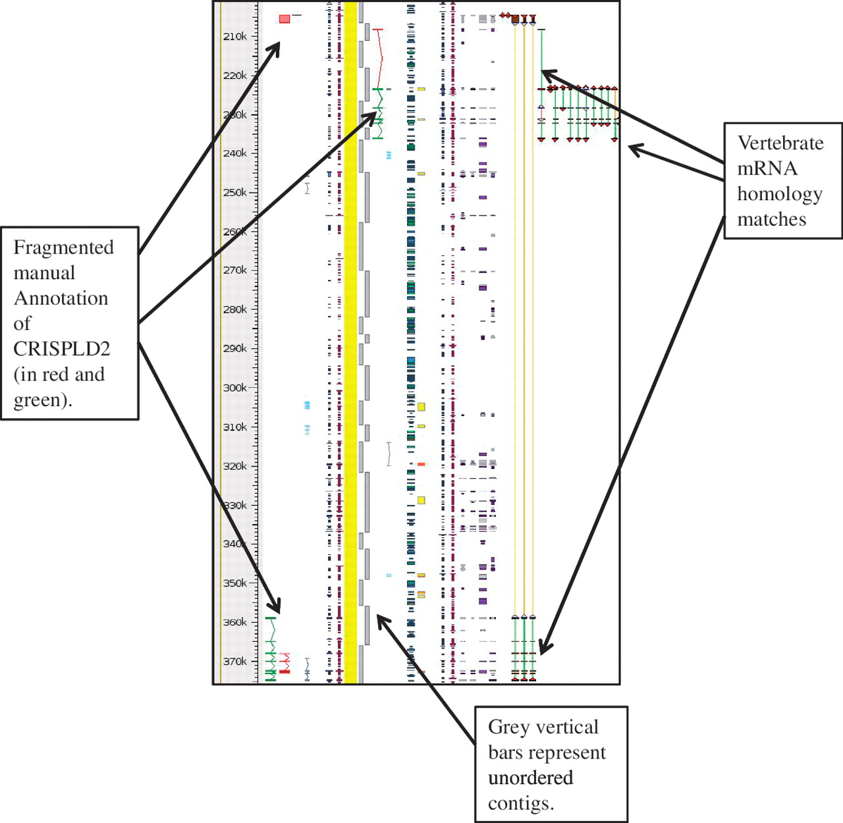
Figure 4. Unordered contigs on pig chromosome 6 viewed in Zmap. The annotation of the CRISPLD2 gene shows clearly how ...
Notes:
Figure 4. Unordered contigs on pig chromosome 6 viewed in Zmap. The annotation of the CRISPLD2 gene shows clearly how the annotation highlights the fragmented nature of the assembly and aids in identifying the correct contig ordering. The vertebrate mRNA homology matches show the mismatches in the contiguity of the sequence. If sequence is contiguous the connecting lines between the matches are green, but where there is missing or incorrectly ordered sequence the connecting lines are orange.
Unless provided in the caption above, the following copyright applies to the content of this slide: © The Author(s) 2012. Published by Oxford University Press.This is an Open Access article distributed under the terms of the Creative Commons Attribution Non-Commercial License (http://creativecommons.org/licenses/by-nc/3.0), which permits unrestricted non-commercial use, distribution, and reproduction in any medium, provided the original work is properly cited.

