Slide 1
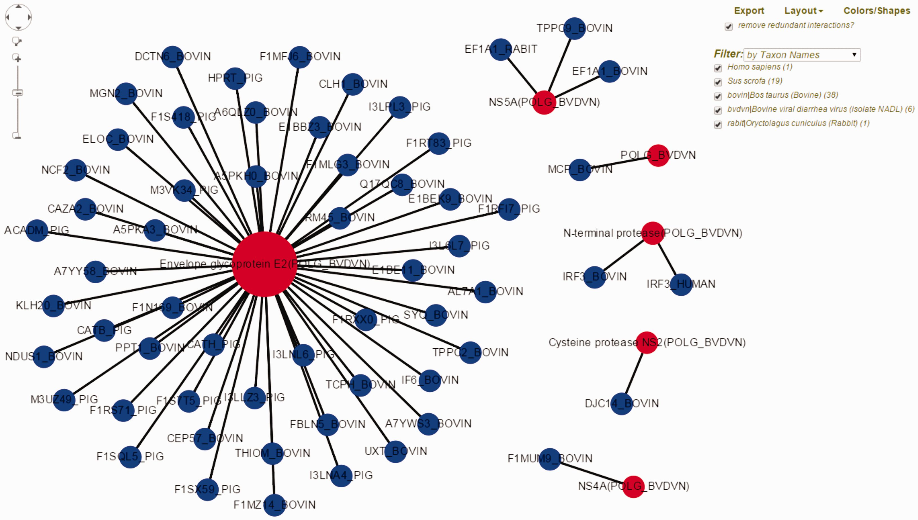
Figure 2. Visualization of BVDV–bovine interaction network in HPIDB 2.0. The represented network is obtained by ...
Notes:
Figure 2. Visualization of BVDV–bovine interaction network in HPIDB 2.0. The represented network is obtained by selecting ‘Network Visualization’ in the result page obtained from a taxon search of HPIDB 2.0 data for BVDV strain NADL. The view shows the options (including exporting network, removing redundant data, changing layout, colors/shapes and filtering by taxon, protein, interaction type and detection method) available to the user to generate a custom network. Red and blue nodes represent viral and host proteins, respectively. Node size reflects the number of interactions available for proteins in the network.
Unless provided in the caption above, the following copyright applies to the content of this slide: © The Author(s) 2016. Published by Oxford University Press. This is an Open Access article distributed under the terms of the Creative Commons Attribution License ( http://creativecommons.org/licenses/by/4.0/ ), which permits unrestricted reuse, distribution, and reproduction in any medium, provided the original work is properly cited.

