Slide 1
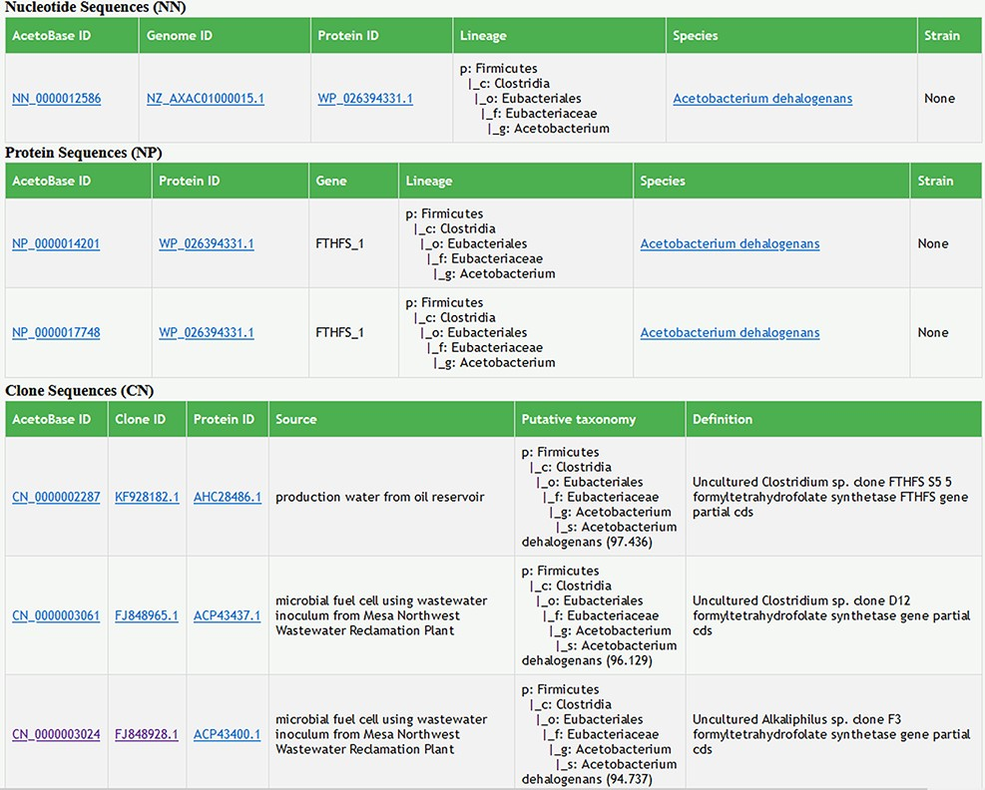
Figure 5. Screenshot of search results in AcetoBase Version 2 showing taxonomic lineages of the query against the ...
Notes:
Figure 5. Screenshot of search results in AcetoBase Version 2 showing taxonomic lineages of the query against the nucleotide and protein data sets. The search results for the clone data set show the isolation source of the clone, its description/definition and the putative taxonomy predicted with the acetotax program.
Unless provided in the caption above, the following copyright applies to the content of this slide: © The Author(s) 2022. Published by Oxford University Press.This is an Open Access article distributed under the terms of the Creative Commons Attribution-NonCommercial License (https://creativecommons.org/licenses/by-nc/4.0/), which permits non-commercial re-use, distribution, and reproduction in any medium, provided the original work is properly cited. For commercial re-use, please contact journals.permissions@oup.com

