Slide 1
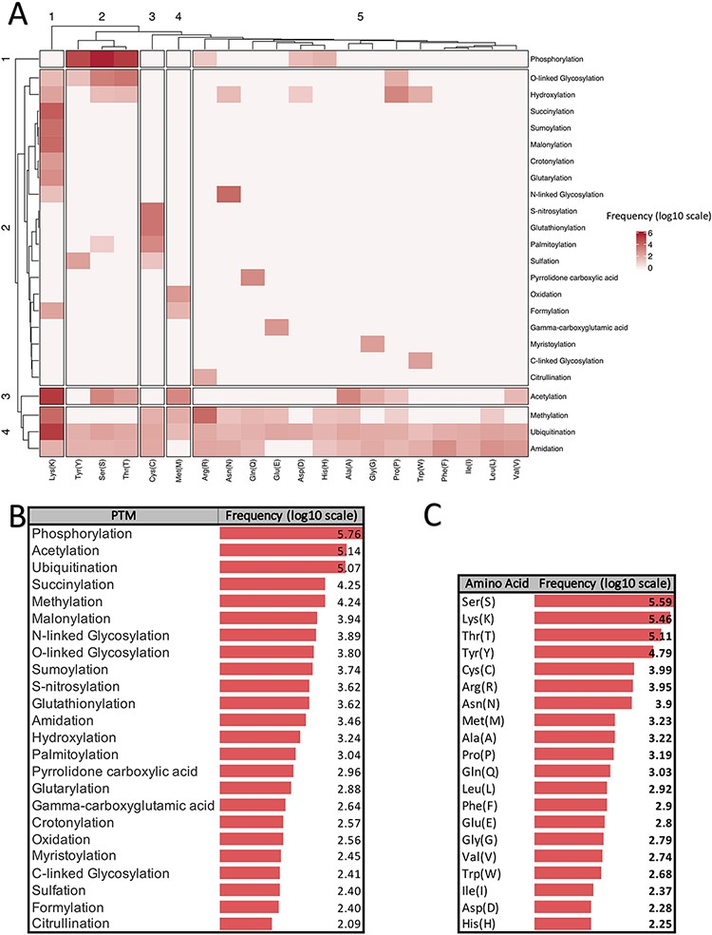
Figure 1. Summarized information of major PTMs (24 PTMs with more than 80 experimentally verified reported modified ...
Notes:
Figure 1. Summarized information of major PTMs (24 PTMs with more than 80 experimentally verified reported modified sites) according to the dbPTM databank (October 2020). All frequencies are shown in log scale. (A) Clustergram indicating the frequency of each PTM on different amino acids. (B) Frequency of major PTMs. (C) Frequency of each amino acid that was reported as a modified site.
Unless provided in the caption above, the following copyright applies to the content of this slide: © The Author(s) 2021. Published by Oxford University Press. All rights reserved. For permissions, please e-mail: journals.permissions@oup.comThis article is published and distributed under the terms of the Oxford University Press, Standard Journals Publication Model (https://academic.oup.com/journals/pages/open_access/funder_policies/chorus/standard_publication_model)

Slide 2
Figure 2. Schematic PTM discovery timeline for 10 major PTMs: phosphorylation (28), methylation (29), sulfation (30), ...
Notes:
Figure 2. Schematic PTM discovery timeline for 10 major PTMs: phosphorylation (28), methylation (29), sulfation (30), acetylation (31), ubiquitylation (32), prenylation (33), myristoylation (34), SUMOylation (35), palmitoylation (36), different types of glycosylation (N-glycosylation (37), O-glycosylation (38), C-glycosylation (39) and S-glycosylation (40)), phosphoglycosylation (41) and glycosylphosphatidylinositol (GPI anchored) (42). For each PTM, target residue(s) and the organism in which the related PTM was discovered for the first time are shown.
Unless provided in the caption above, the following copyright applies to the content of this slide: © The Author(s) 2021. Published by Oxford University Press. All rights reserved. For permissions, please e-mail: journals.permissions@oup.comThis article is published and distributed under the terms of the Oxford University Press, Standard Journals Publication Model (https://academic.oup.com/journals/pages/open_access/funder_policies/chorus/standard_publication_model)

Slide 3
Figure 3. Schematic illustration of the 10 most studied PTMs including Phosphorylation (A), Acetylation (B), ...
Notes:
Figure 3. Schematic illustration of the 10 most studied PTMs including Phosphorylation (A), Acetylation (B), Ubiquitylation (C), Methylation (D), N-glycosylation (E), O-glycosylation (F), SUMOylation (G), S-palmitoylation (H), N-myristoylation (I), Prenylation (J), and Sulfation (k).
Unless provided in the caption above, the following copyright applies to the content of this slide: © The Author(s) 2021. Published by Oxford University Press. All rights reserved. For permissions, please e-mail: journals.permissions@oup.comThis article is published and distributed under the terms of the Oxford University Press, Standard Journals Publication Model (https://academic.oup.com/journals/pages/open_access/funder_policies/chorus/standard_publication_model)

Slide 4
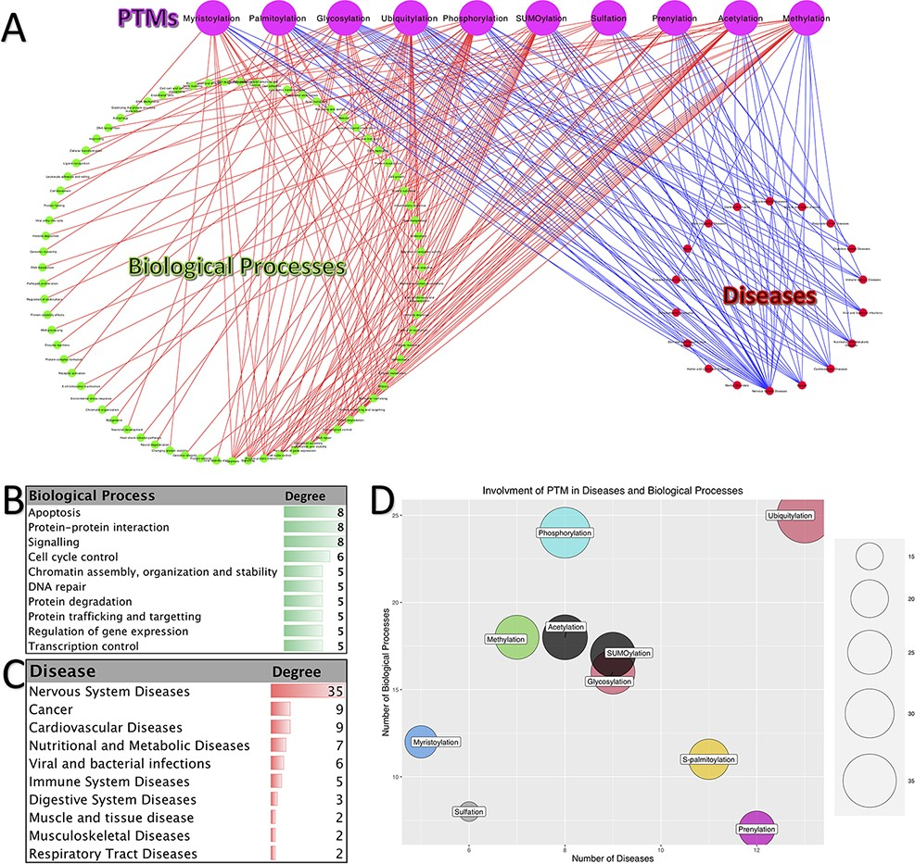
Figure 4. Involvement of PTMs in diseases and biological processes. (A). Tripartite network of PTM involvement in ...
Notes:
Figure 4. Involvement of PTMs in diseases and biological processes. (A). Tripartite network of PTM involvement in diseases and biological processes for the 10 major PTMs. (B) The degree of the biological processes with degree ≥3 in the tripartite network. (C) The degree of the diseases with degree ≥2 in the tripartite network. (D) Involvement of PTMs in disease and biological processes.
Unless provided in the caption above, the following copyright applies to the content of this slide: © The Author(s) 2021. Published by Oxford University Press. All rights reserved. For permissions, please e-mail: journals.permissions@oup.comThis article is published and distributed under the terms of the Oxford University Press, Standard Journals Publication Model (https://academic.oup.com/journals/pages/open_access/funder_policies/chorus/standard_publication_model)

Slide 5
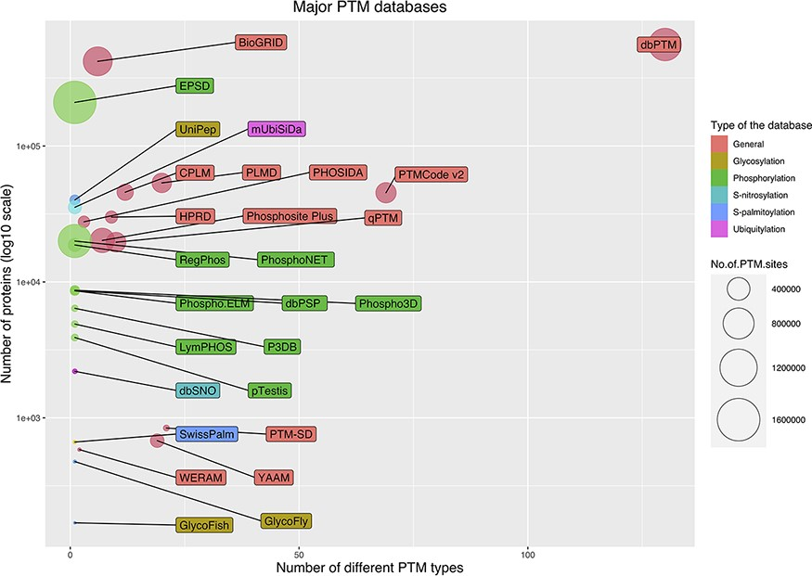
Figure 5. Bubble chart for PTM databases. The chart was drawn based on three parameters for the databases: the number ...
Notes:
Figure 5. Bubble chart for PTM databases. The chart was drawn based on three parameters for the databases: the number of stored modified proteins, the number of modified sites and the number of covered PTM types.
Unless provided in the caption above, the following copyright applies to the content of this slide: © The Author(s) 2021. Published by Oxford University Press. All rights reserved. For permissions, please e-mail: journals.permissions@oup.comThis article is published and distributed under the terms of the Oxford University Press, Standard Journals Publication Model (https://academic.oup.com/journals/pages/open_access/funder_policies/chorus/standard_publication_model)

Slide 6
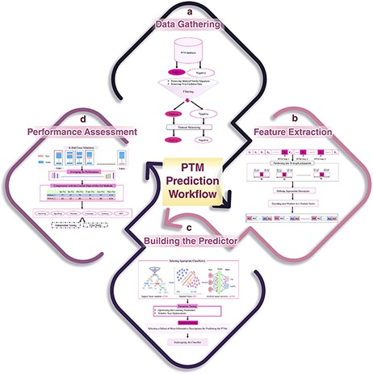
Figure 6. A schematic flowchart to show how a predictor works for PTM prediction. (A) Data collection and dataset ...
Notes:
Figure 6. A schematic flowchart to show how a predictor works for PTM prediction. (A) Data collection and dataset creation. (B) Feature selection. (C) Creating training and testing models. (D) Evaluation of the performance of the models.
Unless provided in the caption above, the following copyright applies to the content of this slide: © The Author(s) 2021. Published by Oxford University Press. All rights reserved. For permissions, please e-mail: journals.permissions@oup.comThis article is published and distributed under the terms of the Oxford University Press, Standard Journals Publication Model (https://academic.oup.com/journals/pages/open_access/funder_policies/chorus/standard_publication_model)

Slide 7
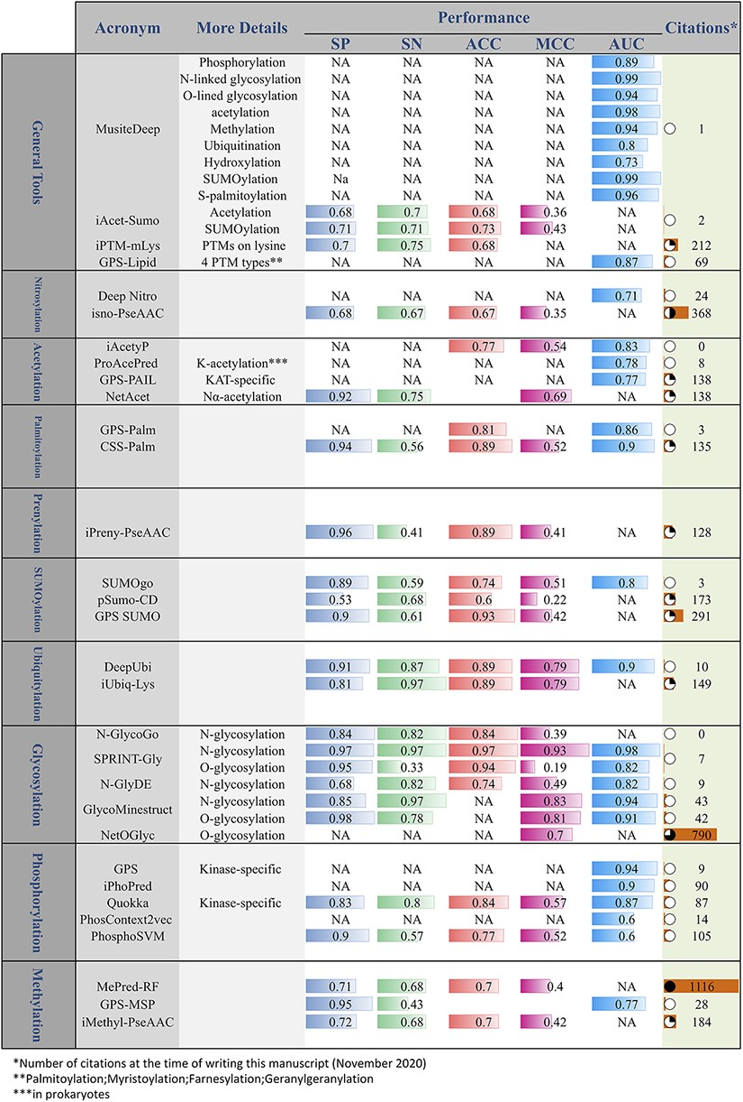
Figure 7. Online PTM prediction tools. The values of five important performance assessment measures have been extracted ...
Notes:
Figure 7. Online PTM prediction tools. The values of five important performance assessment measures have been extracted from the related publications: specificity (SP), sensitivity (SN), accuracy (ACC), Matthews’s correlation coefficient (MCC) and area under the ROC curve (AUC).
Unless provided in the caption above, the following copyright applies to the content of this slide: © The Author(s) 2021. Published by Oxford University Press. All rights reserved. For permissions, please e-mail: journals.permissions@oup.comThis article is published and distributed under the terms of the Oxford University Press, Standard Journals Publication Model (https://academic.oup.com/journals/pages/open_access/funder_policies/chorus/standard_publication_model)

