Slide 1
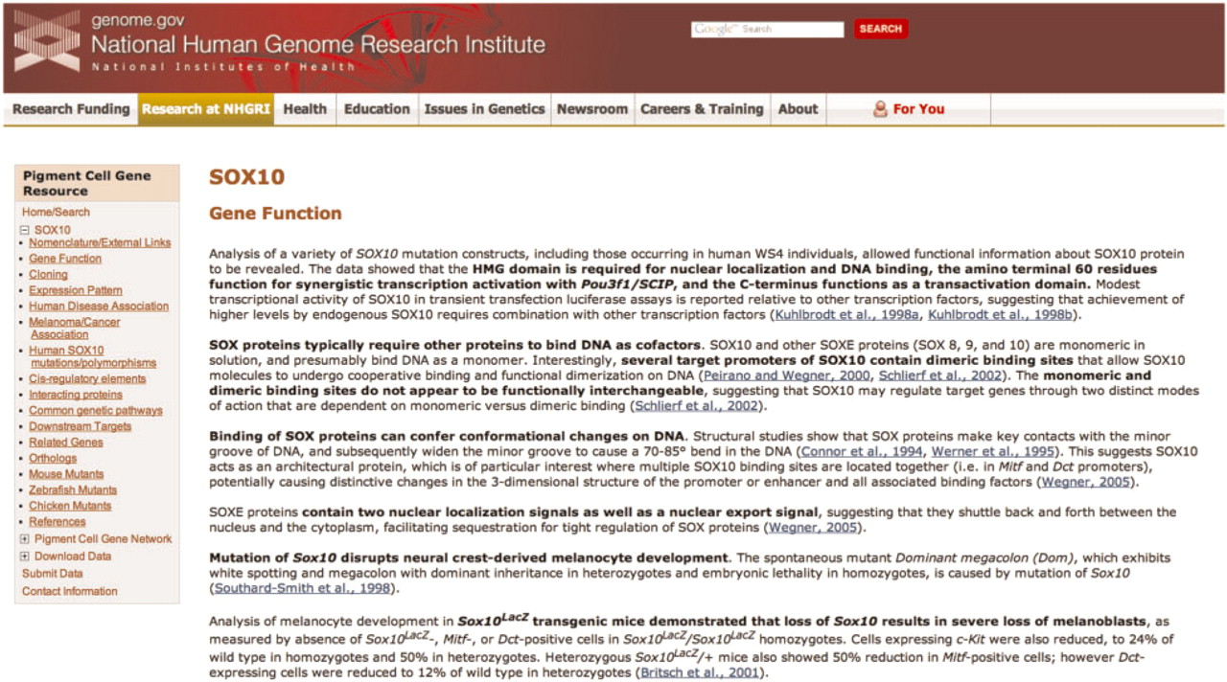
Figure 1. A representative page from the annotated literature section for SOX10 of the Pigment Cell Gene Resource. The ...
Notes:
Figure 1. A representative page from the annotated literature section for SOX10 of the Pigment Cell Gene Resource. The navigation sidebar at left includes the 17 literature summary subcategories; each of these categories is located on a separate page. Links to PubMed abstracts for each summarized article are in blue, and bold text indicates the main points of the summary. The navigation sidebar also contains links to access the Pigment Cell Gene Network, to submit data directly and to download data.
Unless provided in the caption above, the following copyright applies to the content of this slide: Published by Oxford University Press 2010.This is Open Access article distributed under the terms of the Creative Commons Attribution Non-Commercial License (http://creativecommons.org/licenses/by-nc/2.5), which permits unrestricted non-commercial use, distribution, and reproduction in any medium, provided the original work is properly cited.

Slide 2
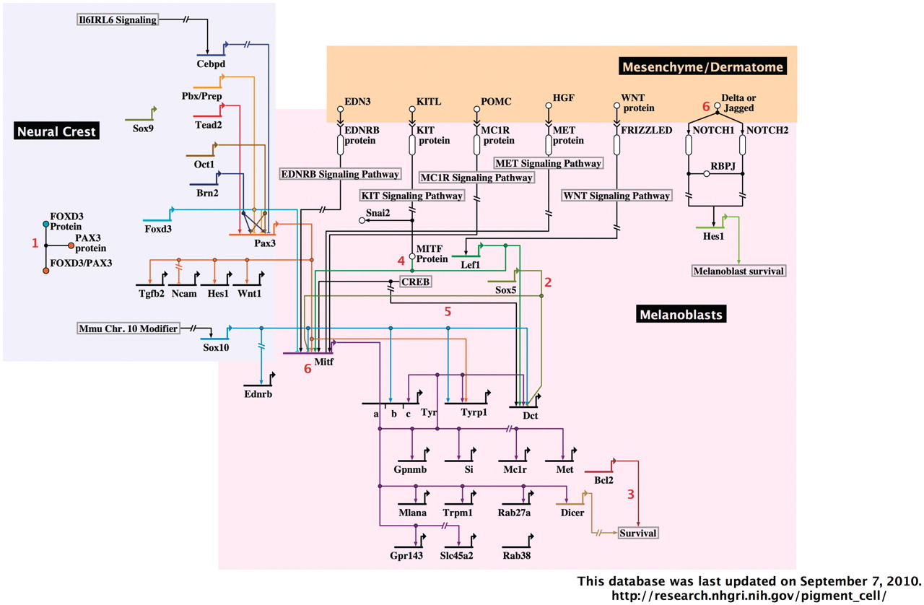
Figure 2. A representative image from the interactive, BioTapestry-generated Pigment Cell Gene Network. The portion of ...
Notes:
Figure 2. A representative image from the interactive, BioTapestry-generated Pigment Cell Gene Network. The portion of the network containing neural crest and melanoblasts with associated dermatome are shown. Red numbers represent interactive notes, which in the online network become visible by mouse-over. Regions included in the complete diagram are categorized by developmental stage/cell type, as follows: neural crest, melanoblasts and associated dermatome, follicular melanocyte stem cells, follicular/dermal melanocytes and associated keratinocytes and RPE.
Unless provided in the caption above, the following copyright applies to the content of this slide: Published by Oxford University Press 2010.This is Open Access article distributed under the terms of the Creative Commons Attribution Non-Commercial License (http://creativecommons.org/licenses/by-nc/2.5), which permits unrestricted non-commercial use, distribution, and reproduction in any medium, provided the original work is properly cited.

Slide 3
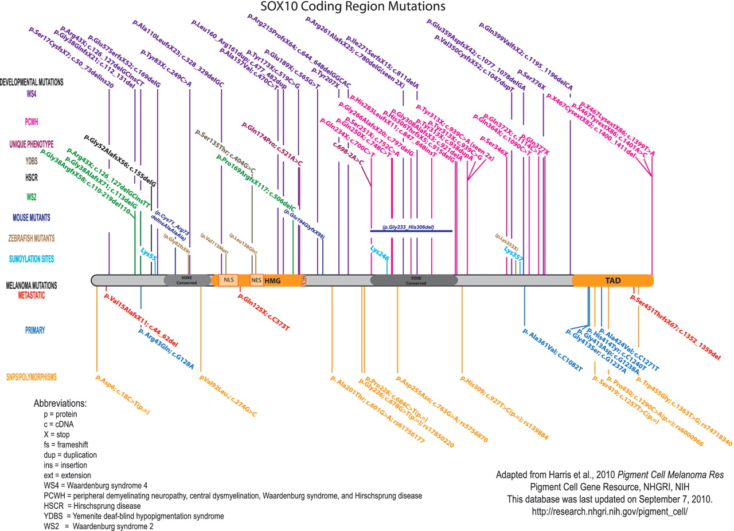
Figure 3. Published SOX10 coding region mutations and polymorphisms. For clarity, the mutations are color-coded based ...
Notes:
Figure 3. Published SOX10 coding region mutations and polymorphisms. For clarity, the mutations are color-coded based upon clinical phenotype/disorder. Human SOX10 developmental mutations are shown above the protein, and melanoma mutations and polymorphisms are shown below the protein. The orthologous changes to published mouse and zebrafish coding mutations are also shown. SOX10 nucleotide/amino acid numbering correlates with NP_008872. Mutation nomenclature is per Human Genome Variation Society guidelines (http://www.hgvs.org/mutnomen/).
Unless provided in the caption above, the following copyright applies to the content of this slide: Published by Oxford University Press 2010.This is Open Access article distributed under the terms of the Creative Commons Attribution Non-Commercial License (http://creativecommons.org/licenses/by-nc/2.5), which permits unrestricted non-commercial use, distribution, and reproduction in any medium, provided the original work is properly cited.

