Slide 1
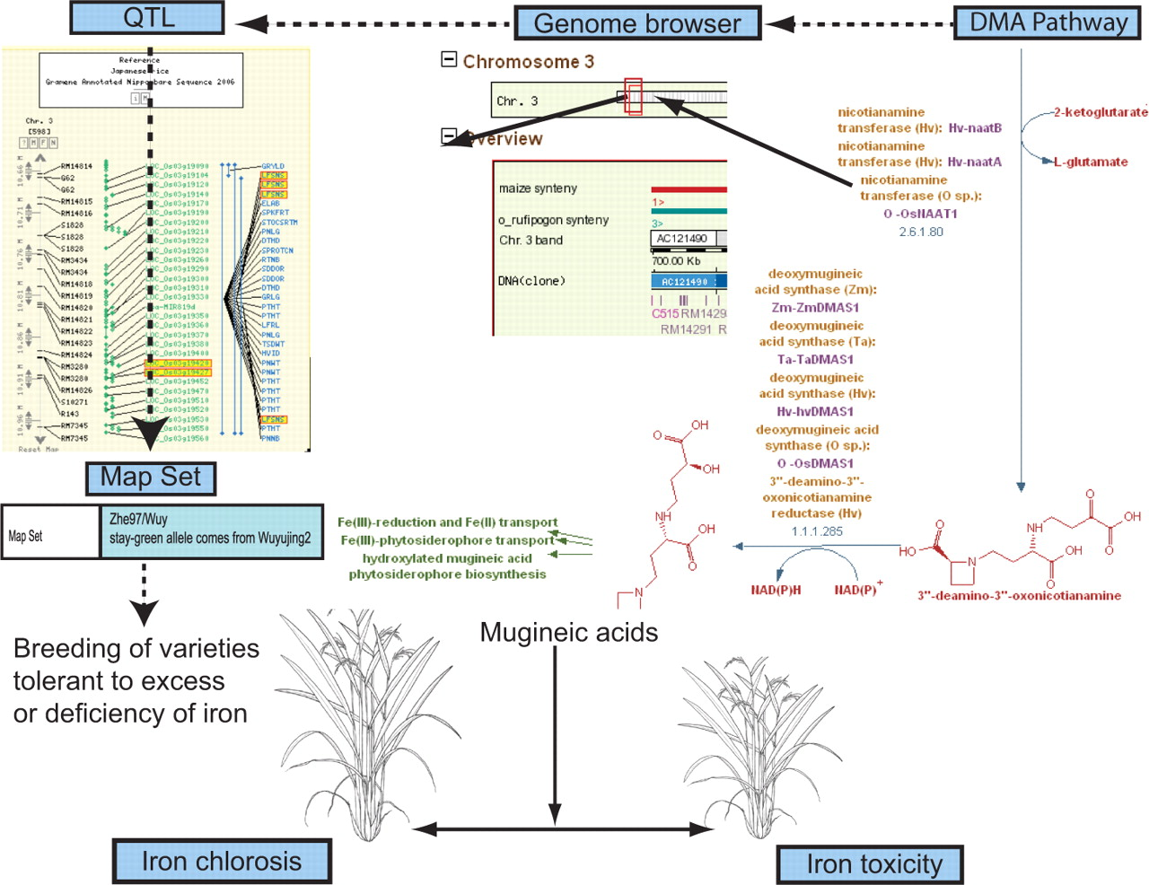
Figure 3. Iron-uptake pathway in rice: cloned gene to complex traits, via pathway, genes and QTLs. Leaf senescence QTLs ...
Notes:
Figure 3. Iron-uptake pathway in rice: cloned gene to complex traits, via pathway, genes and QTLs. Leaf senescence QTLs aligned to CMap view of rice chromosome 3 shown in the top left corner; Genome Browser view of QTL region of rice chromosome 3 with associated gene models shown in the center; DMA metabolic pathway shown in the top right; rice plants expressing iron chlorosis tolerant phenotype and iron toxicity phenotype shown at the bottom. The Mugenic acids (MAs) or phytosiderophores are end products of the DMA metabolic pathway. Biosynthesis of MAs is closely linked to iron deficiency and is highly regulated to avoid toxicity owing to excess iron uptake. The figure represents parts of the curated DMA pathway; the genomic positions of the cloned genes from this pathway are used to trace suitable QTL candidates in that region. The populations from which these QTLs were analyzed can then be used in breeding programs aimed at developing rice varieties that are tolerant to soil environments characterized by deficiencies or excesses of iron.
Unless provided in the caption above, the following copyright applies to the content of this slide: © 2009 The Author(s).This is Open Access article distributed under the terms of the Creative Commons Attribution Non-Commercial License (http://creativecommons.org/licenses/by-nc/2.0/uk/) which permits unrestricted non-commercial use, distribution, and reproduction in any medium, provided the original work is properly cited.

