Slide 1
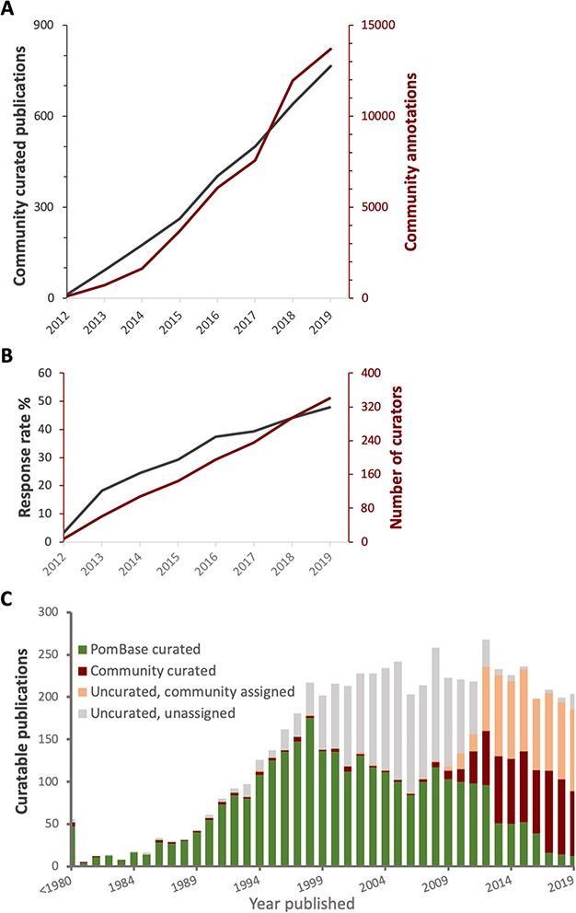
Figure 2 Curation statistics. A. Cumulative numbers of publications curated (grey) and annotations added (red) bythe ...
Notes:
Figure 2 Curation statistics. A. Cumulative numbers of publications curated (grey) and annotations added (red) bythe community over time. B. Cumulative number of new participants (red) and invitation response rate (grey) over time. C. The proportion of curatable fission yeast literature curated by PomBase staff and community, or as yet uncurated, by year published. Uncurated publications are subdivided into ‘uncurated community’ (invitation sent, no response) and ‘uncurated unassigned’ (no invitation sent—we do not send invitations for publications predating 2012).
Unless provided in the caption above, the following copyright applies to the content of this slide: © The Author(s) 2020. Published by Oxford University Press.This is an Open Access article distributed under the terms of the Creative Commons Attribution License (http://creativecommons.org/licenses/by/4.0/), which permits unrestricted reuse, distribution, and reproduction in any medium, provided the original work is properly cited.

