Slide 1
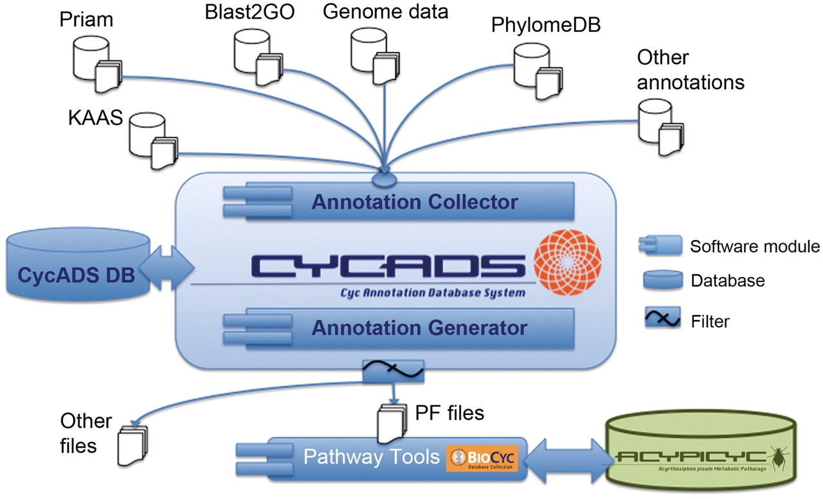
Figure 1. CycADS annotation management system workflow. Genomic information is combined in CycADS with the annotation ...
Notes:
Figure 1. CycADS annotation management system workflow. Genomic information is combined in CycADS with the annotation data obtained using different methods and the collected data are filtered to produce the PathoLogic files (PF files output) that will then be used to generate the BioCyc databases with the Pathway Tools system (PathoLogic module). The annotations can also be extracted for other applications using the filtering system (other files output).
Unless provided in the caption above, the following copyright applies to the content of this slide: © The Author(s) 2011. Published by Oxford University Press.This is Open Access article distributed under the terms of the Creative Commons Attribution Non-Commercial License (http://creativecommons.org/licenses/by-nc/2.5), which permits unrestricted non-commercial use, distribution, and reproduction in any medium, provided the original work is properly cited.

Slide 2
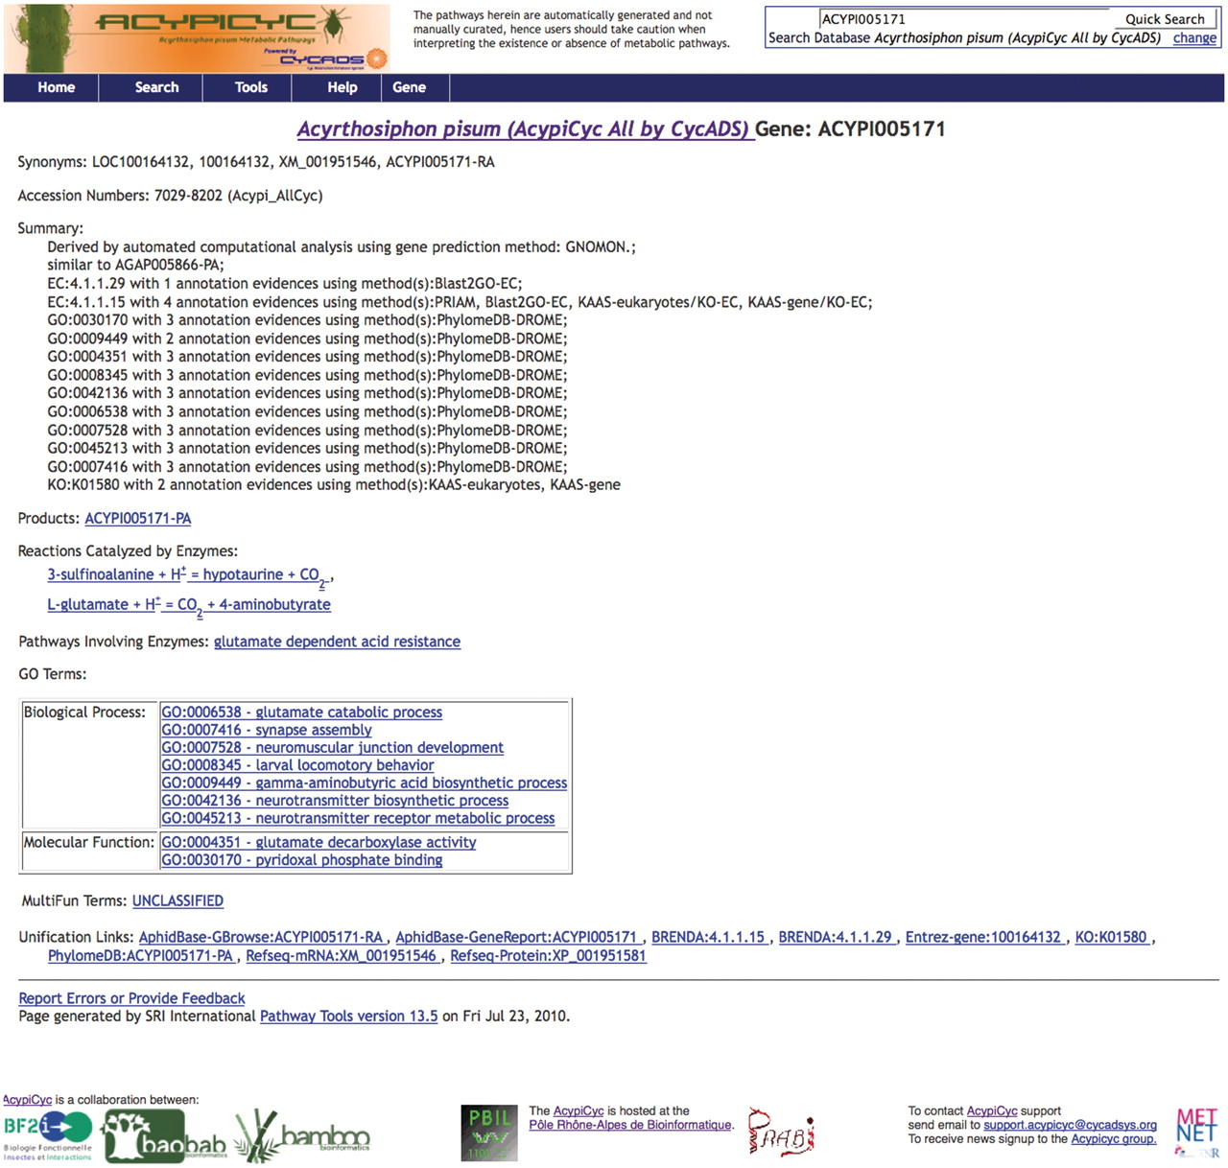
Figure 2. Screenshots of a BioCyc database generated by CycADS. An example page from AcypiCyc showing the enrichment of ...
Notes:
Figure 2. Screenshots of a BioCyc database generated by CycADS. An example page from AcypiCyc showing the enrichment of a BioCyc gene page with complementary information about the annotation source included in the ‘Summary’ and extra hyperlinks (‘Unification Links’) to important resources.
Unless provided in the caption above, the following copyright applies to the content of this slide: © The Author(s) 2011. Published by Oxford University Press.This is Open Access article distributed under the terms of the Creative Commons Attribution Non-Commercial License (http://creativecommons.org/licenses/by-nc/2.5), which permits unrestricted non-commercial use, distribution, and reproduction in any medium, provided the original work is properly cited.

Slide 3
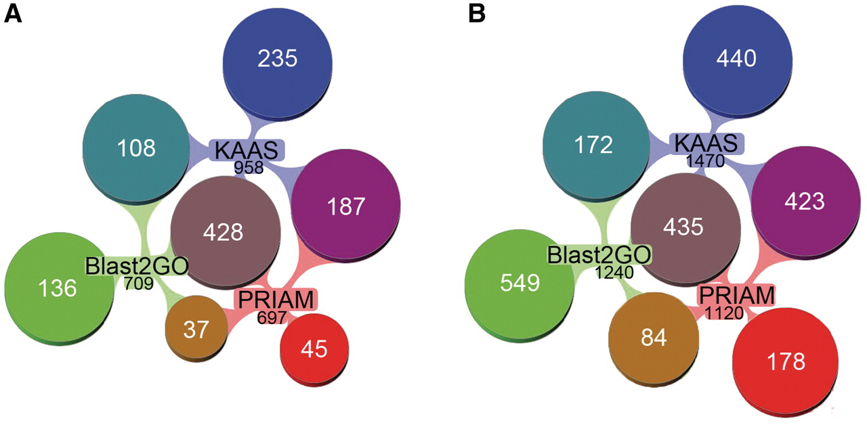
Figure 3. Comparison of the EC annotation by different methods in AcypiCyc. (A) Reaction annotation by EC methods. ...
Notes:
Figure 3. Comparison of the EC annotation by different methods in AcypiCyc. (A) Reaction annotation by EC methods. Venn-diagrams showing the number of reactions (total of 1176) identified in the metabolic reconstructions using data from the different annotation methods [PRIAM, KAAS (two methods), Blast2GO-EC], the total number of reactions annotated by each method is specified in black below the method name, while specified in white is the number of unique or shared reactions among annotations. (B) Gene annotation by EC methods. Venn-diagrams showing the number of genes (total of 2281) annotated using the different methods [colour code for annotations as in (A)]. Note: multiple genes may catalyse a single reaction. This figure was generated using Aduna Cluster Map - http://www.aduna-software.com/technology/clustermap.
Unless provided in the caption above, the following copyright applies to the content of this slide: © The Author(s) 2011. Published by Oxford University Press.This is Open Access article distributed under the terms of the Creative Commons Attribution Non-Commercial License (http://creativecommons.org/licenses/by-nc/2.5), which permits unrestricted non-commercial use, distribution, and reproduction in any medium, provided the original work is properly cited.

