Slide 1
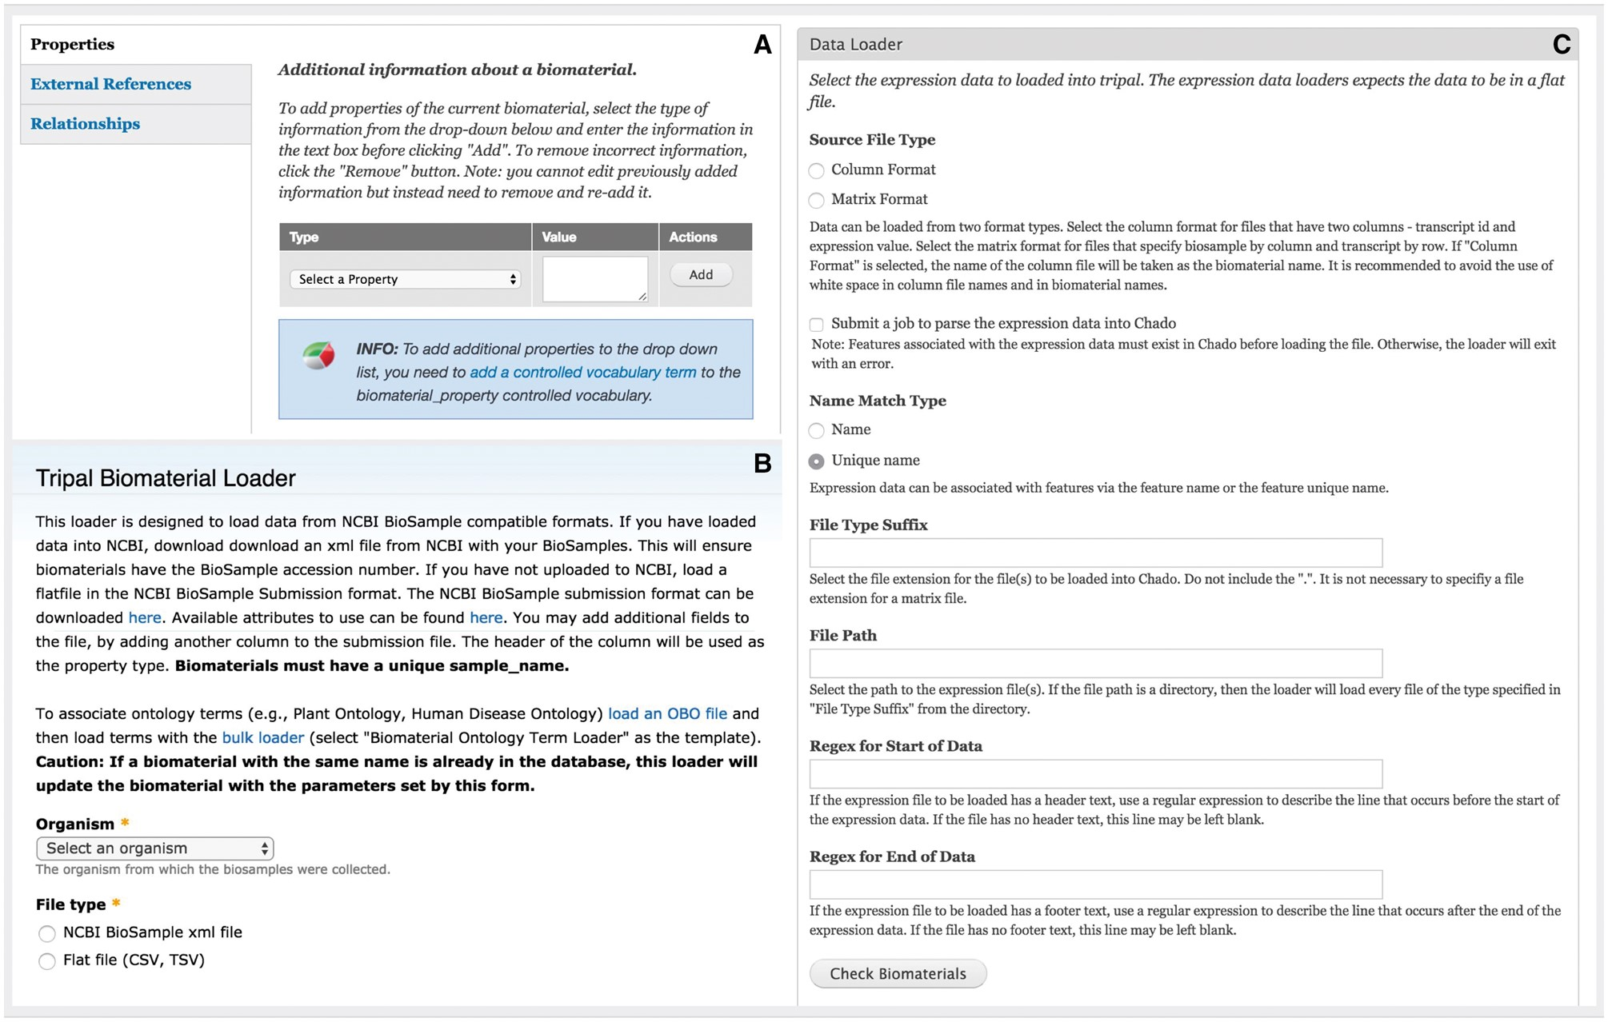
Figure 5. Administration interface of the Expression module. (A) Administrators can add customizable property fields to ...
Notes:
Figure 5. Administration interface of the Expression module. (A) Administrators can add customizable property fields to biomaterial record to provide metadata about experimental conditions, tissue, developmental stage, etc. These fields must be registered as a part of a controlled vocabulary through the core Tripal Controlled Vocabulary module. (B) The module is able to bulk load biomaterials from a CSV file or an NCBI BioSample XML formatted file. (C) The module can load expression data in column or matrix formats. These formats are described at the top of the page. The interface also allows the administrative user to specify regular expressions to exclude any header or footer text in the file that should be ignored such as column headings.
Unless provided in the caption above, the following copyright applies to the content of this slide: © The Author(s) 2017. Published by Oxford University Press.This is an Open Access article distributed under the terms of the Creative Commons Attribution License (http://creativecommons.org/licenses/by/4.0/), which permits unrestricted reuse, distribution, and reproduction in any medium, provided the original work is properly cited.

