Slide 1
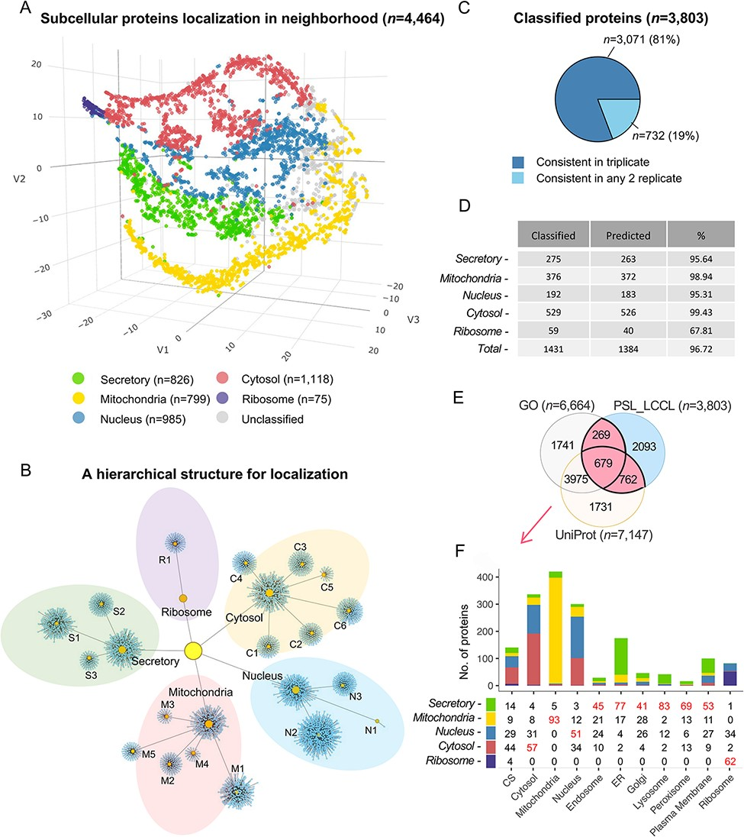
Figure 4. Subcellular localization of the identified proteins (n = 4464) at the neighborhood level. (A) A projection of ...
Notes:
Figure 4. Subcellular localization of the identified proteins (n = 4464) at the neighborhood level. (A) A projection of all identified proteins in a three-dimensional space at the neighborhood level. (B) A hierarchical network of the classification at both cluster and neighborhood levels. (C) The consistency of the classified proteins in replicate. (D) The classification accuracy of marker proteins at the neighborhood level. Classified: the number of marker proteins retained at each neighborhood level after threshold filtering; predicted: number of marker proteins correctly predicted. (E) The overlap of single-neighborhood-classified proteins and proteins annotated with a single location in GO and UniProt. (F) Evaluation of single neighborhood classified against proteins with single subcellular localization annotation from GO or UniProt.
Unless provided in the caption above, the following copyright applies to the content of this slide: © The Author(s) 2022. Published by Oxford University Press.This is an Open Access article distributed under the terms of the Creative Commons Attribution License (https://creativecommons.org/licenses/by/4.0/), which permits unrestricted reuse, distribution, and reproduction in any medium, provided the original work is properly cited.

