Slide 1
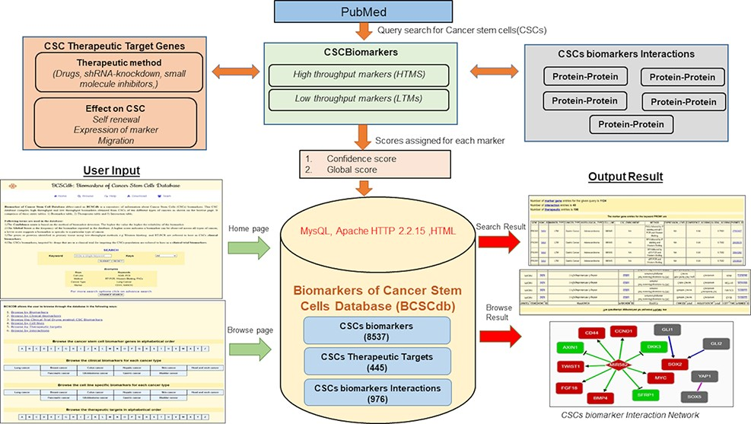
Figure 1. Schematic representation of the workflow of BCSCdb online database and summary of data statistics.
Notes:
Figure 1. Schematic representation of the workflow of BCSCdb online database and summary of data statistics.
Unless provided in the caption above, the following copyright applies to the content of this slide: © The Author(s) 2022. Published by Oxford University Press.This is an Open Access article distributed under the terms of the Creative Commons Attribution-NonCommercial License (https://creativecommons.org/licenses/by-nc/4.0/), which permits non-commercial re-use, distribution, and reproduction in any medium, provided the original work is properly cited. For commercial re-use, please contact journals.permissions@oup.com

