Slide 1
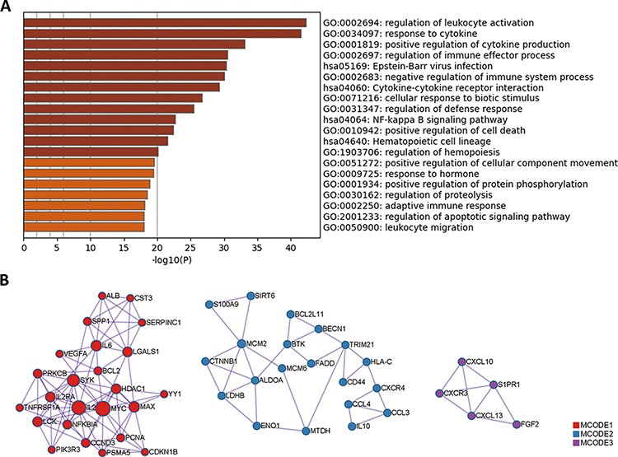
Figure 4. GO and KEGG enrichment analysis of protein biomarkers in LBD. (A) Enriched GO and KEGG pathways. (B) ...
Notes:
Figure 4. GO and KEGG enrichment analysis of protein biomarkers in LBD. (A) Enriched GO and KEGG pathways. (B) Protein–protein interaction network components identified by the MCODE algorithm. Nodes represent protein biomarkers in LBD. Edges represent the relationships between different proteins. The size of the node represents the node degree.
Unless provided in the caption above, the following copyright applies to the content of this slide: © The Author(s) 2022. Published by Oxford University Press.This is an Open Access article distributed under the terms of the Creative Commons Attribution-NonCommercial License (https://creativecommons.org/licenses/by-nc/4.0/), which permits non-commercial re-use, distribution, and reproduction in any medium, provided the original work is properly cited. For commercial re-use, please contact journals.permissions@oup.com

