Slide 1
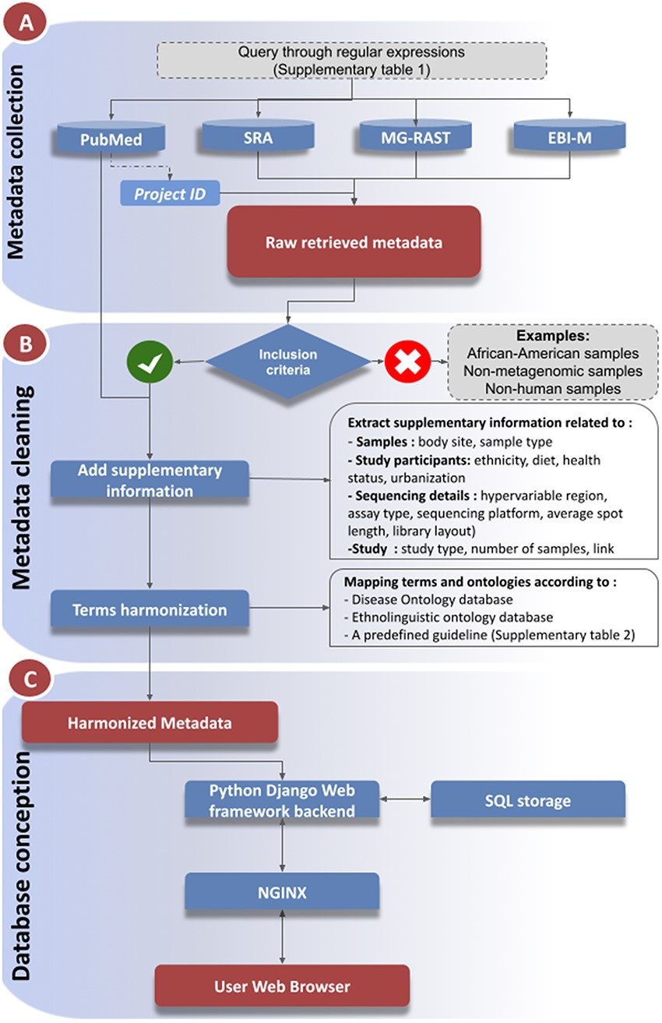
Figure 1. Workflow of metadata collection and database integration. (A): Metadata collection: Metadata were collected ...
Notes:
Figure 1. Workflow of metadata collection and database integration. (A): Metadata collection: Metadata were collected from a number of public data repositories. Metadata completion and cleaning (B): The metadata were cleaned, enriched with supplementary information collected from the associated publications, prior to harmonization steps (C): Database and web service constructions. Alt text Figure 1: Metadata collection and database integration workflow.
Unless provided in the caption above, the following copyright applies to the content of this slide: © The Author(s) 2024. Published by Oxford University Press.This is an Open Access article distributed under the terms of the Creative Commons Attribution License (https://creativecommons.org/licenses/by/4.0/), which permits unrestricted reuse, distribution, and reproduction in any medium, provided the original work is properly cited.

