Slide 1
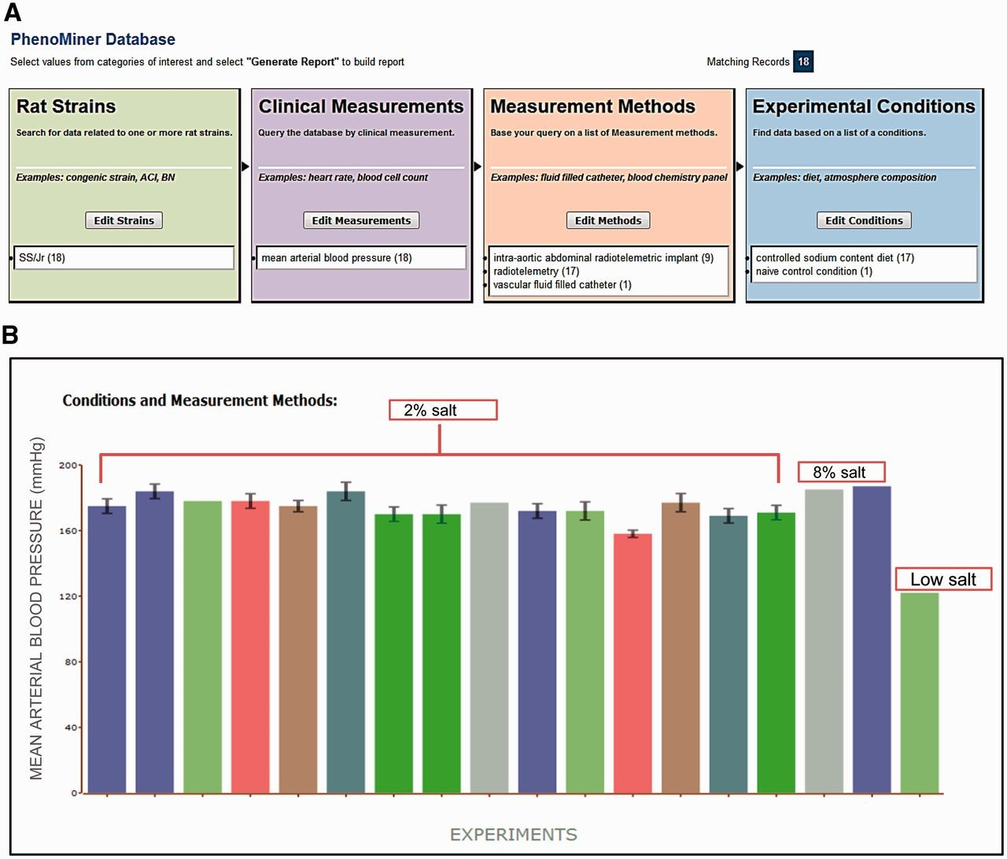
Figure 1. ( A ) Final search page before generating a report in PhenoMiner. A total of 18 records were retrieved by ...
Notes:
Figure 1. ( A ) Final search page before generating a report in PhenoMiner. A total of 18 records were retrieved by limiting data to four ontologies: Rat Strain, Clinical Measurement, Measurement Method and Experimental Condition. The record distribution in each ontology is shown in parentheses following the term. ( B ) Chart display of MAP data set generated in PhenoMiner. These records are from SS/Jr (RGD: 10041) on controlled sodium content diets: low, 2%, or 8%. Each bar represents one experiment and the experimental conditions and measurement methods associated with the experiment are color coded and explained under “Conditions and Measurement Methods.” To simplify the display, these experimental details of each bar are omitted. (Data accessed June 2014)
Unless provided in the caption above, the following copyright applies to the content of this slide: © The Author(s) 2015. Published by Oxford University Press.This is an Open Access article distributed under the terms of the Creative Commons Attribution License (http://creativecommons.org/licenses/by/4.0/), which permits unrestricted reuse, distribution, and reproduction in any medium, provided the original work is properly cited.

Slide 2
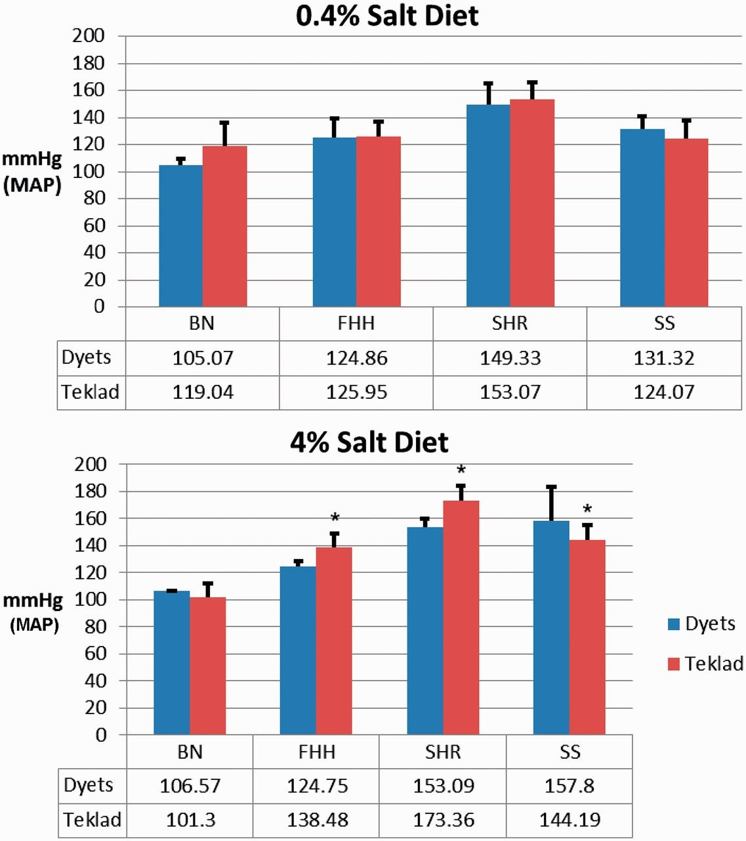
Figure 2. Effect of diet sources on MAP in four rat strains: BN, FHH, SHR and SS. Top: MAP was measured in rats on ...
Notes:
Figure 2. Effect of diet sources on MAP in four rat strains: BN, FHH, SHR and SS. Top: MAP was measured in rats on 0.4% salt-containing chows from Dyets or Teklad. Bottom: MAP was measured in rats on 4% salt-containing chows from Dyets or Teklad. Data for each strain were downloaded from PhenoMiner. The official nomenclature for the rat strains shown are BN/NHsdMcwi (BN), FHH/EurMcwi (FHH), SHR/NCrl (SHR) and SS/JrHsdMcwi (SS). Data tables underneath the charts show the mean values of each group. * P < 0.05 vs. same strain on Dyets chow.
Unless provided in the caption above, the following copyright applies to the content of this slide: © The Author(s) 2015. Published by Oxford University Press.This is an Open Access article distributed under the terms of the Creative Commons Attribution License (http://creativecommons.org/licenses/by/4.0/), which permits unrestricted reuse, distribution, and reproduction in any medium, provided the original work is properly cited.

Slide 3
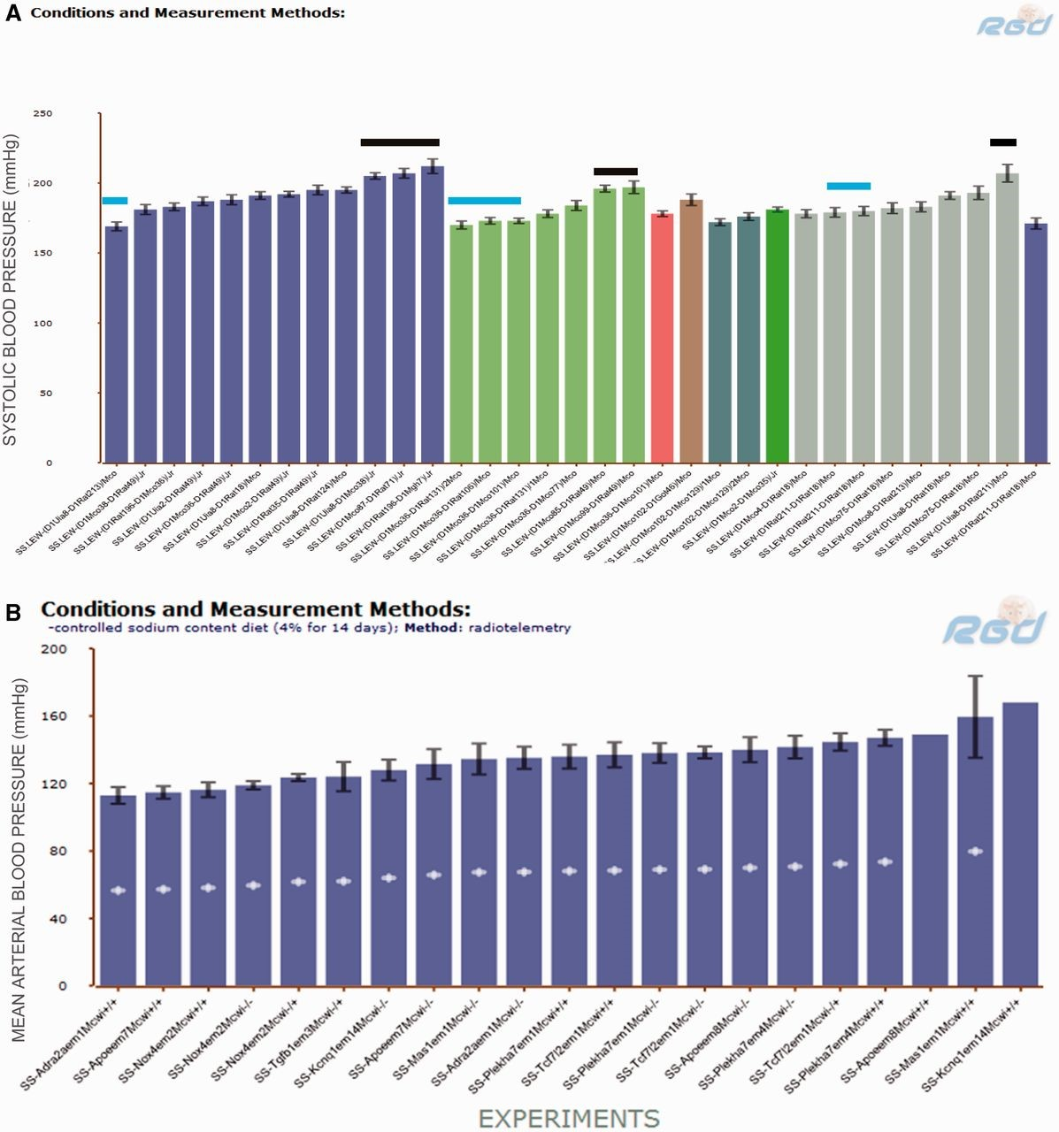
Figure 3. ( A ) SBP of SS.LEW congenic rats from PhenoMiner. Black horizontal bars indicate congenics that had ...
Notes:
Figure 3. ( A ) SBP of SS.LEW congenic rats from PhenoMiner. Black horizontal bars indicate congenics that had comparable SBP to the parents and blue horizontal bars indicate congenics that had lower SBP than the parents. ( B ) MAP of SS chromosome 1 mutants from PhenoMiner. −\−, homozygous mutant; −\+, heterozygous mutant; +\+, wild-type control.
Unless provided in the caption above, the following copyright applies to the content of this slide: © The Author(s) 2015. Published by Oxford University Press.This is an Open Access article distributed under the terms of the Creative Commons Attribution License (http://creativecommons.org/licenses/by/4.0/), which permits unrestricted reuse, distribution, and reproduction in any medium, provided the original work is properly cited.

Slide 4
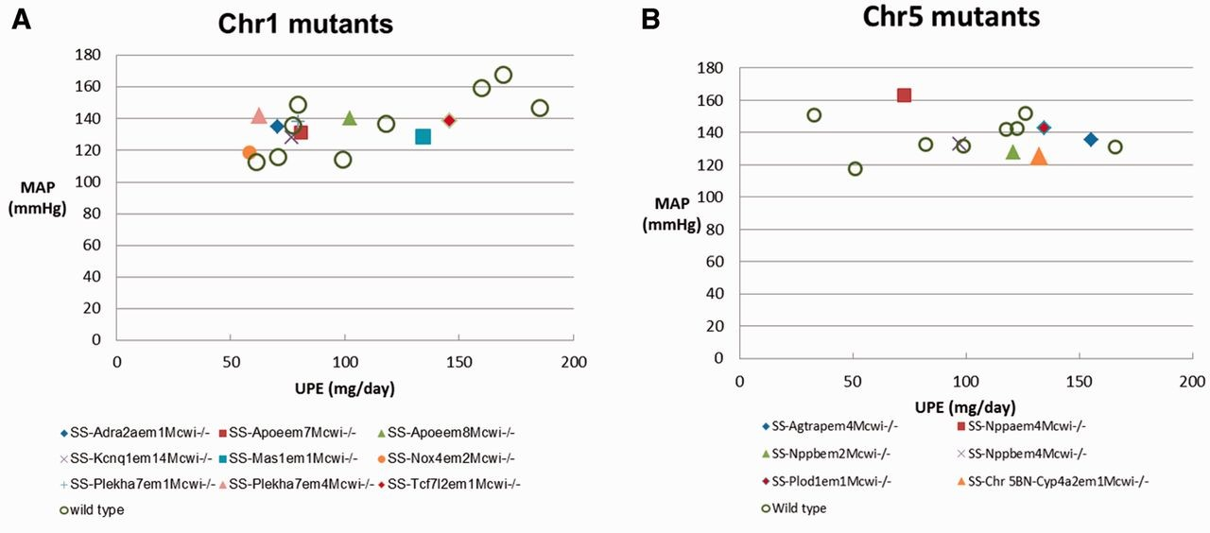
Figure 4. Scatterplots of daily UPE and MAP in SS mutants and wild-type controls on a 4% salt diet. Each data point is ...
Notes:
Figure 4. Scatterplots of daily UPE and MAP in SS mutants and wild-type controls on a 4% salt diet. Each data point is the average for a rat strain. Details are downloadable from the expanded data tables in PhenoMiner.
Unless provided in the caption above, the following copyright applies to the content of this slide: © The Author(s) 2015. Published by Oxford University Press.This is an Open Access article distributed under the terms of the Creative Commons Attribution License (http://creativecommons.org/licenses/by/4.0/), which permits unrestricted reuse, distribution, and reproduction in any medium, provided the original work is properly cited.

