Slide 1
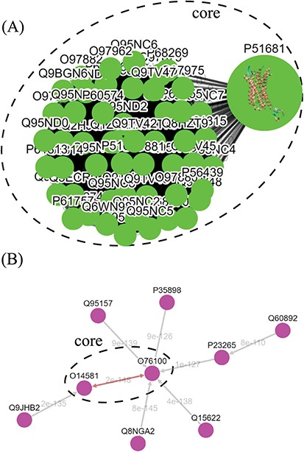
Figure 5 Tree diagrams of the first-level GPCR clusters, showing member sequences of cluster Pe001, which has a ...
Notes:
Figure 5 Tree diagrams of the first-level GPCR clusters, showing member sequences of cluster Pe001, which has a conservative core (A); and member sequences of cluster Ol001, which has no conservative core (B). In (A), the 3D protein structure of P51681 is displayed in its node, and a line segment is used to represent a zero-distance edge connecting two nodes in the core. In (B), a double-headed arrow is used to represent the shortest edge connecting two nodes in the core, and a single-headed arrow (directed toward the node closer to the core) is used to represent all other edges connecting two nodes in the cluster. Each edge is labeled with its length.
Unless provided in the caption above, the following copyright applies to the content of this slide: © The Author(s) 2019. Published by Oxford University Press.This is an Open Access article distributed under the terms of the Creative Commons Attribution License (http://creativecommons.org/licenses/by/4.0/), which permits unrestricted reuse, distribution, and reproduction in any medium, provided the original work is properly cited.

