Slide 1
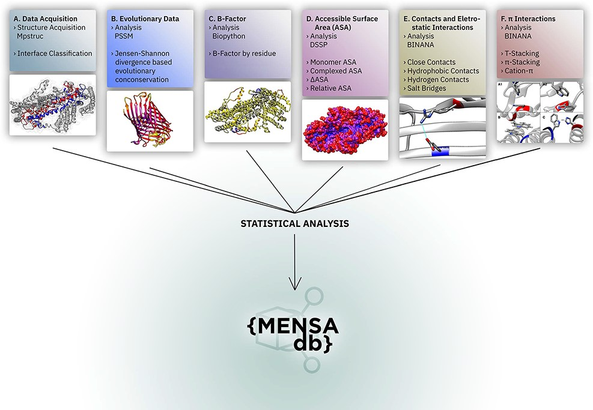
Figure 1. Overall representation of MENSAdb. Boxes A–F illustrate the steps involving the data collection, evolutionary ...
Notes:
Figure 1. Overall representation of MENSAdb. Boxes A–F illustrate the steps involving the data collection, evolutionary conservation, B-factor, accessible surface and PPI analysis. Each box contains an example of the proteinic motifs under the scope of this work. (A) Interface between chains A and B of the STRA6 receptor for retinol uptake in Danio rerio (PDBid: 5SY1) (55). (B) Representation of evolutionary conservation of protein motifs (purple being more conserved and yellow less conserved) in the chain P of a hedgehog auto-processing domain in Drosophila melanogaster (PDBid: 1AT0) (56). (C) and (D) Average B-factor and complexed accessible surface area, respectively, of the chains A and B of 5SY1 (55). (E) Salt bridge between GLU120 and ARG161 of the chain Q of the sucrose-specific porin (PDBid: 1A0T) of Salmonella typhimurium (57). (F) The spectrum of π systems predicted: (A1 and A2) T-stacking motif between TRP25 (chain L) and TRP255 (chain M) from Rattus norvegicus S100B protein (PDBid: 1XYD) (58) is represented from two perspectives; (B) illustration of a π–π stacking structure between TRP262 (chain A) and TRP262 (chain B) from Archaeoglobus fulgidus CDP-alcohol phosphotransferase (PDBid: 4O6M) (59) and (C) cation–π interaction between HIS275 (chain B) and TRP175 (chain C) from Escherichia coli formate dehydrogenase-N (PDNid: 1KQF) (60).
Unless provided in the caption above, the following copyright applies to the content of this slide: © The Author(s) 2021. Published by Oxford University Press.This is an Open Access article distributed under the terms of the Creative Commons Attribution License (http://creativecommons.org/licenses/by/4.0/), which permits unrestricted reuse, distribution, and reproduction in any medium, provided the original work is properly cited.

