Slide 1
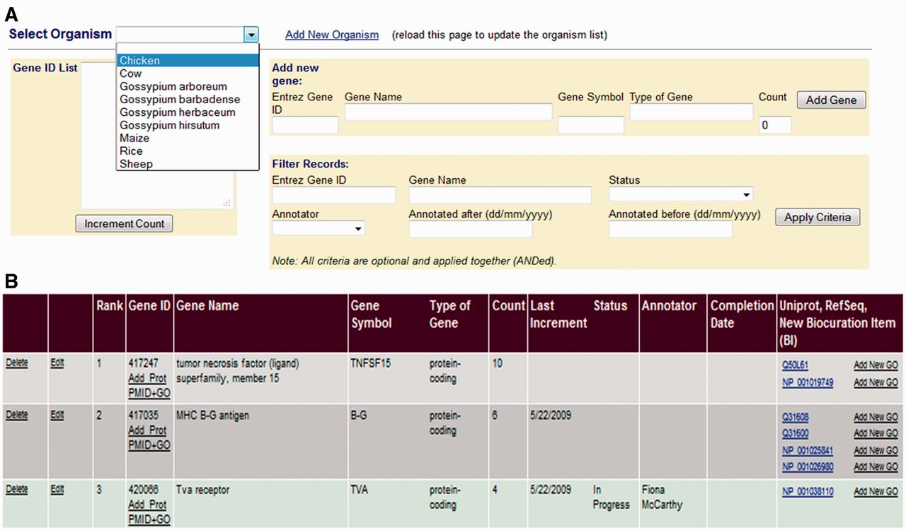
Figure 2 The GP Interface. The GP Interface is used to direct biocurator’s annotation to genes that the community see ...
Notes:
Figure 2 The GP Interface. The GP Interface is used to direct biocurator’s annotation to genes that the community see as requiring annotation. Genes are prioritized separately for each species (A), and each species has a searchable, ranked list where genes are ranked based on requests for annotation and presence on commonly used array. Each gene is linked its gene products in the biocuration interface (B) so that the biocurator can move seamlessly to annotation.
Unless provided in the caption above, the following copyright applies to the content of this slide: © The Author(s) 2012. Published by Oxford University Press.This is an Open Access article distributed under the terms of the Creative Commons Attribution License (http://creativecommons.org/licenses/by-nc/3.0/), which permits non-commercial reuse, distribution, and reproduction in any medium, provided the original work is properly cited. For commercial re-use, please contact journals.permissions@oup.com.

Slide 2
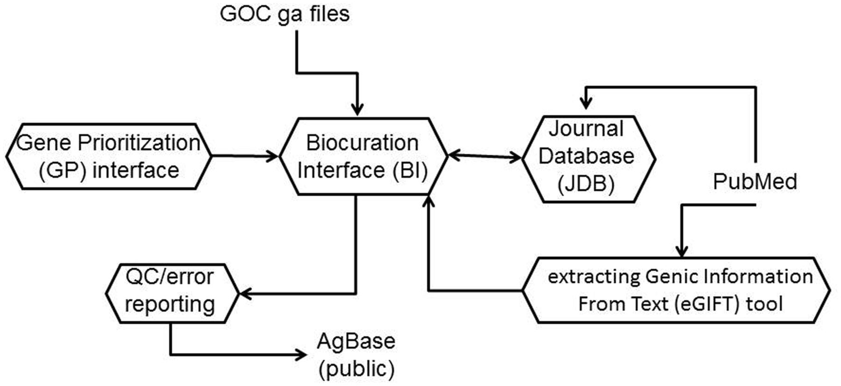
Figure 1 The AgBase biocuration pipeline. The AgBase biocuration pipeline draws from GO Consortium gene association ...
Notes:
Figure 1 The AgBase biocuration pipeline. The AgBase biocuration pipeline draws from GO Consortium gene association files and from PubMed data, and the output is the AgBase public gene association files. Briefly, genes to be annotated are prioritized as a ranked list in the GP interface, which are linked to records in the main BI. The eGIFT tool enhances the ability for biocurators to identify and curate appropriate literature while the JDB records reviewed literature. Biocuration must pass standard GO Consortium error and quality checks before public release.
Unless provided in the caption above, the following copyright applies to the content of this slide: © The Author(s) 2012. Published by Oxford University Press.This is an Open Access article distributed under the terms of the Creative Commons Attribution License (http://creativecommons.org/licenses/by-nc/3.0/), which permits non-commercial reuse, distribution, and reproduction in any medium, provided the original work is properly cited. For commercial re-use, please contact journals.permissions@oup.com.

Slide 3
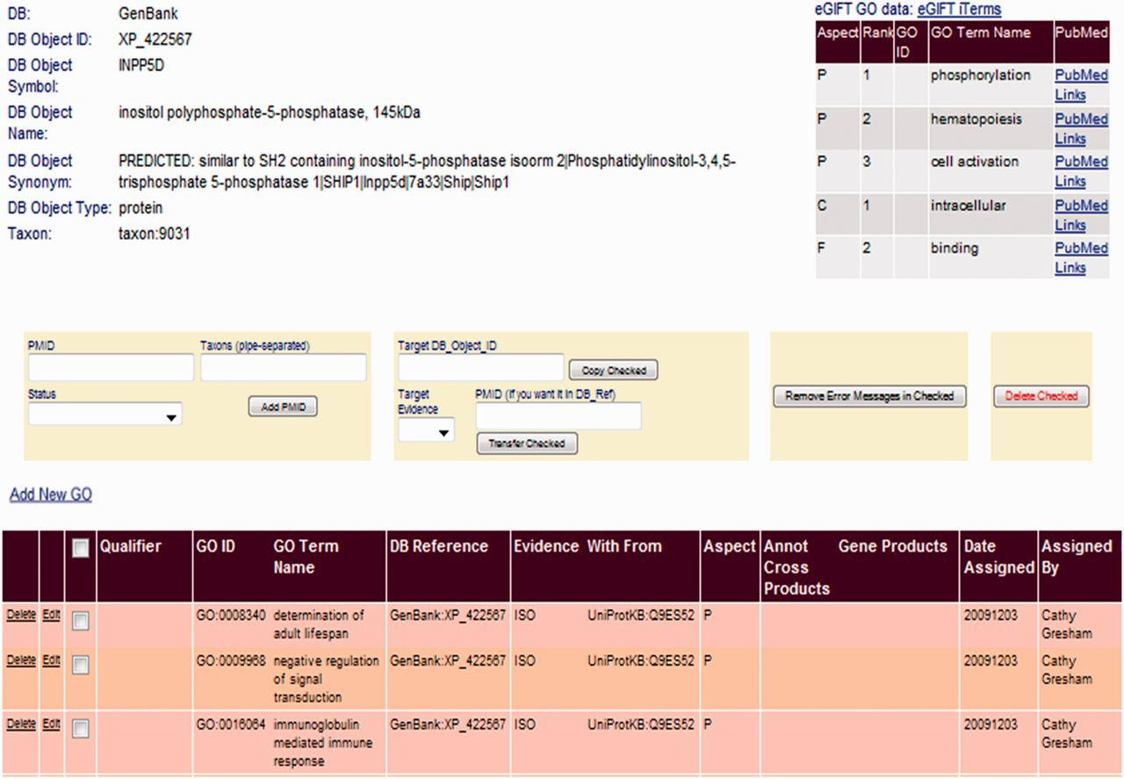
Figure 3 Linking eGIFT to the AgBase BI. A summary of eGIFT GO terms and links to corresponding literature is ...
Notes:
Figure 3 Linking eGIFT to the AgBase BI. A summary of eGIFT GO terms and links to corresponding literature is displayed in the top right hand corner of each gene product page in the AgBase BI. This table allows biocurators to rapidly identify potential new GO Terms and link out to relevant literature.
Unless provided in the caption above, the following copyright applies to the content of this slide: © The Author(s) 2012. Published by Oxford University Press.This is an Open Access article distributed under the terms of the Creative Commons Attribution License (http://creativecommons.org/licenses/by-nc/3.0/), which permits non-commercial reuse, distribution, and reproduction in any medium, provided the original work is properly cited. For commercial re-use, please contact journals.permissions@oup.com.

Slide 4
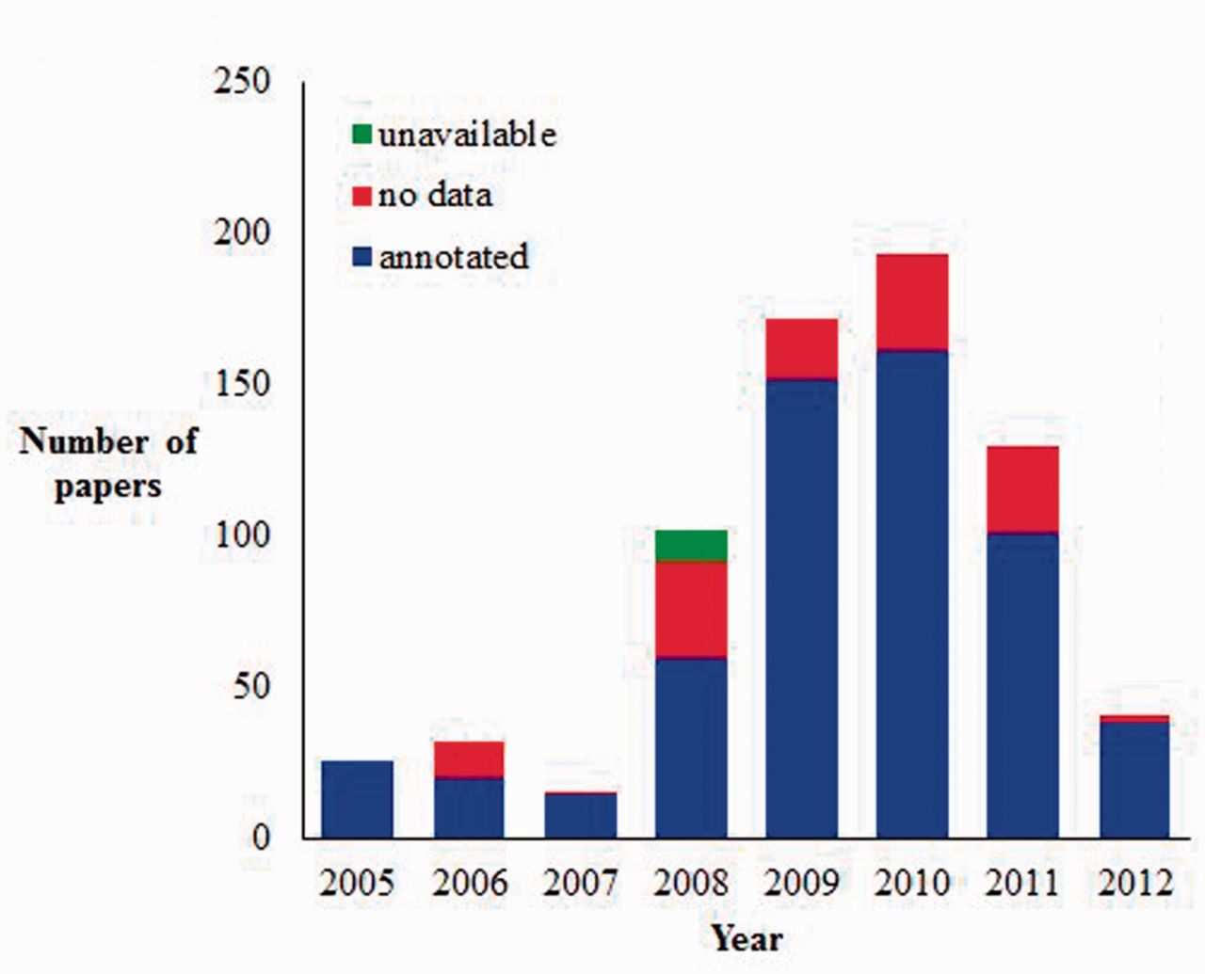
Figure 4 Current AgBase JDB statistics (as of July 2012). AgBase biocurators record the articles they look at for ...
Notes:
Figure 4 Current AgBase JDB statistics (as of July 2012). AgBase biocurators record the articles they look at for biocuration in JDB and classify them as annotated (contain information they annotate to the GO), no data (contain no GO data) or unavailable (likely to have GO data but unable to obtain full article for curation).
Unless provided in the caption above, the following copyright applies to the content of this slide: © The Author(s) 2012. Published by Oxford University Press.This is an Open Access article distributed under the terms of the Creative Commons Attribution License (http://creativecommons.org/licenses/by-nc/3.0/), which permits non-commercial reuse, distribution, and reproduction in any medium, provided the original work is properly cited. For commercial re-use, please contact journals.permissions@oup.com.

Slide 5
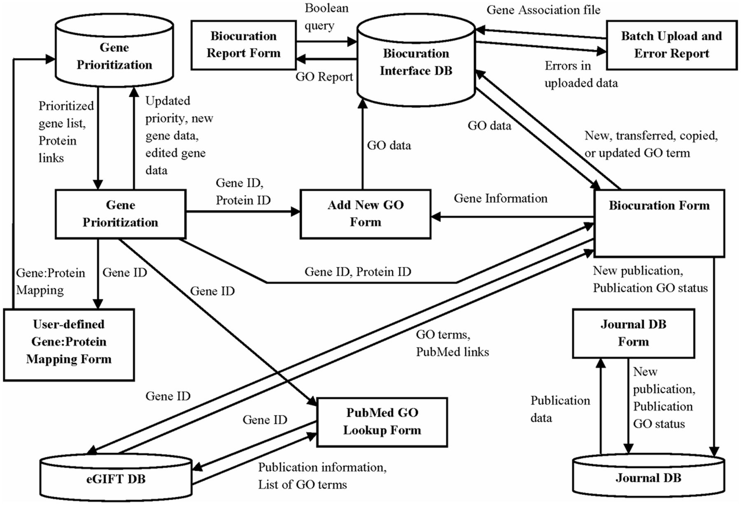
Figure 5 The AgBase annotation workflow is supported by three underlying databases. This schema shows the GP, BI and ...
Notes:
Figure 5 The AgBase annotation workflow is supported by three underlying databases. This schema shows the GP, BI and JDB (cylinders), the information they contribute to interface forms (squares) and the data from each database used to create these interfaces (arrows).
Unless provided in the caption above, the following copyright applies to the content of this slide: © The Author(s) 2012. Published by Oxford University Press.This is an Open Access article distributed under the terms of the Creative Commons Attribution License (http://creativecommons.org/licenses/by-nc/3.0/), which permits non-commercial reuse, distribution, and reproduction in any medium, provided the original work is properly cited. For commercial re-use, please contact journals.permissions@oup.com.

