Slide 1
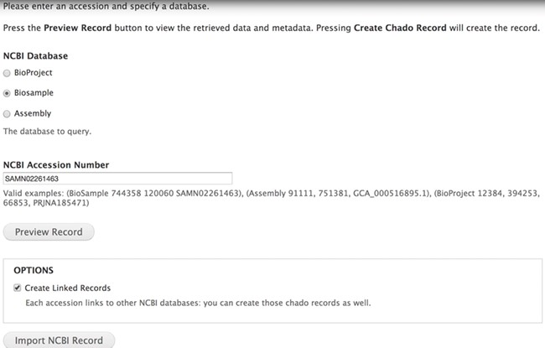
Figure 1 The Tripal EUtils accession importer. Administrators select a database and provide a numeric uid or mixed ...
Notes:
Figure 1 The Tripal EUtils accession importer. Administrators select a database and provide a numeric uid or mixed accession. Clicking the Preview button lists all the fields, properties and additional links found in the record. Each record links back to NCBI. Administrators can choose to only import the single record or to also insert records linked to that primary record. In this example, BioSample accession SAMN02261463 will be inserted into Chado.
Unless provided in the caption above, the following copyright applies to the content of this slide: Published by Oxford University Press 2020.This work is written by US Government employees and is in the public domain in the US.

