Slide 1
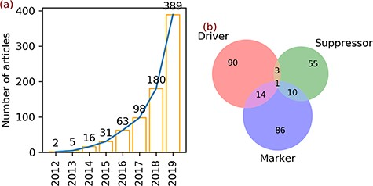
Figure 1 Articles and gene annotation. (a) The increasing trend in the number of ferroptosis articles in PubMed. (b) ...
Notes:
Figure 1 Articles and gene annotation. (a) The increasing trend in the number of ferroptosis articles in PubMed. (b) Intersection of three annotation data sets of genes.
Unless provided in the caption above, the following copyright applies to the content of this slide: © The Author(s) 2020. Published by Oxford University Press.This is an Open Access article distributed under the terms of the Creative Commons Attribution License (http://creativecommons.org/licenses/by/4.0/), which permits unrestricted reuse, distribution, and reproduction in any medium, provided the original work is properly cited.

Slide 2
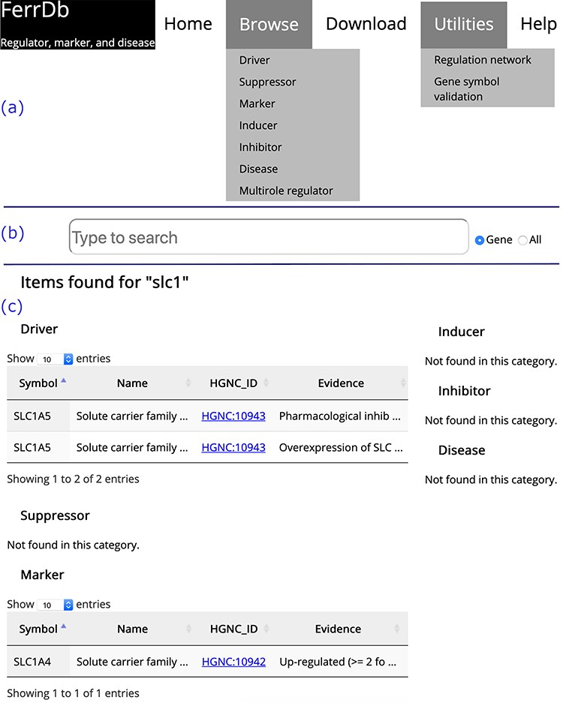
Figure 2 Overview of the FerrDb interface. (a) Navigation bar. (b) Search box. (c) Results of an example search. ...
Notes:
Figure 2 Overview of the FerrDb interface. (a) Navigation bar. (b) Search box. (c) Results of an example search. Tables in (c) are truncated.
Unless provided in the caption above, the following copyright applies to the content of this slide: © The Author(s) 2020. Published by Oxford University Press.This is an Open Access article distributed under the terms of the Creative Commons Attribution License (http://creativecommons.org/licenses/by/4.0/), which permits unrestricted reuse, distribution, and reproduction in any medium, provided the original work is properly cited.

Slide 3
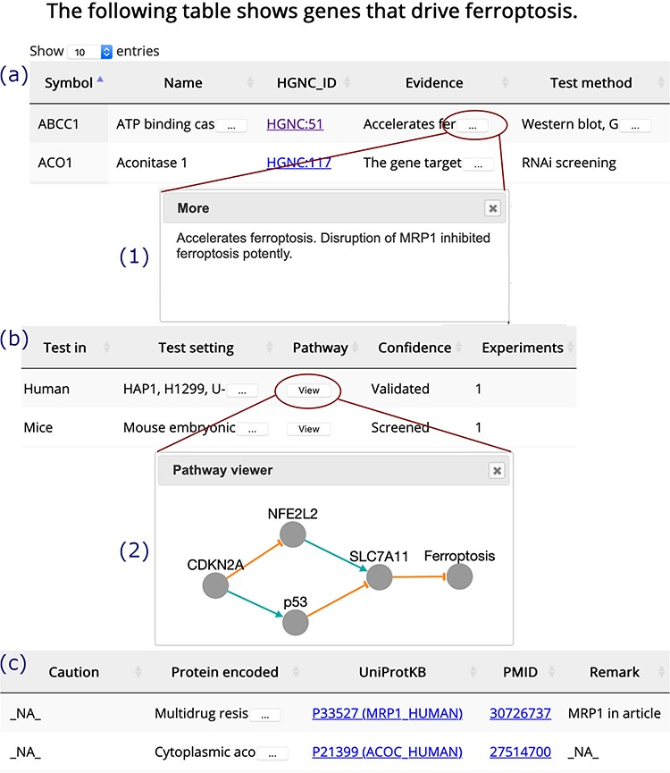
Figure 3 A browser page of drivers. Table columns are split into three parts, (a), (b) and (c). Inset (1) shows the ...
Notes:
Figure 3 A browser page of drivers. Table columns are split into three parts, (a), (b) and (c). Inset (1) shows the whole content of truncated text. Inset (2) visualizes the regulation pathway of an example gene. The orange T-shaped edge denotes suppression, and the green arrow denotes promotion.
Unless provided in the caption above, the following copyright applies to the content of this slide: © The Author(s) 2020. Published by Oxford University Press.This is an Open Access article distributed under the terms of the Creative Commons Attribution License (http://creativecommons.org/licenses/by/4.0/), which permits unrestricted reuse, distribution, and reproduction in any medium, provided the original work is properly cited.

Slide 4
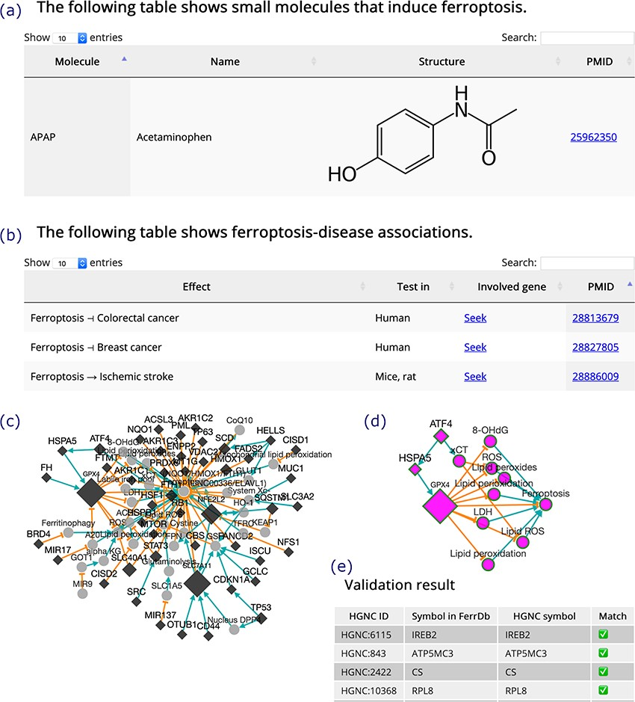
Figure 4 (a) An inducer. (b) Ferroptosis-disease associations. The T-shaped line denotes alleviation, while the arrow ...
Notes:
Figure 4 (a) An inducer. (b) Ferroptosis-disease associations. The T-shaped line denotes alleviation, while the arrow denotes aggravation. (c) Regulation network. Diamonds denote regulators of ferroptosis. Circles denote unclassified regulatory elements. Orange T-shaped lines denote inhibition. Green arrows denote promotion. Node size represents the number of experiments, where larger nodes reflect a greater number of experiments. (d) Sub-network of ATF4, shown as an example. (e) A truncated result table of gene symbol validation. The white check mark in green box indicates success of validation. The red cross indicates failure of validation.
Unless provided in the caption above, the following copyright applies to the content of this slide: © The Author(s) 2020. Published by Oxford University Press.This is an Open Access article distributed under the terms of the Creative Commons Attribution License (http://creativecommons.org/licenses/by/4.0/), which permits unrestricted reuse, distribution, and reproduction in any medium, provided the original work is properly cited.

Slide 5
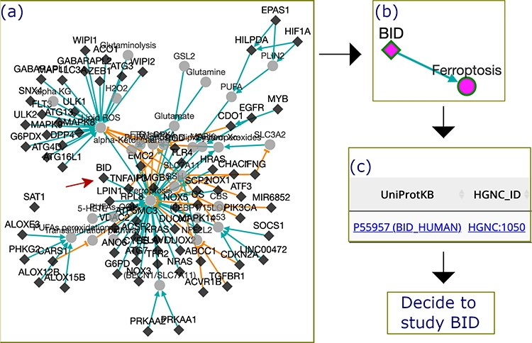
Figure 5 The process by which FerrDb was used to identify BID as a valuable gene for future study. (a) A regulation ...
Notes:
Figure 5 The process by which FerrDb was used to identify BID as a valuable gene for future study. (a) A regulation network integrating drivers’ pathways. Drivers with more than one experiment were removed from the network. (b) BID pathway in ferroptosis. (c) Links to BID resources.
Unless provided in the caption above, the following copyright applies to the content of this slide: © The Author(s) 2020. Published by Oxford University Press.This is an Open Access article distributed under the terms of the Creative Commons Attribution License (http://creativecommons.org/licenses/by/4.0/), which permits unrestricted reuse, distribution, and reproduction in any medium, provided the original work is properly cited.

