Slide 1
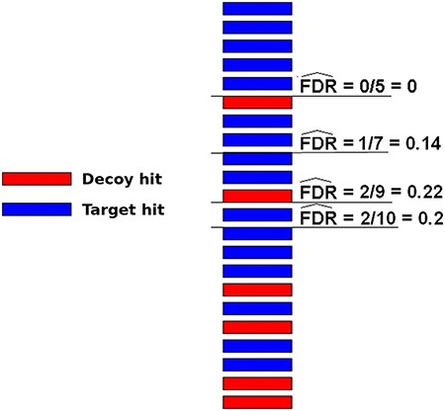
Figure 3. Illustration of how FDRs can be estimated using a composite target-decoy DB (from the work describing the ...
Notes:
Figure 3. Illustration of how FDRs can be estimated using a composite target-decoy DB (from the work describing the method MUMAL by Cerqueira et al. (52)). In this example, only one score (univariate analysis) is used. The hits are presented in descending order, i.e. the highest score is on top. For a given threshold value, the number of decoy hits with score greater or equal to this value is used to estimate the number of wrong matches among target hits obtained using the same threshold.
Unless provided in the caption above, the following copyright applies to the content of this slide: © The Author(s) 2020. Published by Oxford University Press.This is an Open Access article distributed under the terms of the Creative Commons Attribution License (http://creativecommons.org/licenses/by/4.0/), which permits unrestricted reuse, distribution, and reproduction in any medium, provided the original work is properly cited.

