Slide 1
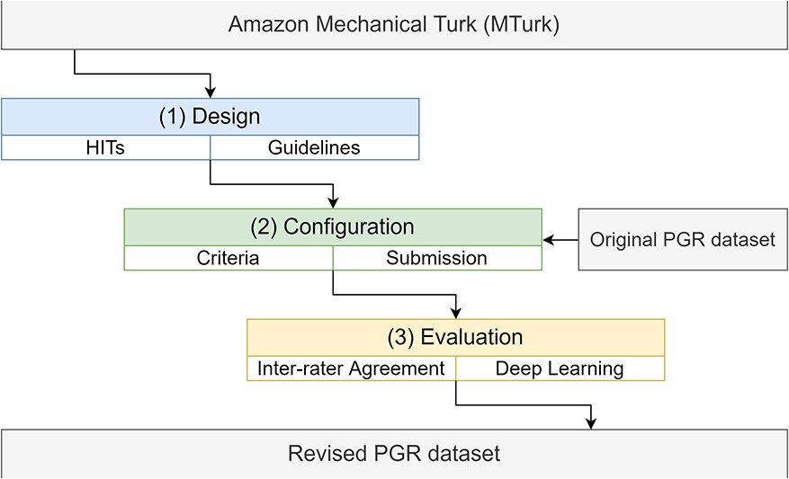
Figure 1. The pipeline to incorporate the PGR dataset into the Amazon MTurk platform, including the design, ...
Notes:
Figure 1. The pipeline to incorporate the PGR dataset into the Amazon MTurk platform, including the design, configuration and evaluation stages.
Unless provided in the caption above, the following copyright applies to the content of this slide: © The Author(s) 2020. Published by Oxford University Press.This is an Open Access article distributed under the terms of the Creative Commons Attribution License (http://creativecommons.org/licenses/by/4.0/), which permits unrestricted reuse, distribution, and reproduction in any medium, provided the original work is properly cited.

