Slide 1
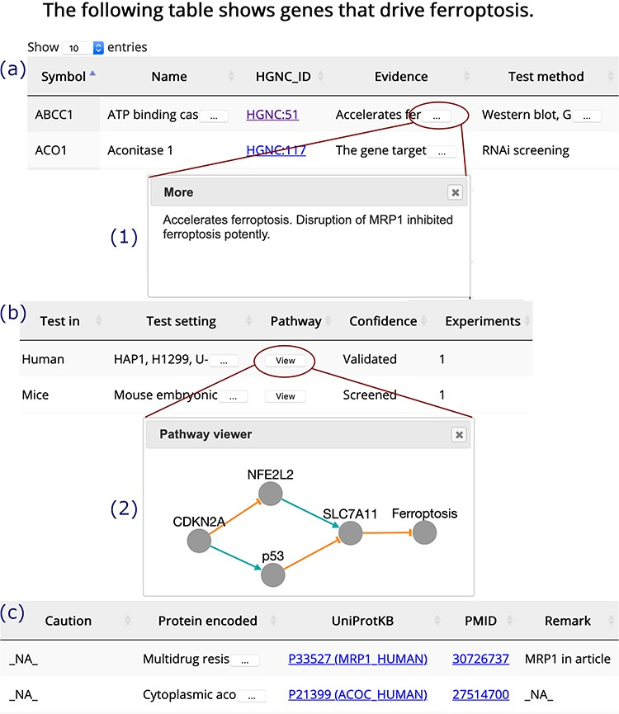
Figure 3 A browser page of drivers. Table columns are split into three parts, (a), (b) and (c). Inset (1) shows the ...
Notes:
Figure 3 A browser page of drivers. Table columns are split into three parts, (a), (b) and (c). Inset (1) shows the whole content of truncated text. Inset (2) visualizes the regulation pathway of an example gene. The orange T-shaped edge denotes suppression, and the green arrow denotes promotion.
Unless provided in the caption above, the following copyright applies to the content of this slide: © The Author(s) 2020. Published by Oxford University Press.This is an Open Access article distributed under the terms of the Creative Commons Attribution License (http://creativecommons.org/licenses/by/4.0/), which permits unrestricted reuse, distribution, and reproduction in any medium, provided the original work is properly cited.

