Slide 1
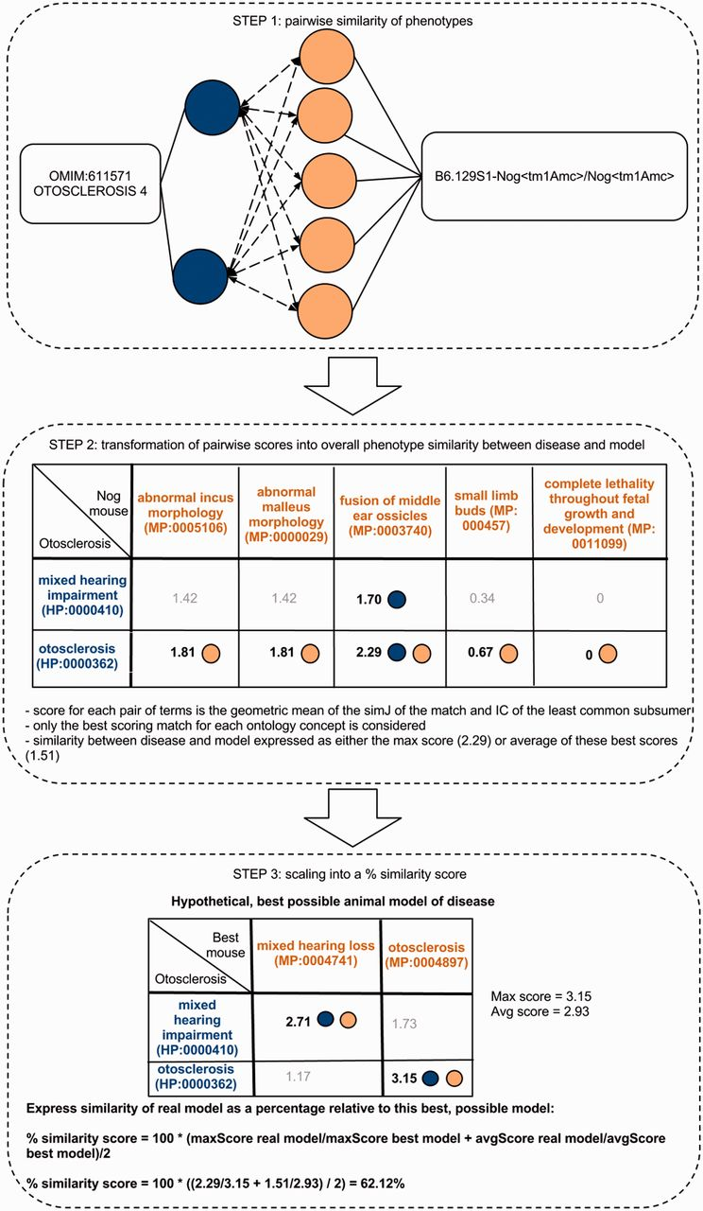
Figure 1. Determining the phenotype similarity of two entities, e.g. a mouse model and a disease, is a three-step ...
Notes:
Figure 1. Determining the phenotype similarity of two entities, e.g. a mouse model and a disease, is a three-step process in our method. The first step is the alignment of ontology concepts based on OWLSim and assigning scores to individual pairs of ontology concepts as illustrated in the top panel of this figure. In a second step, the best scoring matches for each of the annotated ontology concepts are identified and the overall phenotype similarity score described as either the maximum or mean of these scores. In a third step, we scale these two measures relative to their maximum possible values and calculate a single combined percentage score.
Unless provided in the caption above, the following copyright applies to the content of this slide: © The Author(s) 2013. Published by Oxford University Press.This is an Open Access article distributed under the terms of the Creative Commons Attribution Non-Commercial License (http://creativecommons.org/licenses/by-nc/3.0/), which permits non-commercial re-use, distribution, and reproduction in any medium, provided the original work is properly cited. For commercial re-use, please contact journals.permissions@oup.com

Slide 2
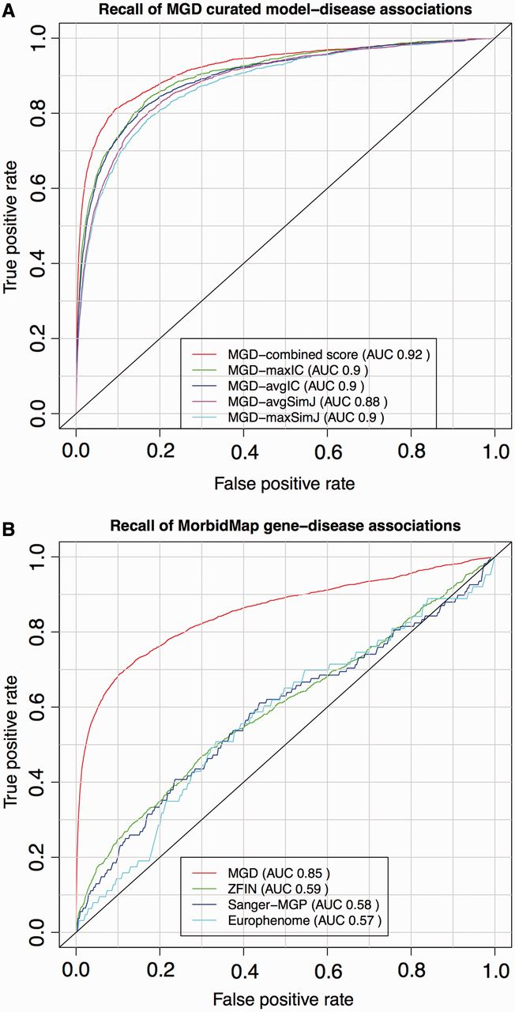
Figure 2. ROC analysis of PhenoDigm’s phenotype prioritization method applied to MGD’s curated mouse model–disease ...
Notes:
Figure 2. ROC analysis of PhenoDigm’s phenotype prioritization method applied to MGD’s curated mouse model–disease associations (top) and OMIM MorbidMap known gene–disease associations (bottom). The success of PhenoDigm applied to disease and MGD phenotypes is shown in the top panel for the combined score used in PhenoDigm as well as the maxIC, avgIC, maxSimJ and avgSimJ measures used for the original MouseFinder implementation. The bottom panel shows the recall of known gene–disease associations when comparing OMIM phenotypes with MGD, ZFIN, Sanger-MGP or Europhenome model organism phenotypes.
Unless provided in the caption above, the following copyright applies to the content of this slide: © The Author(s) 2013. Published by Oxford University Press.This is an Open Access article distributed under the terms of the Creative Commons Attribution Non-Commercial License (http://creativecommons.org/licenses/by-nc/3.0/), which permits non-commercial re-use, distribution, and reproduction in any medium, provided the original work is properly cited. For commercial re-use, please contact journals.permissions@oup.com

Slide 3
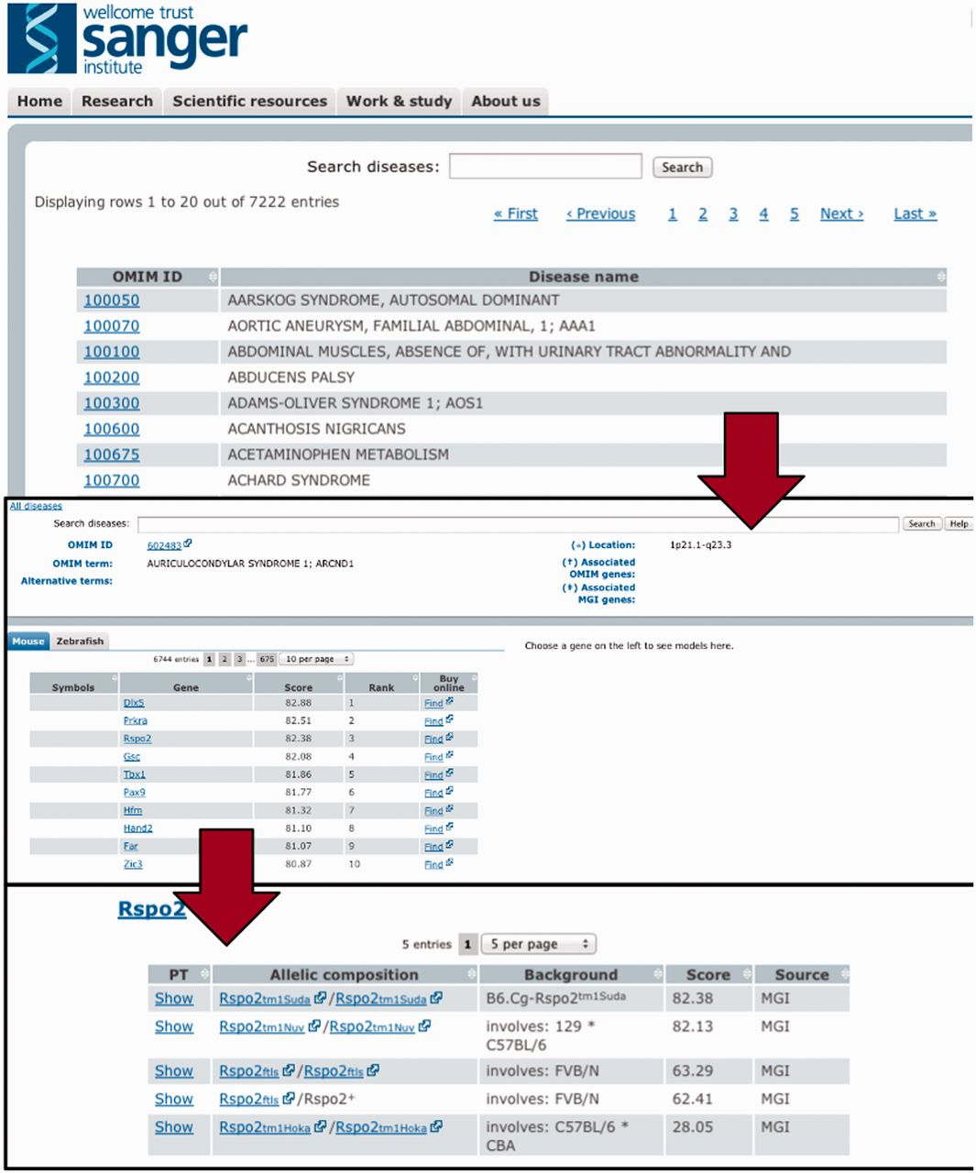
Figure 3. To efficiently browse the obtained prioritisation results, a web interface was developed. As illustrated ...
Notes:
Figure 3. To efficiently browse the obtained prioritisation results, a web interface was developed. As illustrated here, the interface allows the user to browse by and search for diseases and obtain all prioritized models sorted according to species and genes. Genes can then be expanded to models and even to the level of phenotype descriptions to show on what basis the match occured.
Unless provided in the caption above, the following copyright applies to the content of this slide: © The Author(s) 2013. Published by Oxford University Press.This is an Open Access article distributed under the terms of the Creative Commons Attribution Non-Commercial License (http://creativecommons.org/licenses/by-nc/3.0/), which permits non-commercial re-use, distribution, and reproduction in any medium, provided the original work is properly cited. For commercial re-use, please contact journals.permissions@oup.com

