Slide 1
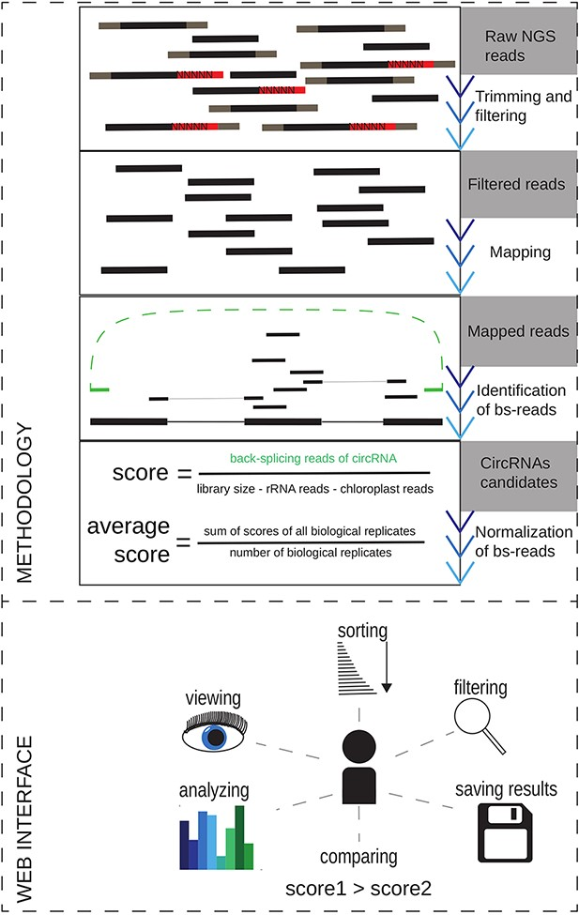
Figure 1. The overview of the methodology used for circRNAs reidentification in the publicly available datasets and the ...
Notes:
Figure 1. The overview of the methodology used for circRNAs reidentification in the publicly available datasets and the schematic view of the At-C-RNA utilities.
Unless provided in the caption above, the following copyright applies to the content of this slide: © The Author(s) 2021. Published by Oxford University Press.This is an Open Access article distributed under the terms of the Creative Commons Attribution License (https://creativecommons.org/licenses/by/4.0/), which permits unrestricted reuse, distribution, and reproduction in any medium, provided the original work is properly cited.

Slide 2
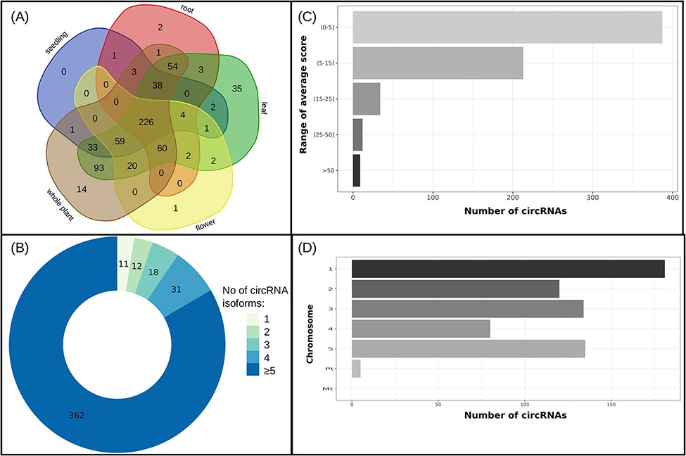
Figure 2. (A) Distribution of reproducible circRNAs across organs/seedling and the whole plant, (B) circRNAs’ isoform ...
Notes:
Figure 2. (A) Distribution of reproducible circRNAs across organs/seedling and the whole plant, (B) circRNAs’ isoform number of genes producing reproducible circRNAs, (C) average score ranges for reproducible circRNAs and (D) distribution of reproducible circRNAs across chromosomes.
Unless provided in the caption above, the following copyright applies to the content of this slide: © The Author(s) 2021. Published by Oxford University Press.This is an Open Access article distributed under the terms of the Creative Commons Attribution License (https://creativecommons.org/licenses/by/4.0/), which permits unrestricted reuse, distribution, and reproduction in any medium, provided the original work is properly cited.

