Slide 1
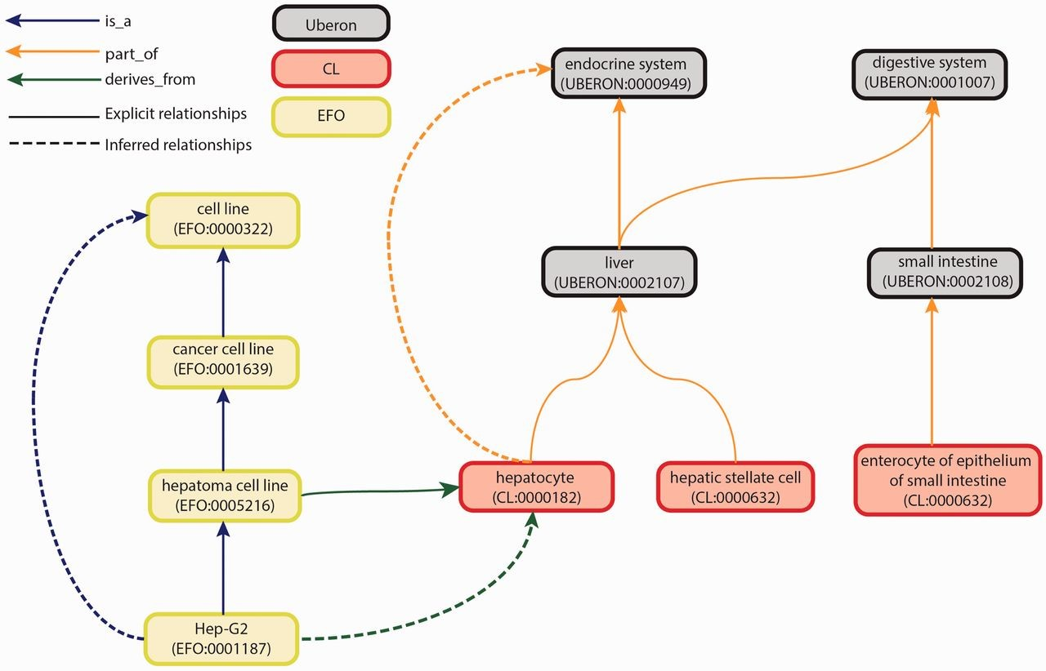
Figure 2. Graph view of integration of Uberon, CL and EFO. The graph view shows some of the relationship types and ...
Notes:
Figure 2. Graph view of integration of Uberon, CL and EFO. The graph view shows some of the relationship types and paths that can be traversed from child to parent terms. These relationships are either explicit or inferred. Explicit relationships are connections that are defined between two terms in the ontology. The integration of the three ontologies uses three relationships: is_a, part_of and derives_from. The is_a relationship indicates that one entity is a subtype of another entity (e.g. Hep-G2—EFO:0001187 is a type of hepatoma cell line—EFO:0005216). The part_of relationship indicates a part-whole relationship, such that an child term is fully and always contained within the parent term (e.g. all hepatocytes—CL:0000182 are found in the liver—UBERON:0002107). The derives_from relationship indicates that the child term succeeds parent term over some temporal divide, such that at least a significant biological portion is inherited (e.g. hepatoma cell lines—EFO:0005216 are cancerous hepatocyte cells—CL:0000182). Inferred relationships are connections between two terms that are transitively reasoned via the explicit relationships. Transitive relationships remain true across multiple links of the relationships. For example, as the Hep-G2 cell line is a type of hepatoma cell line that is derived from hepatocytes, an inferred relationship can be made that the Hep-G2 cell line is also derived from the hepatocytes.
Unless provided in the caption above, the following copyright applies to the content of this slide: © The Author(s) 2015. Published by Oxford University Press.This is an Open Access article distributed under the terms of the Creative Commons Attribution License (http://creativecommons.org/licenses/by/4.0/), which permits unrestricted reuse, distribution, and reproduction in any medium, provided the original work is properly cited.

