Slide 1
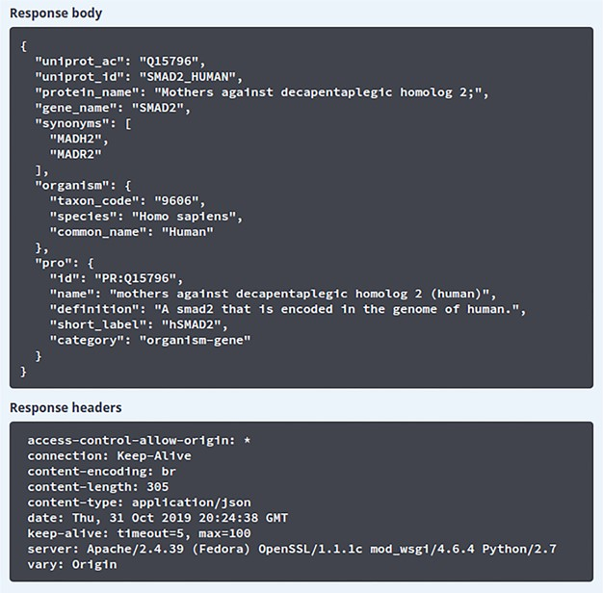
Figure 3 Result of search using Swagger UI. The results obtained after querying the ‘/info’ API endpoint. The response ...
Notes:
Figure 3 Result of search using Swagger UI. The results obtained after querying the ‘/info’ API endpoint. The response body section shows the JSON response received from the API server and the response headers section shows the HTTP headers from the received request.
Unless provided in the caption above, the following copyright applies to the content of this slide: © The Author(s) 2020. Published by Oxford University Press.This is an Open Access article distributed under the terms of the Creative Commons Attribution License (http://creativecommons.org/licenses/by/4.0/), which permits unrestricted reuse, distribution, and reproduction in any medium, provided the original work is properly cited.

