Slide 1
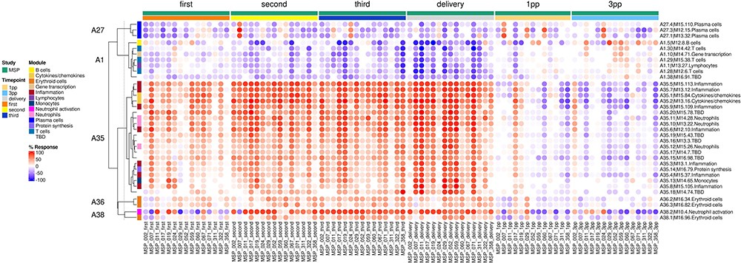
Figure 4. Individual-level fingerprint heatmap representation. This heatmap represents changes in transcript abundance ...
Notes:
Figure 4. Individual-level fingerprint heatmap representation. This heatmap represents changes in transcript abundance for individual modules (rows) belonging to multiple aggregates (A27, A1, A35, A36 and A38 in this example), across individual MSP samples (columns). Columns are arranged according to the study group membership (first, second or third trimester, delivery, 1 month and 3 months post-partum). Rows are arranged via hierarchical clustering, based on similarities in abundance profiles, first across modules aggregates, then secondly within module aggregates (i.e. modules from different aggregates remain on their aggregate’s branch). The red spots indicate an increase in transcript abundance compared to baseline, with proportions of significant transcripts for the corresponding module ranging from 15% to 100%. The blue spots indicate a decrease in transcript abundance with proportions indicated by negative % values ranging from −15% to −100%. Functional associations for the modules shown on the heatmap are indicated by a color code on the vertical annotation track. ‘First’, ‘second’ and ‘third’ = first, second and third trimester of pregnancy, respectively. 1 PP = 1 month post-partum; 3 PP = 3 months post-partum.
Unless provided in the caption above, the following copyright applies to the content of this slide: © The Author(s) 2024. Published by Oxford University Press.This is an Open Access article distributed under the terms of the Creative Commons Attribution License (https://creativecommons.org/licenses/by/4.0/), which permits unrestricted reuse, distribution, and reproduction in any medium, provided the original work is properly cited.

