Slide 1
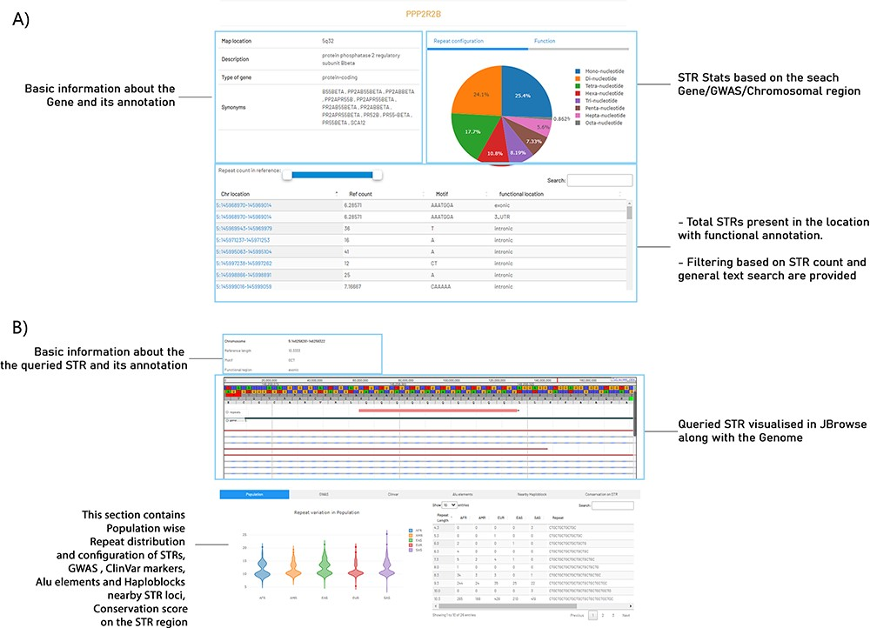
Figure 3. An example view of a query gene and an STR search in STRIDE-DB. (A) The resultant page of gene-wise search in ...
Notes:
Figure 3. An example view of a query gene and an STR search in STRIDE-DB. (A) The resultant page of gene-wise search in STRIDE-DB for PPP2R2B gene. (B) Describing the selected STR from the PPP2R2B gene with genome browser visualization, population-wise repeat distribution, GWAS, ClinVar, Alu elements and Haploblocks nearby STR loci and conservation score on the STR region.
Unless provided in the caption above, the following copyright applies to the content of this slide: © The Author(s) 2024. Published by Oxford University Press.This is an Open Access article distributed under the terms of the Creative Commons Attribution License (https://creativecommons.org/licenses/by/4.0/), which permits unrestricted reuse, distribution, and reproduction in any medium, provided the original work is properly cited.

