Slide 1
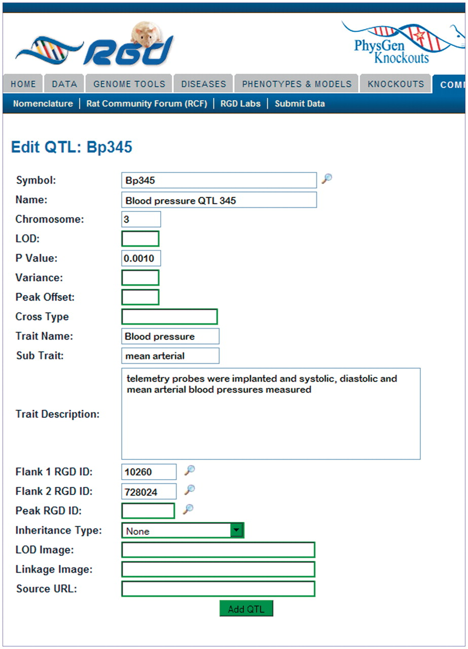
Figure 3. The Object Creation and Editing Tool: QTL entry page. The QTL entry page consists of many text boxes specific ...
Notes:
Figure 3. The Object Creation and Editing Tool: QTL entry page. The QTL entry page consists of many text boxes specific for the different types of information collected by the curator to describe a QTL. Clicking the search icon to the side of the symbol box generates a pop-up window where current QTL symbols may be searched.
Unless provided in the caption above, the following copyright applies to the content of this slide: © The Author(s) 2011. Published by Oxford University Press.This is Open Access article distributed under the terms of the Creative Commons Attribution Non-Commercial License (http://creativecommons.org/licenses/by-nc/2.5), which permits unrestricted non-commercial use, distribution, and reproduction in any medium, provided the original work is properly cited.

